Slide 1
Scholarly Makerspaces A New Perspective on Library Services for Arts and Humanities Researchers
Ben Kaden & Michael Kleineberg | DARIAH-FOSTER Workshop | Grimmzentrum | January 21, 2019

Slide 2
DFG-Project FuReSH
Future e-Research Support in the Humanities (FuReSH)
University library of Humboldt-Universität zu Berlin (05/2018 – 10/2019)
Feasibility study for an implementation of Scholarly Makerspaces as a service of university libraries
Erwin-Schrödinger-Zentrum (HU)
Photo: Frank Kühnlenz

Slide 3
Overview
What are Scholarly Makerspaces?
Academic Libraries as Scholarly Makerspaces
Guiding Principles
Requirement Analysis
Open Questions

Slide 4
What are Scholarly Makerspaces?

Slide 5
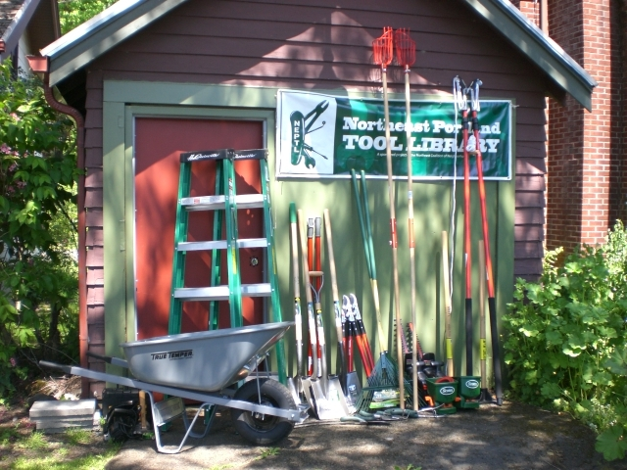
What are Scholarly Makerspaces?
Tool Library
http://static1.squarespace.com

Slide 6
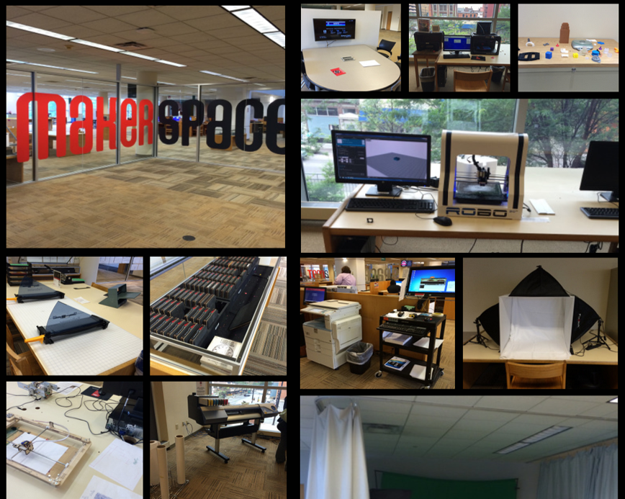
What are Scholarly Makerspaces?
Makerspaces in Public Libraries
http://www.teenlibrariantoolbox.com

Slide 7
What are Scholarly Makerspaces?
Library Labs in Academic Libraries
British Library Labs
ETH Library Lab
Harvard Library Lab
Ghent Library Lab
SBB Library Lab
…
https://www.bl.uk/projects/british-library-labs

Slide 8
What are Scholarly Makerspaces?
Research in the Arts and Humanities has fundamentally changed in the digital age (e.g., data, tools, methods).
Academic libraries need to understand, take on, and frame those transformational effects in order to provide up-to-date services for the needs of their users (i.e., research and education).
“Libraries are understood to function as Scholarly Makerspaces, which enable digital forms of work in research and teaching with appropriate infrastructure and services, including services and tools as e-research technologies.” (project description)

Slide 9
Academic Libraries as
Scholarly Makerspaces
Context
Different communities with different
perspectives
goals
levels of expertise
regarding
tools
methods
research (topics, data, questions,..)
Notes:
The approach of the scholarly makerspaces obviously needs to be one who aims to integrate different perspectives, goals, and levels of expertise. We understand as a possibility to explore digital tools, methods, as as digital data at one place. Digital Humanities are especially tricky, since expert scholars in topical fields of humanities are not necessarily experts in the technological aspects of digital research. And if they are, they most probably already have their one infrastructures and networks and therefore won't need the scholarly makerspaces. Our challenge will be to bring different aspects conclusively together in order to implement our service successfully.
1. There is the messaging – it is fine that you do not have in-depth-knowledge and programming skills to enter or enhance your research with contemporary digital tools and methods. Scholarly Makerspaces will make you enjoy your learning curve. The other part will me the message: You, as a skilled and innovative programmer, are at the right place to apply your skill on exquisite cultural data in a meaningful way. Another message needs to be: We as your library have the expertise to answer your questions regarding all things connected to digital humanities research. And if we don't we will connect you with someone who has.
2. We, of course, need to provide not only an overarching message but also purposeful information about the state, the chances and the limits of tool based research in the humanities. And we need to provide the data as well as the tools to start plus, maybe most necessarly, basic instructions. Our aim is to fit all students, scholars, and maybe also citizens who come to us with anything necessary to begin or deepen their exploration of the field of digital research.
3. While there is a highly elaborated and often deeply specialized DH-community there is also this community with a more general perspective or simply in need for a certain solution and without resources to qualify itself on a comprehensive DH-level. After all, humanities still have their rather traditional humanities agenda and new tools may play only a small part in many fields of research. And, also, the more traditional scholars might be rather critical and cautious for any "all-in"-approach. Scholarly makerspaces need to address this tension as well and remodel it into a chance. Therefore we want to establish the makerspaces as a space for dialogue, meta-discussions, and the exchange of expertise.
We want to provide explicitely a service which is as approachable as possible because our aim will be to tackle the two gaps – the knowledge gap, the dissemination gap. And, if possible, the gap of mutual understanding.

Slide 10
Academic Libraries as
Scholarly Makerspaces
Communities
experts in topical humanities
experts in digital humanities
+ education, qualification
"third" communities (e.g. citizen science)
libraries = traditionally information services / supply of academic literature additional new role: intersection between communities
spaces for dialogue, collaboration, exchange of expertise, ideas, expectations
Notes:
The approach of the scholarly makerspaces obviously needs to be one who aims to integrate different perspectives, goals, and levels of expertise. We understand as a possibility to explore digital tools, methods, as as digital data at one place. Digital Humanities are especially tricky, since expert scholars in topical fields of humanities are not necessarily experts in the technological aspects of digital research. And if they are, they most probably already have their one infrastructures and networks and therefore won't need the scholarly makerspaces. Our challenge will be to bring different aspects conclusively together in order to implement our service successfully.
1. There is the messaging – it is fine that you do not have in-depth-knowledge and programming skills to enter or enhance your research with contemporary digital tools and methods. Scholarly Makerspaces will make you enjoy your learning curve. The other part will me the message: You, as a skilled and innovative programmer, are at the right place to apply your skill on exquisite cultural data in a meaningful way. Another message needs to be: We as your library have the expertise to answer your questions regarding all things connected to digital humanities research. And if we don't we will connect you with someone who has.
2. We, of course, need to provide not only an overarching message but also purposeful information about the state, the chances and the limits of tool based research in the humanities. And we need to provide the data as well as the tools to start plus, maybe most necessarly, basic instructions. Our aim is to fit all students, scholars, and maybe also citizens who come to us with anything necessary to begin or deepen their exploration of the field of digital research.
3. While there is a highly elaborated and often deeply specialized DH-community there is also this community with a more general perspective or simply in need for a certain solution and without resources to qualify itself on a comprehensive DH-level. After all, humanities still have their rather traditional humanities agenda and new tools may play only a small part in many fields of research. And, also, the more traditional scholars might be rather critical and cautious for any "all-in"-approach. Scholarly makerspaces need to address this tension as well and remodel it into a chance. Therefore we want to establish the makerspaces as a space for dialogue, meta-discussions, and the exchange of expertise.
We want to provide explicitely a service which is as approachable as possible because our aim will be to tackle the two gaps – the knowledge gap, the dissemination gap. And, if possible, the gap of mutual understanding.

Slide 11
Academic Libraries as
Scholarly Makerspaces
Library as a place to connect with digital research in terms of
content
tools
skills
communities
methodology
knowledge hub for digital humanities research
Notes:
The approach of the scholarly makerspaces obviously needs to be one who aims to integrate different perspectives, goals, and levels of expertise. We understand as a possibility to explore digital tools, methods, as as digital data at one place. Digital Humanities are especially tricky, since expert scholars in topical fields of humanities are not necessarily experts in the technological aspects of digital research. And if they are, they most probably already have their one infrastructures and networks and therefore won't need the scholarly makerspaces. Our challenge will be to bring different aspects conclusively together in order to implement our service successfully.
1. There is the messaging – it is fine that you do not have in-depth-knowledge and programming skills to enter or enhance your research with contemporary digital tools and methods. Scholarly Makerspaces will make you enjoy your learning curve. The other part will me the message: You, as a skilled and innovative programmer, are at the right place to apply your skill on exquisite cultural data in a meaningful way. Another message needs to be: We as your library have the expertise to answer your questions regarding all things connected to digital humanities research. And if we don't we will connect you with someone who has.
2. We, of course, need to provide not only an overarching message but also purposeful information about the state, the chances and the limits of tool based research in the humanities. And we need to provide the data as well as the tools to start plus, maybe most necessarly, basic instructions. Our aim is to fit all students, scholars, and maybe also citizens who come to us with anything necessary to begin or deepen their exploration of the field of digital research.
3. While there is a highly elaborated and often deeply specialized DH-community there is also this community with a more general perspective or simply in need for a certain solution and without resources to qualify itself on a comprehensive DH-level. After all, humanities still have their rather traditional humanities agenda and new tools may play only a small part in many fields of research. And, also, the more traditional scholars might be rather critical and cautious for any "all-in"-approach. Scholarly makerspaces need to address this tension as well and remodel it into a chance. Therefore we want to establish the makerspaces as a space for dialogue, meta-discussions, and the exchange of expertise.
We want to provide explicitely a service which is as approachable as possible because our aim will be to tackle the two gaps – the knowledge gap, the dissemination gap. And, if possible, the gap of mutual understanding.

Slide 12
Academic Libraries as
Scholarly Makerspaces
Scholarly Makerspaces aim to fit all
students
lecturers
scholars
(other patrons)
with anything necessary to interact with / explore the field of digital humanities research.
Notes:
The approach of the scholarly makerspaces obviously needs to be one who aims to integrate different perspectives, goals, and levels of expertise. We understand as a possibility to explore digital tools, methods, as as digital data at one place. Digital Humanities are especially tricky, since expert scholars in topical fields of humanities are not necessarily experts in the technological aspects of digital research. And if they are, they most probably already have their one infrastructures and networks and therefore won't need the scholarly makerspaces. Our challenge will be to bring different aspects conclusively together in order to implement our service successfully.
1. There is the messaging – it is fine that you do not have in-depth-knowledge and programming skills to enter or enhance your research with contemporary digital tools and methods. Scholarly Makerspaces will make you enjoy your learning curve. The other part will me the message: You, as a skilled and innovative programmer, are at the right place to apply your skill on exquisite cultural data in a meaningful way. Another message needs to be: We as your library have the expertise to answer your questions regarding all things connected to digital humanities research. And if we don't we will connect you with someone who has.
2. We, of course, need to provide not only an overarching message but also purposeful information about the state, the chances and the limits of tool based research in the humanities. And we need to provide the data as well as the tools to start plus, maybe most necessarly, basic instructions. Our aim is to fit all students, scholars, and maybe also citizens who come to us with anything necessary to begin or deepen their exploration of the field of digital research.
3. While there is a highly elaborated and often deeply specialized DH-community there is also this community with a more general perspective or simply in need for a certain solution and without resources to qualify itself on a comprehensive DH-level. After all, humanities still have their rather traditional humanities agenda and new tools may play only a small part in many fields of research. And, also, the more traditional scholars might be rather critical and cautious for any "all-in"-approach. Scholarly makerspaces need to address this tension as well and remodel it into a chance. Therefore we want to establish the makerspaces as a space for dialogue, meta-discussions, and the exchange of expertise.
We want to provide explicitely a service which is as approachable as possible because our aim will be to tackle the two gaps – the knowledge gap, the dissemination gap. And, if possible, the gap of mutual understanding.

Slide 13
Academic Libraries as
Scholarly Makerspaces
Main requirement: approachability
easy to access
easy to understand
easy to use
easy to connect with
easy to expand.
Notes:
The approach of the scholarly makerspaces obviously needs to be one who aims to integrate different perspectives, goals, and levels of expertise. We understand as a possibility to explore digital tools, methods, as as digital data at one place. Digital Humanities are especially tricky, since expert scholars in topical fields of humanities are not necessarily experts in the technological aspects of digital research. And if they are, they most probably already have their one infrastructures and networks and therefore won't need the scholarly makerspaces. Our challenge will be to bring different aspects conclusively together in order to implement our service successfully.
1. There is the messaging – it is fine that you do not have in-depth-knowledge and programming skills to enter or enhance your research with contemporary digital tools and methods. Scholarly Makerspaces will make you enjoy your learning curve. The other part will me the message: You, as a skilled and innovative programmer, are at the right place to apply your skill on exquisite cultural data in a meaningful way. Another message needs to be: We as your library have the expertise to answer your questions regarding all things connected to digital humanities research. And if we don't we will connect you with someone who has.
2. We, of course, need to provide not only an overarching message but also purposeful information about the state, the chances and the limits of tool based research in the humanities. And we need to provide the data as well as the tools to start plus, maybe most necessarly, basic instructions. Our aim is to fit all students, scholars, and maybe also citizens who come to us with anything necessary to begin or deepen their exploration of the field of digital research.
3. While there is a highly elaborated and often deeply specialized DH-community there is also this community with a more general perspective or simply in need for a certain solution and without resources to qualify itself on a comprehensive DH-level. After all, humanities still have their rather traditional humanities agenda and new tools may play only a small part in many fields of research. And, also, the more traditional scholars might be rather critical and cautious for any "all-in"-approach. Scholarly makerspaces need to address this tension as well and remodel it into a chance. Therefore we want to establish the makerspaces as a space for dialogue, meta-discussions, and the exchange of expertise.
We want to provide explicitely a service which is as approachable as possible because our aim will be to tackle the two gaps – the knowledge gap, the dissemination gap. And, if possible, the gap of mutual understanding.

Slide 14
Academic Libraries as
Scholarly Makerspaces
Main objective: brigde
knowledge gap
dissemination gap
gap of mutual understanding
gap of experiences.
Notes:
The approach of the scholarly makerspaces obviously needs to be one who aims to integrate different perspectives, goals, and levels of expertise. We understand as a possibility to explore digital tools, methods, as as digital data at one place. Digital Humanities are especially tricky, since expert scholars in topical fields of humanities are not necessarily experts in the technological aspects of digital research. And if they are, they most probably already have their one infrastructures and networks and therefore won't need the scholarly makerspaces. Our challenge will be to bring different aspects conclusively together in order to implement our service successfully.
1. There is the messaging – it is fine that you do not have in-depth-knowledge and programming skills to enter or enhance your research with contemporary digital tools and methods. Scholarly Makerspaces will make you enjoy your learning curve. The other part will me the message: You, as a skilled and innovative programmer, are at the right place to apply your skill on exquisite cultural data in a meaningful way. Another message needs to be: We as your library have the expertise to answer your questions regarding all things connected to digital humanities research. And if we don't we will connect you with someone who has.
2. We, of course, need to provide not only an overarching message but also purposeful information about the state, the chances and the limits of tool based research in the humanities. And we need to provide the data as well as the tools to start plus, maybe most necessarly, basic instructions. Our aim is to fit all students, scholars, and maybe also citizens who come to us with anything necessary to begin or deepen their exploration of the field of digital research.
3. While there is a highly elaborated and often deeply specialized DH-community there is also this community with a more general perspective or simply in need for a certain solution and without resources to qualify itself on a comprehensive DH-level. After all, humanities still have their rather traditional humanities agenda and new tools may play only a small part in many fields of research. And, also, the more traditional scholars might be rather critical and cautious for any "all-in"-approach. Scholarly makerspaces need to address this tension as well and remodel it into a chance. Therefore we want to establish the makerspaces as a space for dialogue, meta-discussions, and the exchange of expertise.
We want to provide explicitely a service which is as approachable as possible because our aim will be to tackle the two gaps – the knowledge gap, the dissemination gap. And, if possible, the gap of mutual understanding.

Slide 15
Academic Libraries as
Scholarly Makerspaces
Scholarly Makerspaces should
stimulate curiosity
rewarding
provide low-threshold entrance points
provide best-practice-examples
provide exit points to connect, expand, and aspire.
Notes:
The approach of the scholarly makerspaces obviously needs to be one who aims to integrate different perspectives, goals, and levels of expertise. We understand as a possibility to explore digital tools, methods, as as digital data at one place. Digital Humanities are especially tricky, since expert scholars in topical fields of humanities are not necessarily experts in the technological aspects of digital research. And if they are, they most probably already have their one infrastructures and networks and therefore won't need the scholarly makerspaces. Our challenge will be to bring different aspects conclusively together in order to implement our service successfully.
1. There is the messaging – it is fine that you do not have in-depth-knowledge and programming skills to enter or enhance your research with contemporary digital tools and methods. Scholarly Makerspaces will make you enjoy your learning curve. The other part will me the message: You, as a skilled and innovative programmer, are at the right place to apply your skill on exquisite cultural data in a meaningful way. Another message needs to be: We as your library have the expertise to answer your questions regarding all things connected to digital humanities research. And if we don't we will connect you with someone who has.
2. We, of course, need to provide not only an overarching message but also purposeful information about the state, the chances and the limits of tool based research in the humanities. And we need to provide the data as well as the tools to start plus, maybe most necessarly, basic instructions. Our aim is to fit all students, scholars, and maybe also citizens who come to us with anything necessary to begin or deepen their exploration of the field of digital research.
3. While there is a highly elaborated and often deeply specialized DH-community there is also this community with a more general perspective or simply in need for a certain solution and without resources to qualify itself on a comprehensive DH-level. After all, humanities still have their rather traditional humanities agenda and new tools may play only a small part in many fields of research. And, also, the more traditional scholars might be rather critical and cautious for any "all-in"-approach. Scholarly makerspaces need to address this tension as well and remodel it into a chance. Therefore we want to establish the makerspaces as a space for dialogue, meta-discussions, and the exchange of expertise.
We want to provide explicitely a service which is as approachable as possible because our aim will be to tackle the two gaps – the knowledge gap, the dissemination gap. And, if possible, the gap of mutual understanding.

Slide 16
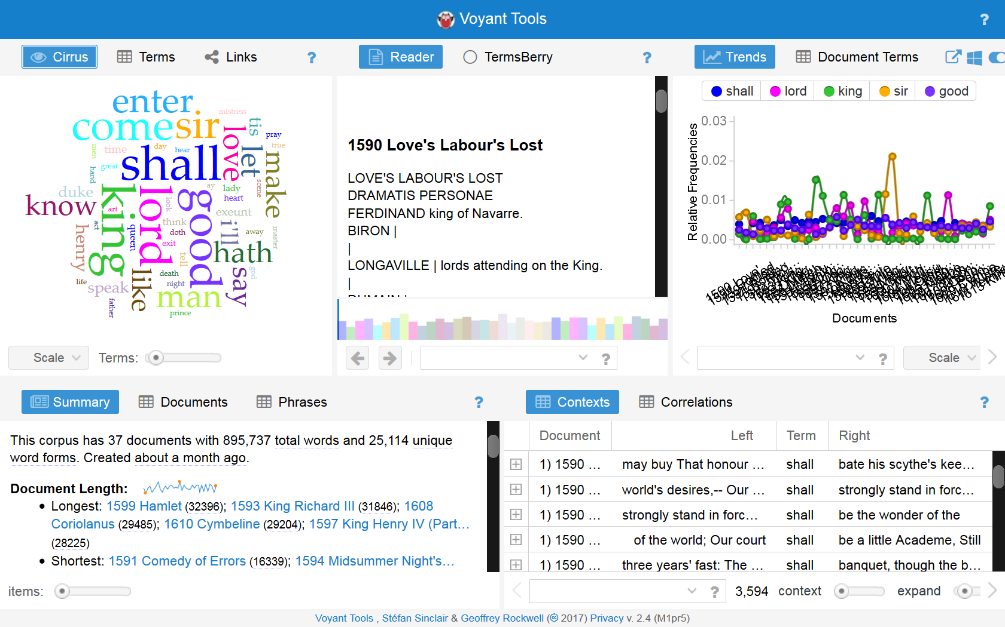
Academic Libraries as
Scholarly Makerspaces
http://voyant-tools.org
Notes:
A relatively easy and rewarding way of creating curiosity towards DH-tools is from our expericence the visualization approach. Voyant tools are a fine example. Despite their methodological drawbacks they instantly sharpen the perspective of the possibilities of data-centered approaches on research materials. Scholarly makerspaces will focus such easy-to-use tools which also need to run very stable and work ideally within a browser. Another suitable tool will be DARIAH's Geobrowser. The scholarly makerspaces will offer a selected range of such solutions as well as data sets and simple tutorials to establish a set of easy-to-use cases. They will also provide junction points to more sophisticated or specialized use cases and solutions with respective advisory notes. And users will be always able to import their own data too to support an easy transition between exploration and testing to starting research itself. Learning will be, ideally, iterative.

Slide 17
Academic Libraries as
Scholarly Makerspaces
tools: stable, mature, easy-to-use (if possible)
scenarios, use cases, tutorials
information / support / contacts for special, elaborate requirements
Notes:
The approach of the scholarly makerspaces obviously needs to be one who aims to integrate different perspectives, goals, and levels of expertise. We understand as a possibility to explore digital tools, methods, as as digital data at one place. Digital Humanities are especially tricky, since expert scholars in topical fields of humanities are not necessarily experts in the technological aspects of digital research. And if they are, they most probably already have their one infrastructures and networks and therefore won't need the scholarly makerspaces. Our challenge will be to bring different aspects conclusively together in order to implement our service successfully.
1. There is the messaging – it is fine that you do not have in-depth-knowledge and programming skills to enter or enhance your research with contemporary digital tools and methods. Scholarly Makerspaces will make you enjoy your learning curve. The other part will me the message: You, as a skilled and innovative programmer, are at the right place to apply your skill on exquisite cultural data in a meaningful way. Another message needs to be: We as your library have the expertise to answer your questions regarding all things connected to digital humanities research. And if we don't we will connect you with someone who has.
2. We, of course, need to provide not only an overarching message but also purposeful information about the state, the chances and the limits of tool based research in the humanities. And we need to provide the data as well as the tools to start plus, maybe most necessarly, basic instructions. Our aim is to fit all students, scholars, and maybe also citizens who come to us with anything necessary to begin or deepen their exploration of the field of digital research.
3. While there is a highly elaborated and often deeply specialized DH-community there is also this community with a more general perspective or simply in need for a certain solution and without resources to qualify itself on a comprehensive DH-level. After all, humanities still have their rather traditional humanities agenda and new tools may play only a small part in many fields of research. And, also, the more traditional scholars might be rather critical and cautious for any "all-in"-approach. Scholarly makerspaces need to address this tension as well and remodel it into a chance. Therefore we want to establish the makerspaces as a space for dialogue, meta-discussions, and the exchange of expertise.
We want to provide explicitely a service which is as approachable as possible because our aim will be to tackle the two gaps – the knowledge gap, the dissemination gap. And, if possible, the gap of mutual understanding.

Slide 18
Academic Libraries as
Scholarly Makerspaces
Model solutions
MIT libraries information page
Digital Humanities: Tools
Notes:
The approach of the scholarly makerspaces obviously needs to be one who aims to integrate different perspectives, goals, and levels of expertise. We understand as a possibility to explore digital tools, methods, as as digital data at one place. Digital Humanities are especially tricky, since expert scholars in topical fields of humanities are not necessarily experts in the technological aspects of digital research. And if they are, they most probably already have their one infrastructures and networks and therefore won't need the scholarly makerspaces. Our challenge will be to bring different aspects conclusively together in order to implement our service successfully.
1. There is the messaging – it is fine that you do not have in-depth-knowledge and programming skills to enter or enhance your research with contemporary digital tools and methods. Scholarly Makerspaces will make you enjoy your learning curve. The other part will me the message: You, as a skilled and innovative programmer, are at the right place to apply your skill on exquisite cultural data in a meaningful way. Another message needs to be: We as your library have the expertise to answer your questions regarding all things connected to digital humanities research. And if we don't we will connect you with someone who has.
2. We, of course, need to provide not only an overarching message but also purposeful information about the state, the chances and the limits of tool based research in the humanities. And we need to provide the data as well as the tools to start plus, maybe most necessarly, basic instructions. Our aim is to fit all students, scholars, and maybe also citizens who come to us with anything necessary to begin or deepen their exploration of the field of digital research.
3. While there is a highly elaborated and often deeply specialized DH-community there is also this community with a more general perspective or simply in need for a certain solution and without resources to qualify itself on a comprehensive DH-level. After all, humanities still have their rather traditional humanities agenda and new tools may play only a small part in many fields of research. And, also, the more traditional scholars might be rather critical and cautious for any "all-in"-approach. Scholarly makerspaces need to address this tension as well and remodel it into a chance. Therefore we want to establish the makerspaces as a space for dialogue, meta-discussions, and the exchange of expertise.
We want to provide explicitely a service which is as approachable as possible because our aim will be to tackle the two gaps – the knowledge gap, the dissemination gap. And, if possible, the gap of mutual understanding.

Slide 19
Academic Libraries as
Scholarly Makerspaces
https://libguides.mit.edu
Notes:
There is already, of course, a number of initiatives aimed at making respective tools more visible. For instance this list provided by MIT-libraries. It was, among other, very helpful for establishing an overview on services which are already available and how those can be put in categories. You will find certain clusters – Metadata, Data Mining + Text Encoding + Text Analysis; Web Publishing; Visualization, and additional resources – Tool Boxes, Registries, Crawlers. However, there are significant restrictions with such a concept especially for patrons with small or none background knowledge. Additional Information on scope, maturity, topicality, ease (or un-ease) of use etc. are scarcely or – see visualization tools - not provided. You may also note that the Best Practices-field is empty. While experts or aspiring experts in computing and humanities methods might find it useful, it will be a little overwhelming for the assumed average library patron who tries to get a first or second grip on tool-based scholarly work. And one might also miss additional information on how current the information is and whether those tools are still in development, still updated, still supported. Overall, such lists could be a service for people already active in the field of digital humanities who are curious about the activities of their peers and colleagues. But since the scholarly makerspaces are intended to foster an integrative approach, we would need something simpler.

Slide 20
Academic Libraries as
Scholarly Makerspaces
expert-level
not very transparent regarding
scope
comprehensiveness
maturity
ease of use
best practice
= needs to be edited for our aim
Notes:
The approach of the scholarly makerspaces obviously needs to be one who aims to integrate different perspectives, goals, and levels of expertise. We understand as a possibility to explore digital tools, methods, as as digital data at one place. Digital Humanities are especially tricky, since expert scholars in topical fields of humanities are not necessarily experts in the technological aspects of digital research. And if they are, they most probably already have their one infrastructures and networks and therefore won't need the scholarly makerspaces. Our challenge will be to bring different aspects conclusively together in order to implement our service successfully.
1. There is the messaging – it is fine that you do not have in-depth-knowledge and programming skills to enter or enhance your research with contemporary digital tools and methods. Scholarly Makerspaces will make you enjoy your learning curve. The other part will me the message: You, as a skilled and innovative programmer, are at the right place to apply your skill on exquisite cultural data in a meaningful way. Another message needs to be: We as your library have the expertise to answer your questions regarding all things connected to digital humanities research. And if we don't we will connect you with someone who has.
2. We, of course, need to provide not only an overarching message but also purposeful information about the state, the chances and the limits of tool based research in the humanities. And we need to provide the data as well as the tools to start plus, maybe most necessarly, basic instructions. Our aim is to fit all students, scholars, and maybe also citizens who come to us with anything necessary to begin or deepen their exploration of the field of digital research.
3. While there is a highly elaborated and often deeply specialized DH-community there is also this community with a more general perspective or simply in need for a certain solution and without resources to qualify itself on a comprehensive DH-level. After all, humanities still have their rather traditional humanities agenda and new tools may play only a small part in many fields of research. And, also, the more traditional scholars might be rather critical and cautious for any "all-in"-approach. Scholarly makerspaces need to address this tension as well and remodel it into a chance. Therefore we want to establish the makerspaces as a space for dialogue, meta-discussions, and the exchange of expertise.
We want to provide explicitely a service which is as approachable as possible because our aim will be to tackle the two gaps – the knowledge gap, the dissemination gap. And, if possible, the gap of mutual understanding.

Slide 21
Academic Libraries as
Scholarly Makerspaces
Model solutions
DARIAH-DE
Digital Humanities Dashboard
Notes:
The approach of the scholarly makerspaces obviously needs to be one who aims to integrate different perspectives, goals, and levels of expertise. We understand as a possibility to explore digital tools, methods, as as digital data at one place. Digital Humanities are especially tricky, since expert scholars in topical fields of humanities are not necessarily experts in the technological aspects of digital research. And if they are, they most probably already have their one infrastructures and networks and therefore won't need the scholarly makerspaces. Our challenge will be to bring different aspects conclusively together in order to implement our service successfully.
1. There is the messaging – it is fine that you do not have in-depth-knowledge and programming skills to enter or enhance your research with contemporary digital tools and methods. Scholarly Makerspaces will make you enjoy your learning curve. The other part will me the message: You, as a skilled and innovative programmer, are at the right place to apply your skill on exquisite cultural data in a meaningful way. Another message needs to be: We as your library have the expertise to answer your questions regarding all things connected to digital humanities research. And if we don't we will connect you with someone who has.
2. We, of course, need to provide not only an overarching message but also purposeful information about the state, the chances and the limits of tool based research in the humanities. And we need to provide the data as well as the tools to start plus, maybe most necessarly, basic instructions. Our aim is to fit all students, scholars, and maybe also citizens who come to us with anything necessary to begin or deepen their exploration of the field of digital research.
3. While there is a highly elaborated and often deeply specialized DH-community there is also this community with a more general perspective or simply in need for a certain solution and without resources to qualify itself on a comprehensive DH-level. After all, humanities still have their rather traditional humanities agenda and new tools may play only a small part in many fields of research. And, also, the more traditional scholars might be rather critical and cautious for any "all-in"-approach. Scholarly makerspaces need to address this tension as well and remodel it into a chance. Therefore we want to establish the makerspaces as a space for dialogue, meta-discussions, and the exchange of expertise.
We want to provide explicitely a service which is as approachable as possible because our aim will be to tackle the two gaps – the knowledge gap, the dissemination gap. And, if possible, the gap of mutual understanding.

Slide 22
Academic Libraries as
Scholarly Makerspaces
http://dhdashboard.de/
Notes:
We have also DARIAH's Digital-Humanities-Dashboard which provides and collects an impressive amount of information and links. It is an obvious connection point for the scholarly makerspaces which naturally will integrate and connect with as many existing services as possible. However, from our experiences this dashboard is the first choice for students and scholars whereas the university library is.

Slide 23
Academic Libraries as
Scholarly Makerspaces
But
will they find it?
will they understand it?
will they use it?
DARIAH=DH-Brand, not locally established
= needs to be edited for our aim
Notes:
The approach of the scholarly makerspaces obviously needs to be one who aims to integrate different perspectives, goals, and levels of expertise. We understand as a possibility to explore digital tools, methods, as as digital data at one place. Digital Humanities are especially tricky, since expert scholars in topical fields of humanities are not necessarily experts in the technological aspects of digital research. And if they are, they most probably already have their one infrastructures and networks and therefore won't need the scholarly makerspaces. Our challenge will be to bring different aspects conclusively together in order to implement our service successfully.
1. There is the messaging – it is fine that you do not have in-depth-knowledge and programming skills to enter or enhance your research with contemporary digital tools and methods. Scholarly Makerspaces will make you enjoy your learning curve. The other part will me the message: You, as a skilled and innovative programmer, are at the right place to apply your skill on exquisite cultural data in a meaningful way. Another message needs to be: We as your library have the expertise to answer your questions regarding all things connected to digital humanities research. And if we don't we will connect you with someone who has.
2. We, of course, need to provide not only an overarching message but also purposeful information about the state, the chances and the limits of tool based research in the humanities. And we need to provide the data as well as the tools to start plus, maybe most necessarly, basic instructions. Our aim is to fit all students, scholars, and maybe also citizens who come to us with anything necessary to begin or deepen their exploration of the field of digital research.
3. While there is a highly elaborated and often deeply specialized DH-community there is also this community with a more general perspective or simply in need for a certain solution and without resources to qualify itself on a comprehensive DH-level. After all, humanities still have their rather traditional humanities agenda and new tools may play only a small part in many fields of research. And, also, the more traditional scholars might be rather critical and cautious for any "all-in"-approach. Scholarly makerspaces need to address this tension as well and remodel it into a chance. Therefore we want to establish the makerspaces as a space for dialogue, meta-discussions, and the exchange of expertise.
We want to provide explicitely a service which is as approachable as possible because our aim will be to tackle the two gaps – the knowledge gap, the dissemination gap. And, if possible, the gap of mutual understanding.

Slide 24
Academic Libraries as
Scholarly Makerspaces
Model solutions
DiRT directory purpose focused registry of digital research tools for scholarly use
Notes:
The approach of the scholarly makerspaces obviously needs to be one who aims to integrate different perspectives, goals, and levels of expertise. We understand as a possibility to explore digital tools, methods, as as digital data at one place. Digital Humanities are especially tricky, since expert scholars in topical fields of humanities are not necessarily experts in the technological aspects of digital research. And if they are, they most probably already have their one infrastructures and networks and therefore won't need the scholarly makerspaces. Our challenge will be to bring different aspects conclusively together in order to implement our service successfully.
1. There is the messaging – it is fine that you do not have in-depth-knowledge and programming skills to enter or enhance your research with contemporary digital tools and methods. Scholarly Makerspaces will make you enjoy your learning curve. The other part will me the message: You, as a skilled and innovative programmer, are at the right place to apply your skill on exquisite cultural data in a meaningful way. Another message needs to be: We as your library have the expertise to answer your questions regarding all things connected to digital humanities research. And if we don't we will connect you with someone who has.
2. We, of course, need to provide not only an overarching message but also purposeful information about the state, the chances and the limits of tool based research in the humanities. And we need to provide the data as well as the tools to start plus, maybe most necessarly, basic instructions. Our aim is to fit all students, scholars, and maybe also citizens who come to us with anything necessary to begin or deepen their exploration of the field of digital research.
3. While there is a highly elaborated and often deeply specialized DH-community there is also this community with a more general perspective or simply in need for a certain solution and without resources to qualify itself on a comprehensive DH-level. After all, humanities still have their rather traditional humanities agenda and new tools may play only a small part in many fields of research. And, also, the more traditional scholars might be rather critical and cautious for any "all-in"-approach. Scholarly makerspaces need to address this tension as well and remodel it into a chance. Therefore we want to establish the makerspaces as a space for dialogue, meta-discussions, and the exchange of expertise.
We want to provide explicitely a service which is as approachable as possible because our aim will be to tackle the two gaps – the knowledge gap, the dissemination gap. And, if possible, the gap of mutual understanding.

Slide 25
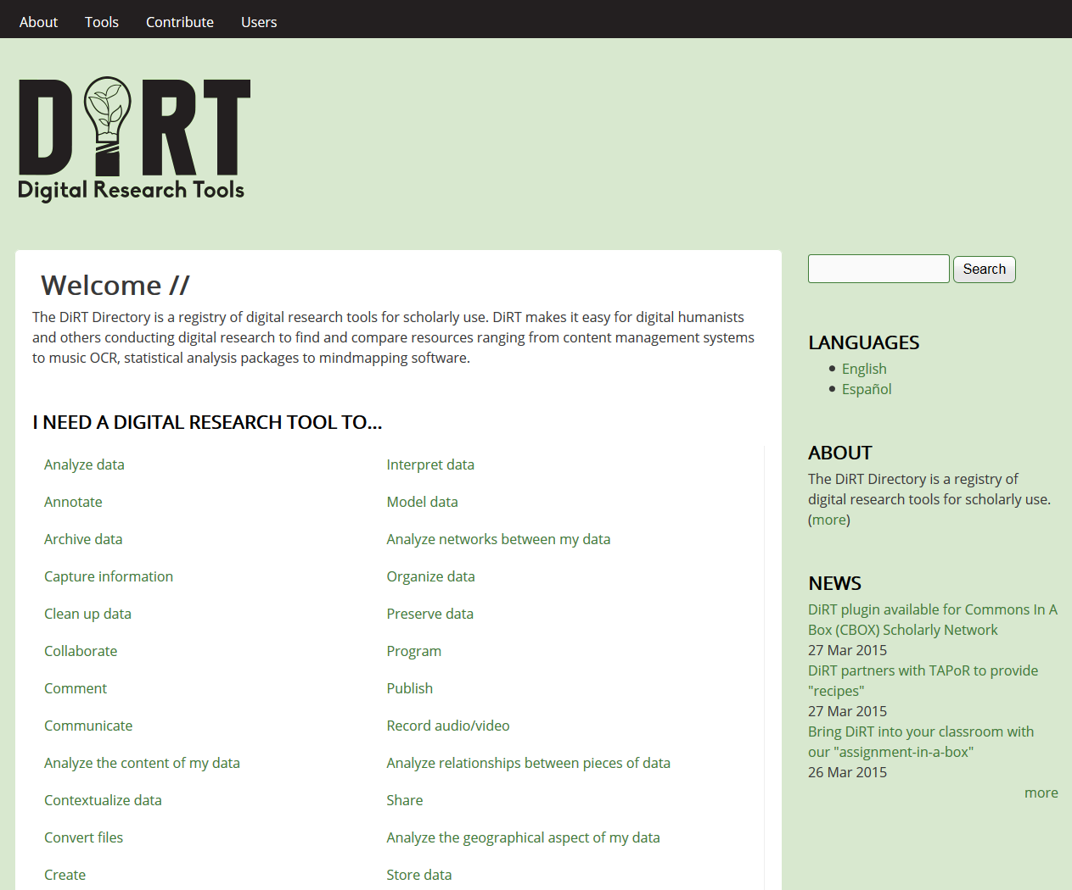
Academic Libraries as
Scholarly Makerspaces
http://dirtdirectory.org/
Notes:
In regard to presentation we need to find a solution which is comparably easy, ideally intuitively, to grasp. Therefore we have to start with activities scholars and students already know – an approach also to be found at the DIRT-directory. We will tweak or rather complement this however more towards the idea of the research life cycle. This is not least in order to emphasize how digital tools are not simply additional aspects of research but need to and can be integrated with the research workflows itself.

Slide 26
Academic Libraries as
Scholarly Makerspaces
information source
accessible approach
curational approach
unfortunately not very known
focus on tools
Notes:
The approach of the scholarly makerspaces obviously needs to be one who aims to integrate different perspectives, goals, and levels of expertise. We understand as a possibility to explore digital tools, methods, as as digital data at one place. Digital Humanities are especially tricky, since expert scholars in topical fields of humanities are not necessarily experts in the technological aspects of digital research. And if they are, they most probably already have their one infrastructures and networks and therefore won't need the scholarly makerspaces. Our challenge will be to bring different aspects conclusively together in order to implement our service successfully.
1. There is the messaging – it is fine that you do not have in-depth-knowledge and programming skills to enter or enhance your research with contemporary digital tools and methods. Scholarly Makerspaces will make you enjoy your learning curve. The other part will me the message: You, as a skilled and innovative programmer, are at the right place to apply your skill on exquisite cultural data in a meaningful way. Another message needs to be: We as your library have the expertise to answer your questions regarding all things connected to digital humanities research. And if we don't we will connect you with someone who has.
2. We, of course, need to provide not only an overarching message but also purposeful information about the state, the chances and the limits of tool based research in the humanities. And we need to provide the data as well as the tools to start plus, maybe most necessarly, basic instructions. Our aim is to fit all students, scholars, and maybe also citizens who come to us with anything necessary to begin or deepen their exploration of the field of digital research.
3. While there is a highly elaborated and often deeply specialized DH-community there is also this community with a more general perspective or simply in need for a certain solution and without resources to qualify itself on a comprehensive DH-level. After all, humanities still have their rather traditional humanities agenda and new tools may play only a small part in many fields of research. And, also, the more traditional scholars might be rather critical and cautious for any "all-in"-approach. Scholarly makerspaces need to address this tension as well and remodel it into a chance. Therefore we want to establish the makerspaces as a space for dialogue, meta-discussions, and the exchange of expertise.
We want to provide explicitely a service which is as approachable as possible because our aim will be to tackle the two gaps – the knowledge gap, the dissemination gap. And, if possible, the gap of mutual understanding.

Slide 27
Academic Libraries as
Scholarly Makerspaces
goal Scholarly Makerspaces:
integration of
content
tools
skills
community
methodology
Notes:
The approach of the scholarly makerspaces obviously needs to be one who aims to integrate different perspectives, goals, and levels of expertise. We understand as a possibility to explore digital tools, methods, as as digital data at one place. Digital Humanities are especially tricky, since expert scholars in topical fields of humanities are not necessarily experts in the technological aspects of digital research. And if they are, they most probably already have their one infrastructures and networks and therefore won't need the scholarly makerspaces. Our challenge will be to bring different aspects conclusively together in order to implement our service successfully.
1. There is the messaging – it is fine that you do not have in-depth-knowledge and programming skills to enter or enhance your research with contemporary digital tools and methods. Scholarly Makerspaces will make you enjoy your learning curve. The other part will me the message: You, as a skilled and innovative programmer, are at the right place to apply your skill on exquisite cultural data in a meaningful way. Another message needs to be: We as your library have the expertise to answer your questions regarding all things connected to digital humanities research. And if we don't we will connect you with someone who has.
2. We, of course, need to provide not only an overarching message but also purposeful information about the state, the chances and the limits of tool based research in the humanities. And we need to provide the data as well as the tools to start plus, maybe most necessarly, basic instructions. Our aim is to fit all students, scholars, and maybe also citizens who come to us with anything necessary to begin or deepen their exploration of the field of digital research.
3. While there is a highly elaborated and often deeply specialized DH-community there is also this community with a more general perspective or simply in need for a certain solution and without resources to qualify itself on a comprehensive DH-level. After all, humanities still have their rather traditional humanities agenda and new tools may play only a small part in many fields of research. And, also, the more traditional scholars might be rather critical and cautious for any "all-in"-approach. Scholarly makerspaces need to address this tension as well and remodel it into a chance. Therefore we want to establish the makerspaces as a space for dialogue, meta-discussions, and the exchange of expertise.
We want to provide explicitely a service which is as approachable as possible because our aim will be to tackle the two gaps – the knowledge gap, the dissemination gap. And, if possible, the gap of mutual understanding.

Slide 28
Academic Libraries as
Scholarly Makerspaces
GESIS
discovery environment
Notes:
The approach of the scholarly makerspaces obviously needs to be one who aims to integrate different perspectives, goals, and levels of expertise. We understand as a possibility to explore digital tools, methods, as as digital data at one place. Digital Humanities are especially tricky, since expert scholars in topical fields of humanities are not necessarily experts in the technological aspects of digital research. And if they are, they most probably already have their one infrastructures and networks and therefore won't need the scholarly makerspaces. Our challenge will be to bring different aspects conclusively together in order to implement our service successfully.
1. There is the messaging – it is fine that you do not have in-depth-knowledge and programming skills to enter or enhance your research with contemporary digital tools and methods. Scholarly Makerspaces will make you enjoy your learning curve. The other part will me the message: You, as a skilled and innovative programmer, are at the right place to apply your skill on exquisite cultural data in a meaningful way. Another message needs to be: We as your library have the expertise to answer your questions regarding all things connected to digital humanities research. And if we don't we will connect you with someone who has.
2. We, of course, need to provide not only an overarching message but also purposeful information about the state, the chances and the limits of tool based research in the humanities. And we need to provide the data as well as the tools to start plus, maybe most necessarly, basic instructions. Our aim is to fit all students, scholars, and maybe also citizens who come to us with anything necessary to begin or deepen their exploration of the field of digital research.
3. While there is a highly elaborated and often deeply specialized DH-community there is also this community with a more general perspective or simply in need for a certain solution and without resources to qualify itself on a comprehensive DH-level. After all, humanities still have their rather traditional humanities agenda and new tools may play only a small part in many fields of research. And, also, the more traditional scholars might be rather critical and cautious for any "all-in"-approach. Scholarly makerspaces need to address this tension as well and remodel it into a chance. Therefore we want to establish the makerspaces as a space for dialogue, meta-discussions, and the exchange of expertise.
We want to provide explicitely a service which is as approachable as possible because our aim will be to tackle the two gaps – the knowledge gap, the dissemination gap. And, if possible, the gap of mutual understanding.

Slide 29
Guiding Principles

Slide 30
Guiding Principles
Bridging the gaps
Local communities
Visibility
Accessibility
Approachability
Assessibility
Extensibility
Connectibility
Notes:
To summarize the guiding principle of our approach, we consider scholarly makerspaces as means to bridge the dissemination and knowledge gap regarding the possibilities of tool-based research in the humanities. A scholarly makerspace connects local learning and research communities – the respective library users – with materials, tools, methods, trends as well as expert communities. The scholarly makerspaces need to be easily visible and will be both, a physical space in the library and a virtual space. Both spaces and the provided materials and tools need to accessible. Therefore we will not include restricted data and tools which are still unstable. We will however inform users about trends and possibly relevant external resources. We are not sure yet how much to emphasize the aspect of usabilty since there is a number of tools which work quite well on a functional level but are not yet equipped with very elaborate user interfaces. Still, approachability as the possibility for average users to understand and use those tools with providable support and endurable will should be a criteria. If you need to connect with the developers to understand and use a tool, we will simply state this fact and provide, if possible, a contact. Another important aspect will be assessbility of tools and research materials, which means that those need to provide metadata that makes it possible to understand whether and how something is appropriate for the respective intended use.

Slide 31
Guiding Principles
Scholarly Makerspaces
Physical and virtual space
Shifting focus from content (e.g., books, articles, data) to processes (e.g., digital tools, apps, software algorithms)
Providing own digital collections and a digital tool box
Digital curation of digital tools beyond link lists
Mediation of method competence (e.g., tutorials, workshops)
Scholarly Makerspaces for exploring, learning, experimenting, training, community-building, teaching, and researching
Notes:
It could be a challenge for some libraries but as research is transformed, the supporting services need to transform too. Scholarly makerspaces can be understood as such a transformational phenomenon. The emphasis shifts from content to processes of use and the means of usage and processing. We need both but storage and access are, at least for the scholarly makespaces, only two aspect of a larger conceptional framework. The makerspaces provide a lab, or workbench and therefore the content and the tools. Every maker his/her tool practically means there also needs to be a provision of a guarantee, that it will work and that it could be the right solution for the intended use. Mere link lists are not a fitting way. Curation, hopefully, is. We also need to mediate at least competencies on how to use which tool and where its respective methodological limits lie.
Overall, scholarly makerspaces are thought not to be a one-way-street to optimize and/or support precise research scenarios. Rather we will reconnect with the basic idea of Makerspaces in general: Scholarly Makerspaces at an university library are aimed on enabling a whole range of engaging with materials tools and methods.

Slide 32
Requirement Analysis
Expert interviews
Academic libraries could reach a larger audience than DH research associations (cooperation with DARIAH, CLARIN).
Framework: typical processes of digital research in Arts and Humanities (e.g., from book scanning to OCR to pre-processing to annotation to data and text mining to visualization to publishing or sharing)
Ready-made tools and sandboxes (e.g., workstations, web applications)
Digital curation of DH tools, support, network (e.g., workshops, contact persons)
Notes:
Since we cannot only stick to our drawing board we reached out to collect different opinions and the find more out about existing similar approaches. To that end we conducted a number of interviews with experts and though there was very constructive criticism, our basic assumptions and ideas were confirmed.
Everyone agreed, that academic and especially university libraries can reach broader audiences than specialized associations. The research-cycle-layout to guide, teach, and support users appears to be the most plausible way. We found a preference, not suprisingly, for stable and mature software and the necessity to provide sandboxes and export interfaces. However, we will and cannot develop another virtual research environment but rather imagine a collection of stand-alone applications which a high degree of interoperabilty. Since we can and will not tap into software development ourselves, we will have to work with already available solutions. That's why the emphasis lays on the practice of curation, which will be an ever ongoing task. Scholarly makerspaces therefore need to be maintained consistently by appropriately qualified staff, which will be quite a challenge.

Slide 33
Open Questions
Specification of organizational model and service portfolio
Establishment and fostering an community
Combination of virtual and physical space (with physical tools)
Licencing of DH tools
Interoperability of DH tools (e.g., standards, interface compatibility)
Sustainability and re-use or adoption in other academic libraries
Notes:
Speaking of challenges: Currently we face a significant number of open questions. Currently we are working on the specifications and trying to layout out how to best bring virtual and physical components together. There are some tools which are very useful and commercial. We have to figure out the best way to make them available. Interoperability is a big issue which will not solved by us. But we plan to concept the makerspaces also as a pool of experience and knowledge for developers who may appreciate the feedback of such an lab. We can easily imagine a wide range of possible cooperations in this regard. Like I mentioned before we need to establish the best way to distribute our service. And of course we are not developing to concept for scholarly makerspaces for the application at the Humboldt-University. Rather than that we would like to share it with anyone interested.

Slide 34
Thank you for your attention!

Slide 35
References
Degkwitz, Andreas (2016). “‘I Have A Dream …’ – Bibliothek der Zukunft”. In: Degkwitz, Andreas (Hrsg.) Bibliothek der Zukunft – Zukunft der Bibliothek. Festschrift für Elmar Mittler anlässlich seines 75. Geburtstags, Berlin, Boston: De Gruyter, S. 24-33.
Degkwitz, Andreas (2015a). “Enhanced Publications Exploit the Potential of Digital Media”. In: Evolving Genres of ETDs for Knowledge Discovery. Proceedings of ETD 2015, 18th International Symposium on Electronic Theses and Dissertations, S. 51-59.
Degkwitz, Andreas (2015b). “‘Yes, We Can’, If We Take Over Future Tasks!” In: Heaney, Michael (Hrsg.) Knowledge Management in Libraries and Organizations. IFLA Publications Volume 173, Berlin, Boston: De Gruyter, S. 55-64.
Degkwitz, Andreas (2014a). “Digitale Sammlungen. Vision eines Neubeginns”. In: Bibliothek, Forschung und Praxis 38, S. 411-416.
Degkwitz, Andreas (2014b). Von Texten zu Daten – Zukunft der Bibliothek. Vorträge anlässlich der Ernennung zum Honorarprofessor der Fachhochschule Potsdam. Mit einem Vorwort hrsg. von Hans Christoph Hobohm. Berliner Arbeiten zur Bibliotheks- und Informationswissenschaft, Bd. 26., Berlin: Logos.
Degkwitz, Andreas (2013). “What Will Future Publications Be Like?”. In: Hobohm, Hans-Christoph (Hrsg.) Informationswissenschaft zwischen virtueller Infrastruktur und materiellen Lebenswelten. Proceedings des 13. Internationalen Symposiums für Informationswissenschaft (ISI 2013), Potsdam, 19. bis 22. März 2013, Glückstadt: Hülsbusch, S. 81-92. Verfügbar unter:http://opus4.kobv.de/opus4-fhpotsdam/frontdoor/index/index/docId/399.
Kaden, Ben (2016). "Zur Epistemologie digitaler Methoden in den Geisteswissenschaften". Preprint. Zenodo. DOI: 10.5281/zenodo.50623

Slide 36
References
Kaden, Ben (2013). Elektronisches Publizieren. In: Kuhlen, Rainer; Semar, Wolfgang; Strauch, Dietmar (Hrsg.): Grundlagen der praktischen Informationen und Dokumentation: Handbuch zur Einführung in die Informationswissenschaft und –praxis. Berlin: De Gruyter Saur 2014, S. 509-519. Volltext via E-LIS: http://eprints.rclis.org/19100/1/GdPIuD_D2.pdf.
Kaden, Ben (2012). Referenz, Netzwerk und Regelkreis. Herausforderungen digitaler Kommunikationsumgebungen für die Bibliotheks- und Informationswissenschaft. In: IWP – Information Wissenschaft & Praxis, 2011, Heft 8, S. 343-350.
Kaden, Ben; Kindling, Maxi (2010:) Kommunikation und Kontext. Überlegungen zur Entwicklung virtueller Diskursräume für die Wissenschaft. In: Ockenfeld, Marlies (Hrsg.) Semantic Web & LinkedData. Elemente zukünftiger Informationsinfrastrukturen. Proceedings der 1.DGI-Konferenz, 7. bis 9. Oktober 2010 in Frankfurt am Main. Frankfurt/Main: DGI, S. 127-134.
FuReSH Blog: https://blogs.hu-berlin.de/furesh/

Slide 37
Contact
Ben Kaden
Project FuReSH
Tel.: +49 (0)30 2093-70074
Fax: +49 (0)30 2093-2959
ben.kaden@ub.hu-berlin.de
Michael Kleineberg
Project FuReSH
Tel.: +49 (0)30 2093-70074
Fax: +49 (0)30 2093-29591
michael.kleineberg@ub.hu-berlin.de

Slide 38
Creative Commons 4.0 International Lizenz (CC-BY 4.0)

Slide 39
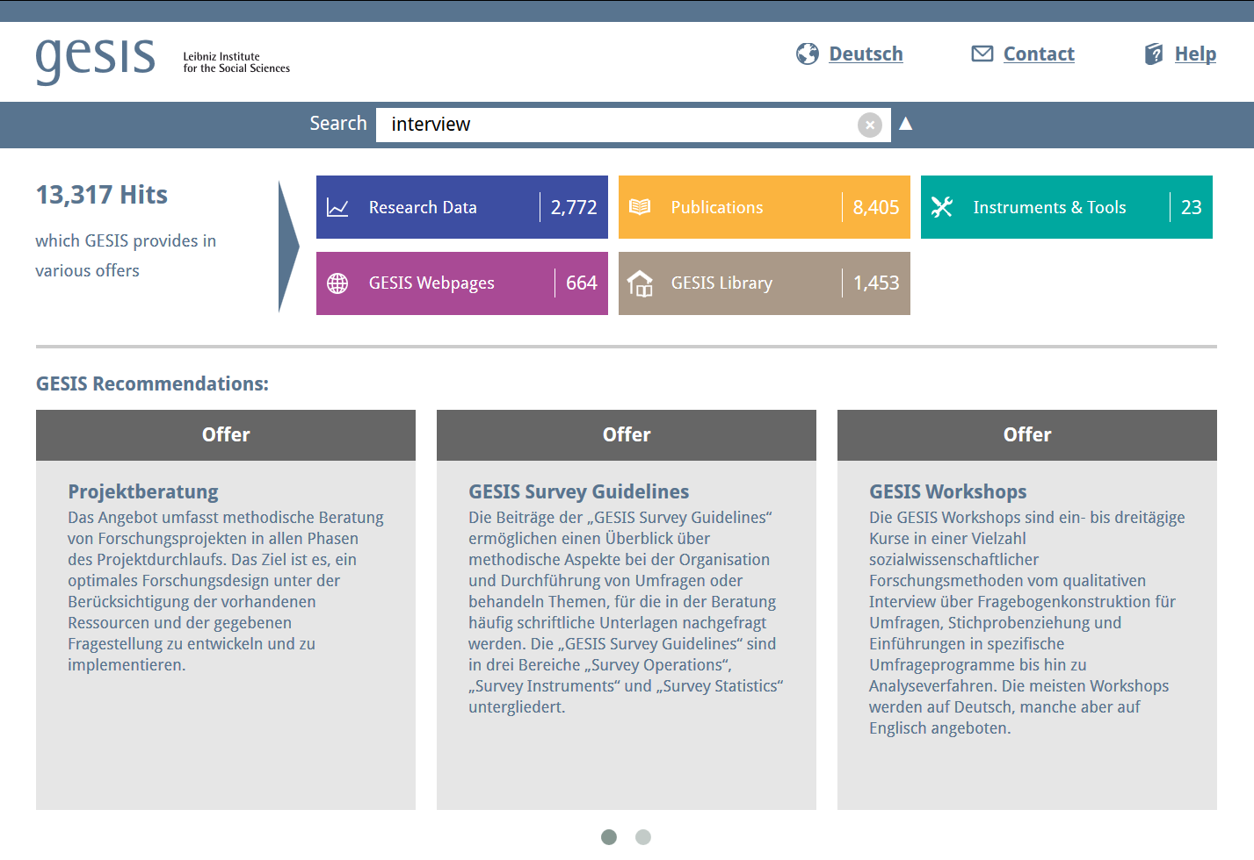
Academic Libraries and DH Tools
https://www.gesis.org
Notes:
Finally, the integration, as I already hinted earlier, does not stop on the level of tools. A comprehensive approach demands to think material (or research data), tools, as well as the step of communicating results and insights, traditionally in form of publications, as connected phenomena. GESIS, Germany's central provider of services for the social sciences, is a good example of how those different aspects can be presented together. Scholarly makerspaces will add three more components: tutorials, methodology, and annotated use cases, which will be mostly projects.

Slide 40
Academic Libraries and DH Tools
social sciences
research focused (not learning)
discovery, not curation
not an open community approach
Notes:
The approach of the scholarly makerspaces obviously needs to be one who aims to integrate different perspectives, goals, and levels of expertise. We understand as a possibility to explore digital tools, methods, as as digital data at one place. Digital Humanities are especially tricky, since expert scholars in topical fields of humanities are not necessarily experts in the technological aspects of digital research. And if they are, they most probably already have their one infrastructures and networks and therefore won't need the scholarly makerspaces. Our challenge will be to bring different aspects conclusively together in order to implement our service successfully.
1. There is the messaging – it is fine that you do not have in-depth-knowledge and programming skills to enter or enhance your research with contemporary digital tools and methods. Scholarly Makerspaces will make you enjoy your learning curve. The other part will me the message: You, as a skilled and innovative programmer, are at the right place to apply your skill on exquisite cultural data in a meaningful way. Another message needs to be: We as your library have the expertise to answer your questions regarding all things connected to digital humanities research. And if we don't we will connect you with someone who has.
2. We, of course, need to provide not only an overarching message but also purposeful information about the state, the chances and the limits of tool based research in the humanities. And we need to provide the data as well as the tools to start plus, maybe most necessarly, basic instructions. Our aim is to fit all students, scholars, and maybe also citizens who come to us with anything necessary to begin or deepen their exploration of the field of digital research.
3. While there is a highly elaborated and often deeply specialized DH-community there is also this community with a more general perspective or simply in need for a certain solution and without resources to qualify itself on a comprehensive DH-level. After all, humanities still have their rather traditional humanities agenda and new tools may play only a small part in many fields of research. And, also, the more traditional scholars might be rather critical and cautious for any "all-in"-approach. Scholarly makerspaces need to address this tension as well and remodel it into a chance. Therefore we want to establish the makerspaces as a space for dialogue, meta-discussions, and the exchange of expertise.
We want to provide explicitely a service which is as approachable as possible because our aim will be to tackle the two gaps – the knowledge gap, the dissemination gap. And, if possible, the gap of mutual understanding.

