Slide 1
Facilitate Open Science Training for European Research
WORKSHOP 1:
Open Research Data in Social Sciences and Humanities (ADP)
June 18th 2014, Social Science Data Archives, Faculty of Social Sciences,
University of Ljubljana

Slide 2



Introduction to RDM and emerging good RDM practice in UK universities
Joy Davidson, Digital Curation Centre
Funded by:

Slide 3
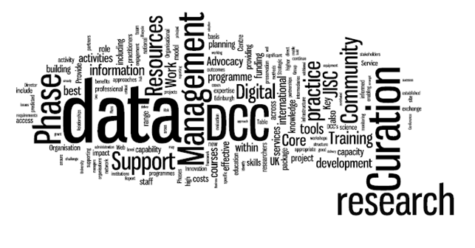

The DCC Mission
“Helping to build capacity, capability and skills in data management and curation across the UK’s higher education research community”
Phase 3 Business Plan
www.dcc.ac.uk

Slide 4
What is research data management and curation?
Active management, adding value and maintaining access to research data over the course of its scholarly lifecycle.
Part of good research practice

Slide 5
UK Context

Slide 6
What has been driving this agenda in the UK?
Several factors making RDM a key issue for many UK HEIs
These factors are international and are affecting research practice in many countries (US, Canada, EU)

Slide 7

“Data sets are becoming the new instruments of science”
Dan Atkins, University of Michigan

Slide 8
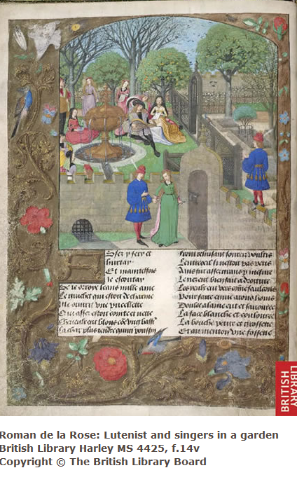
Digital data as the new special collections?
Sayeed Choudhury, Johns Hopkins

Slide 9
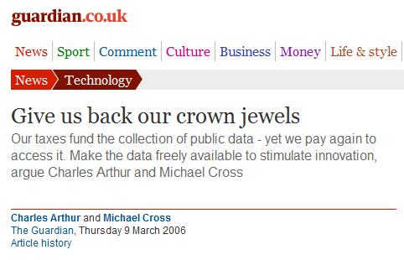
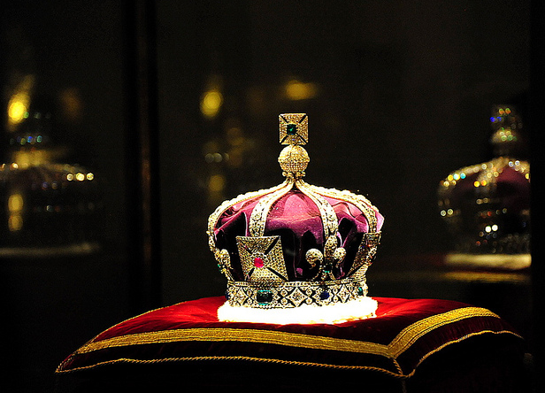
Research data: institutional crown jewels?
http://www.flickr.com/photos/lifes__too_short__to__drink__cheap__wine/4754234186/

Slide 10
What do UK funders expect?

Slide 11

Ultimately funders expect:
timely release of data
  once patents are filed or on (acceptance for) publication
open data sharing
  minimal or no restrictions if possible
preservation of data
  typically 5-10+ years if of long-term value
See the RCUK Common Principles on Data Policy:
www.rcuk.ac.uk/research/Pages/DataPolicy.aspx

Slide 12
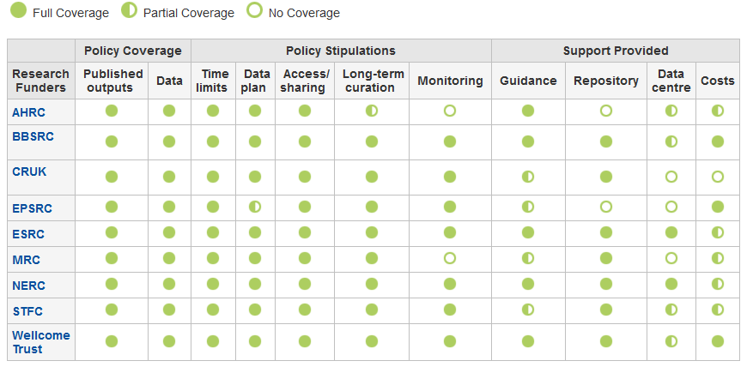
http://www.dcc.ac.uk/resources/policy-and-legal/overview-funders-data-policies

Slide 13
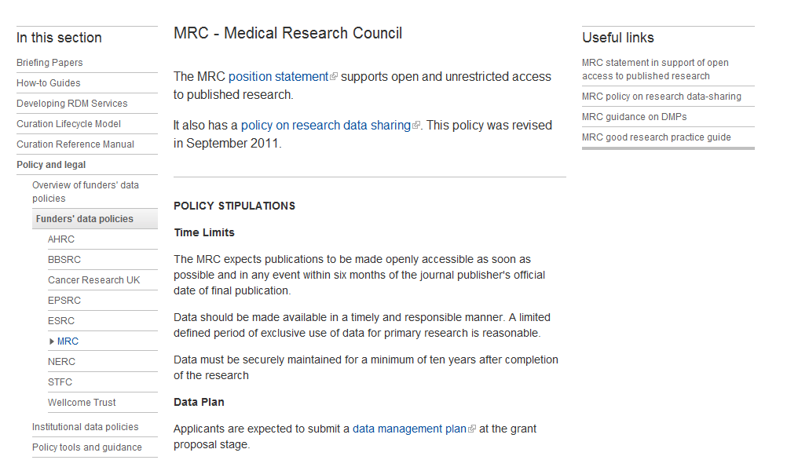

Slide 14
Working with UK Universities

Slide 15
Institutional Engagement programme
Pilot phase ran from Spring 2011 to Spring 2013
Funded by HEFCE under Universities Modernisation Fund
Provided up to 60 days of resource to 21 institutions
Aimed to:
  Increase capacity and capability in Research Data Management
  Drive efficiencies in the HE sector by sharing models and lessons

Slide 16
The engagement model
RDM development process knowledge
Awareness of stakeholders, enablers and barriers
Design RDM policies and services
Diagnose practices
Initiate change
Efficient information sharing across HE sector
Redesign of DCC support

Slide 17
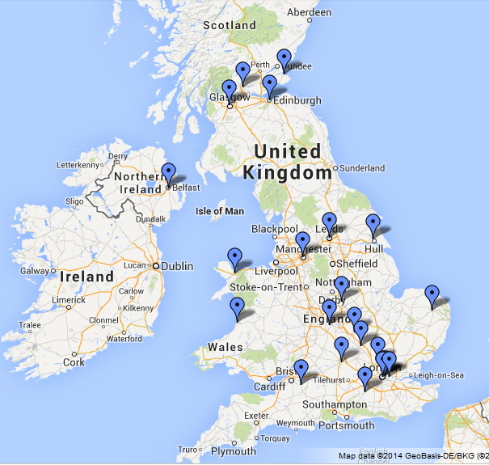
Who we worked with

Slide 18
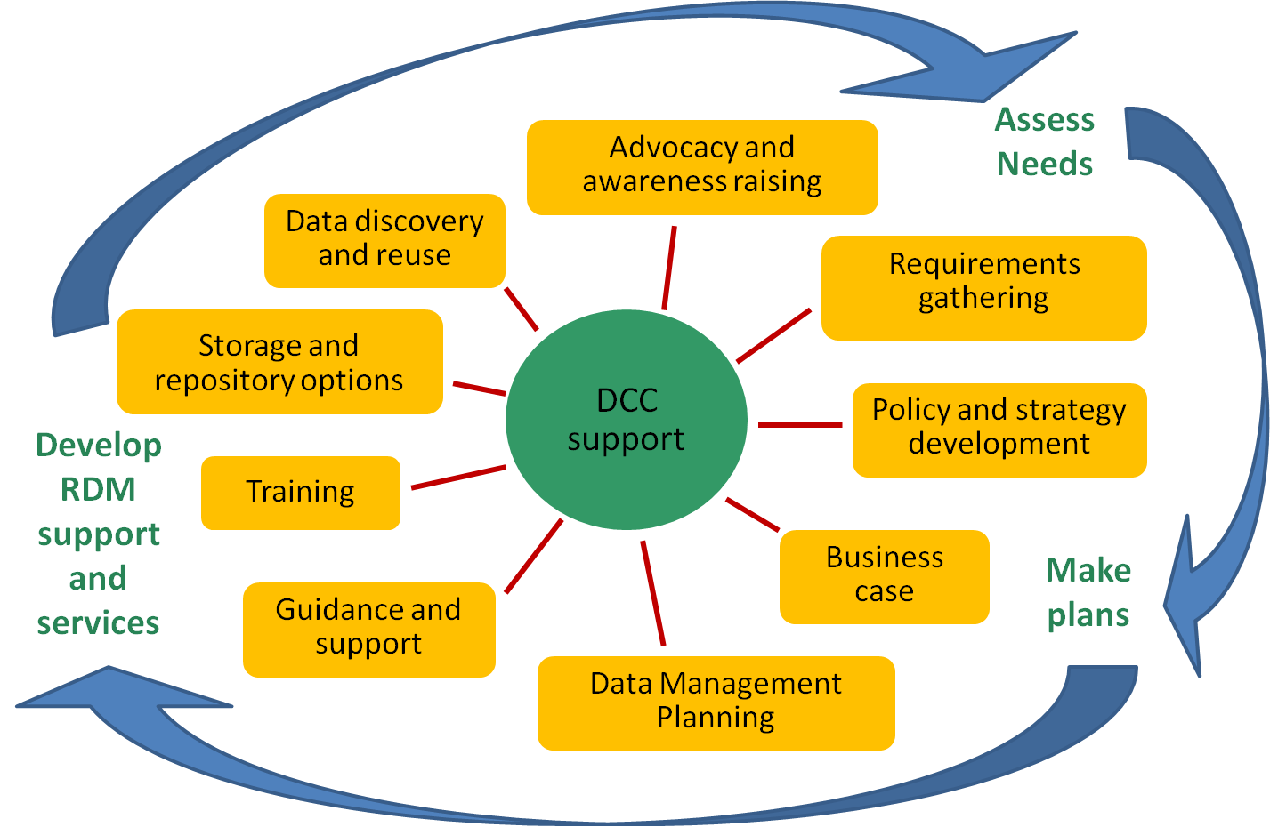
DCC tailored support
www.dcc.ac.uk/tailored-support

Slide 19
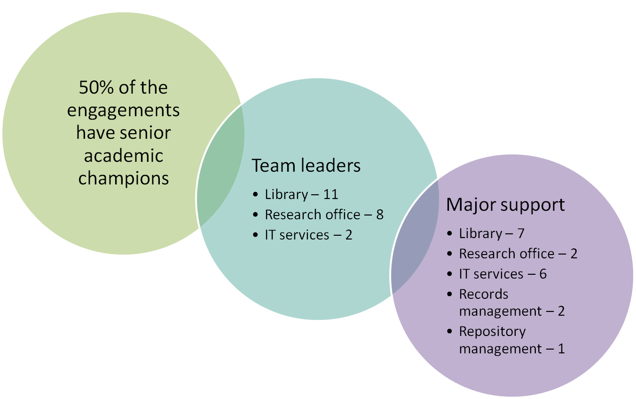
Roles of main participants

Slide 20
Examples of support:
CARDIO at Queen Mary
Advised on the mini quiz and full CARDIO
Ran a workshop to reach consensus on results
Wrote up findings to feed into strategy
‘heatmap’ approach being used to guide roadmap development
DCC support fits into the curation strand of the IT Transformations
Project at QMUL

Slide 21
Fostering skills development

Slide 22
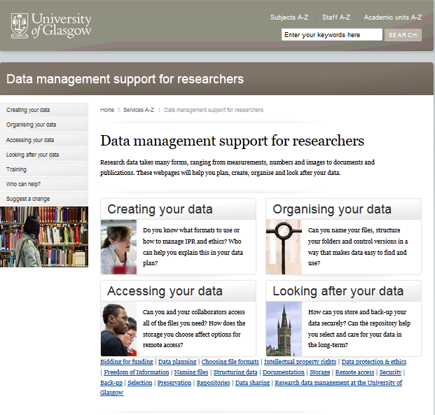
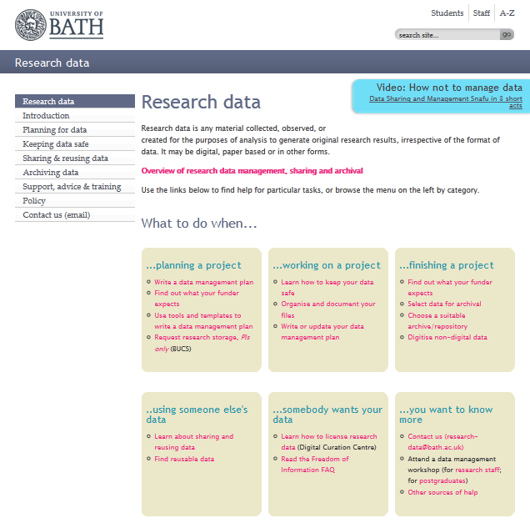
Guidance webpages
www.gla.ac.uk/datamanagement
www.bath.ac.uk/research/data

Slide 23
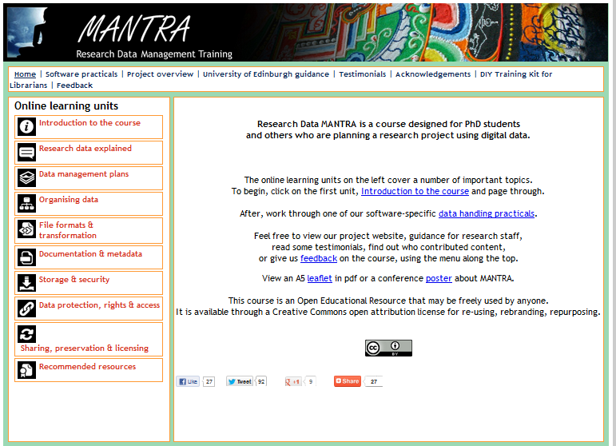
Online training for PhD students
http://datalib.edina.ac.uk/mantra

Slide 24
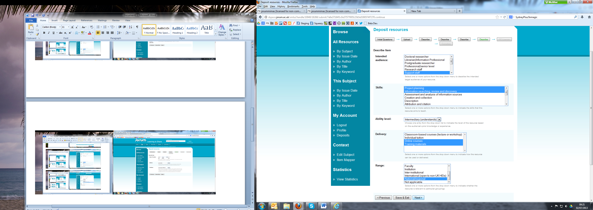

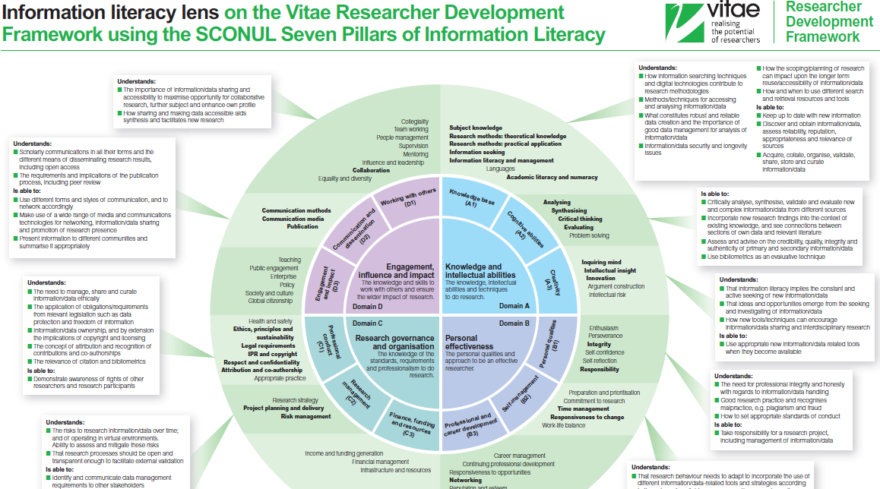
Jorum
http://www.fosteropenscience.eu/
Vitae RDF
Notes:
24

Slide 25
Examples of support:
Capacity building at UEL
Co-designed a series of modules for training RDM support staff
Developed online learning resource, presentations and exercises
Delivered training with UEL colleagues
Helped to build awareness and confidence in dealing with RDM
SupportDM: http://www.uel.ac.uk/trad/outputs/resources/
Review of the course: http://datamanagementuel.wordpress.com/ 2013/06/19/are-you-rdm-ready-from-zeroes-to-heroes/

Slide 26
Supporting data management planning

Slide 27
What is a DMP?
A short plan that outlines:
what data will be created and how
how it will be managed (storage, back-up, access…)
plans for data sharing and preservation
Create
Document
Use
Share
Preserve
Store

Slide 28










Some other funders that require DMPs or equivalent

Slide 29
Five common themes
  Description of data to be collected / created
  (i.e. content, type, format, volume...)
  Standards / methodologies for data collection & management
  Ethics and Intellectual Property
  (highlight any restrictions on data sharing e.g. embargoes, confidentiality)
  Plans for data sharing and access
  (i.e. how, when, to whom)
  Strategy for long-term preservation

Slide 30
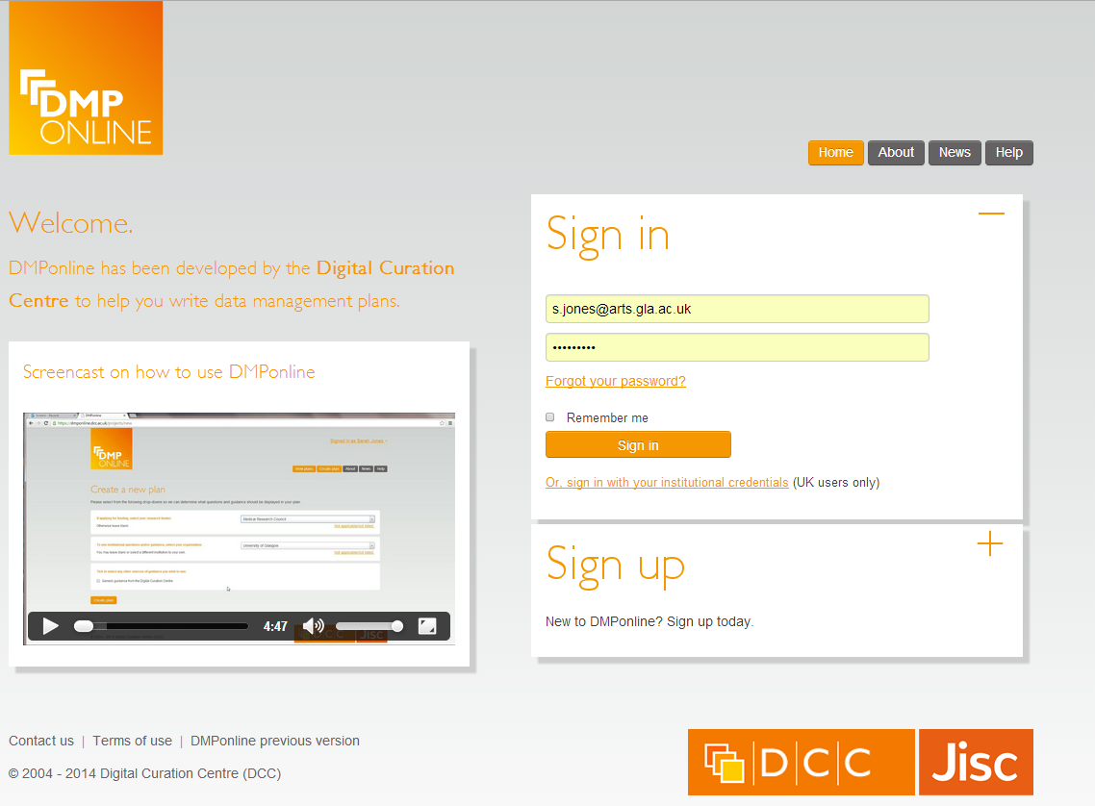
DMPonline
https://dmponline.dcc.ac.uk

Slide 31
Main features of DMPonline
Templates for different requirements (funder or institution)
Tailored guidance (funder, institutional, discipline-specific etc)
Ability to provide examples and boilerplate text
Supports multiple phases (e.g. pre- / during / post-project)
Granular read / write / share permissions
Customised exports to a variety of formats
API for systems interoperability
Shibboleth authentication

Slide 32


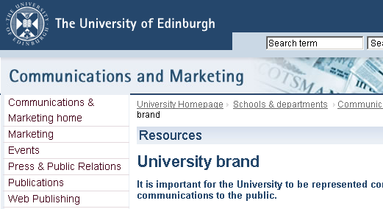
Institutions can customise DMPonline
Profile local support via custom guidance and boilerplate text
Add your logo, URL etc
Select / write desired questions
www.dcc.ac.uk/news/customising-dmponline

Slide 33
Facilitating research data discovery

Slide 34










Archiving – external data centres
  Structured databases
  Research funders’ data centres…
Registries of international
data centres
Disciplinary& community initiatives
Notes:
34

Slide 35




Institutional data repositories
Not intended to replace national, subject or other established data repositories
Acknowledge hybrid environment
http://datashare.is.ed.ac.uk
Research Data at Essex and
DataPool at Southampton
www.dspace.cam.ac.uk
  https://databank.ora.ox.ac.uk
Notes:
35

Slide 36
Data catalogues
Oxford is developing its DataFinder tool http://blogs.it.ox.ac.uk/damaro
Research Data @ Essex has developed a profile based on DataCite, Inspire and DDI standards www.data-archive.ac.uk/ media/395364/rde_march2013_repositoryoutputs.pdf
C4D is developing a research data extension to the CERIF standard - http://cerif4datasets.wordpress.com
CKAN is being explored by various projects http://ckan.org

Slide 37
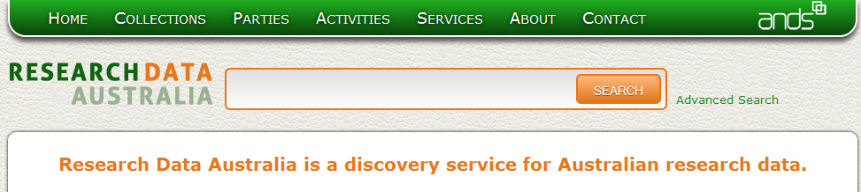
Research Data Registry pilot
aim is to improve data discovery and provide a national level service
aggregate metadata relating to data collections or datasets held in UK HEIs and subject data centres
have mapped metadata schema to develop crosswalks
trialling ANDS Research Data Australia

Slide 38
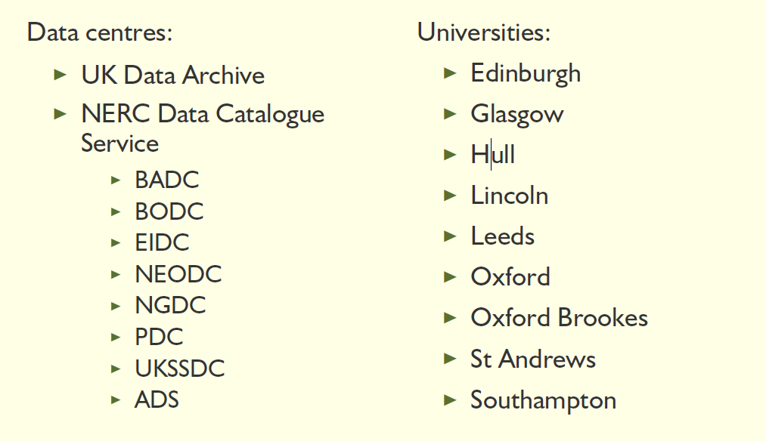
Jisc RDRDS Pilot Partners

Slide 39
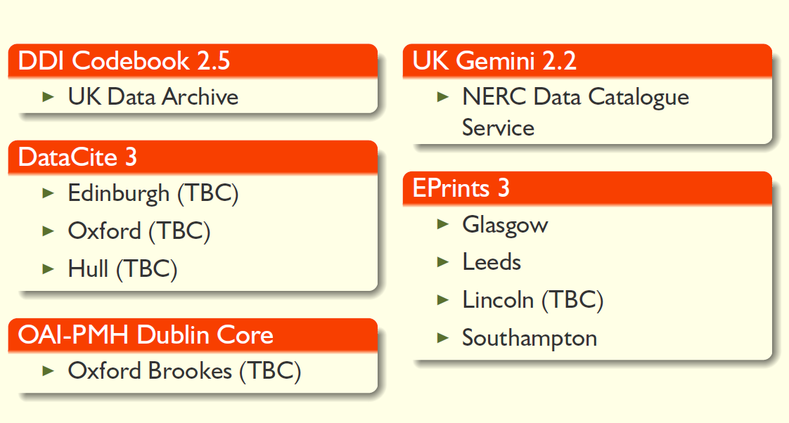
RDRDS Metadata Work

Slide 40
Metadata catalogues: defining levels
mandatory minimal metadata
mandatory administrative information
optional, discipline-specific metadata

Slide 41
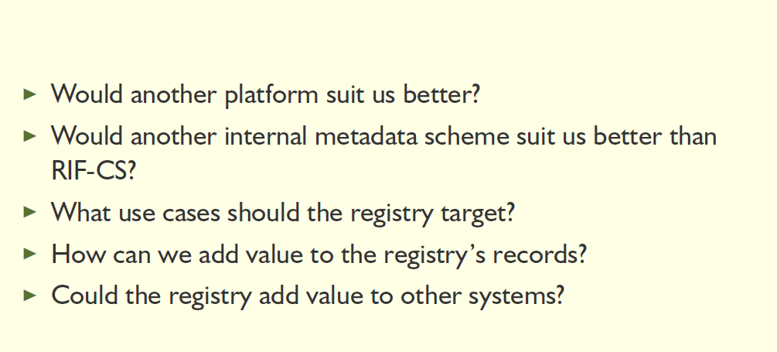
RDRDS ongoing investigations

Slide 42
Assessing RDM costs and benefits

Slide 43
http://www.dcc.ac.uk/resources/policy-and-legal/overview-funders-data-policies
Notes:
43

Slide 44
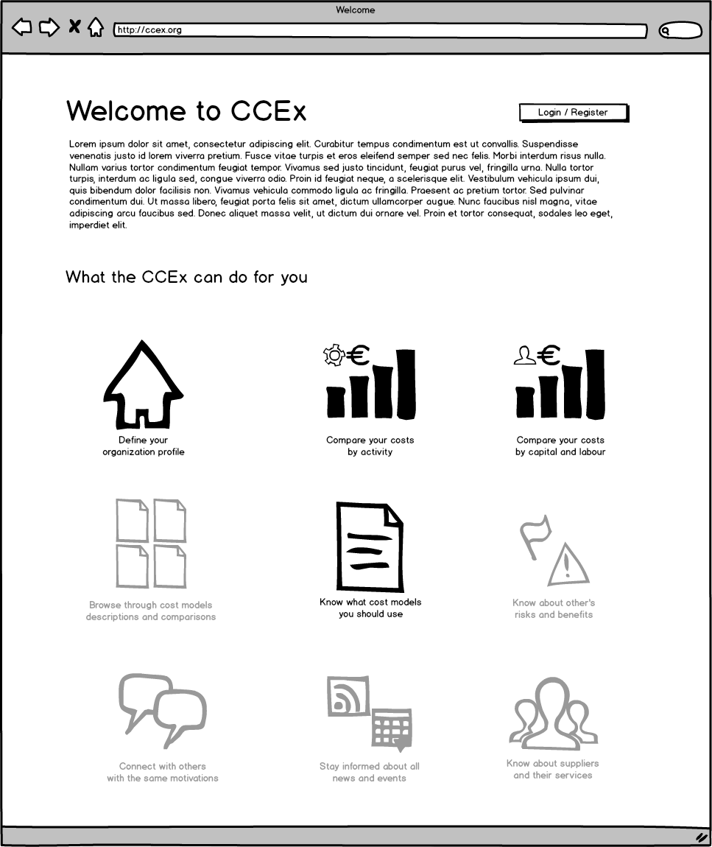

Collaboration to Clarify the Costs of Curation (4C)
http://4cproject.eu/

Slide 45
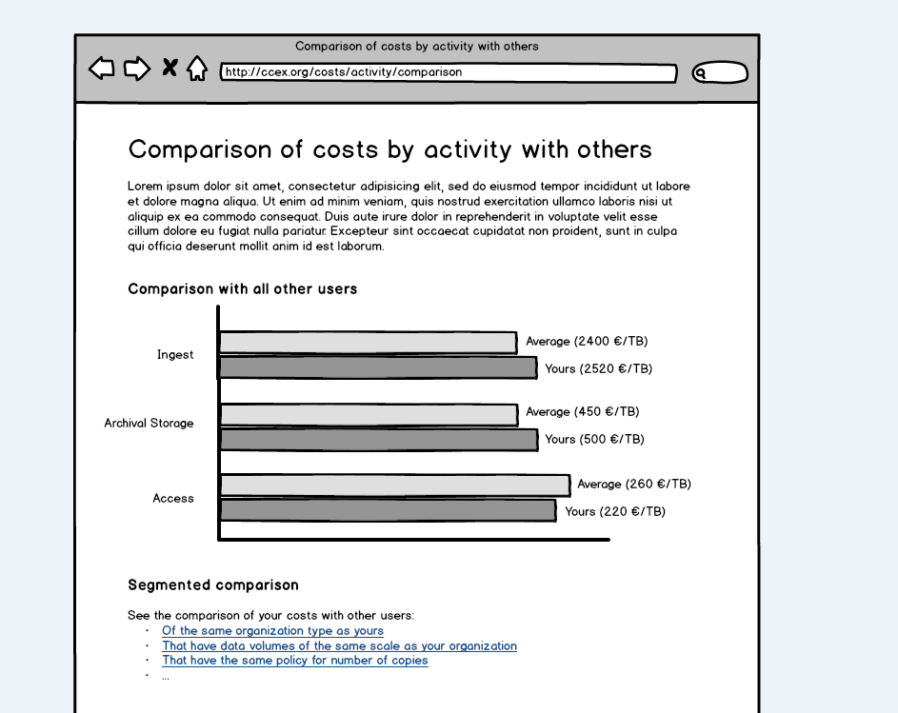
Collaboration to Clarify the Costs of Curation (4C)
http://4cproject.eu/
Notes:
45

Slide 46
Lessons we can share

Slide 47
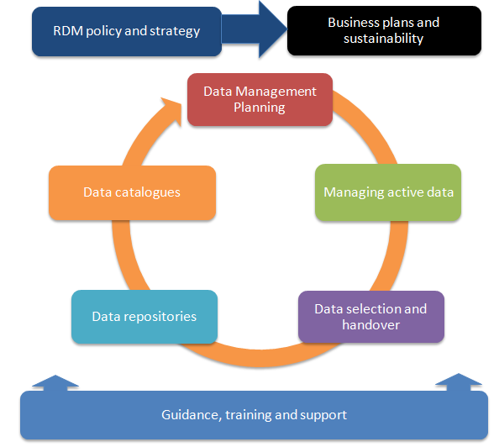
Components of RDM services

Slide 48





UK research data policies
legal tone / language
a section in uni DM policy
useful guide as appendix
“Statement of commitment”
→ Infrastructure → policy
“10 commandments”
mutual promises
aspirational
Based on Edin. with a few additions
Baseline of RCUK Code
+ procedures & support
Notes:
48

Slide 49
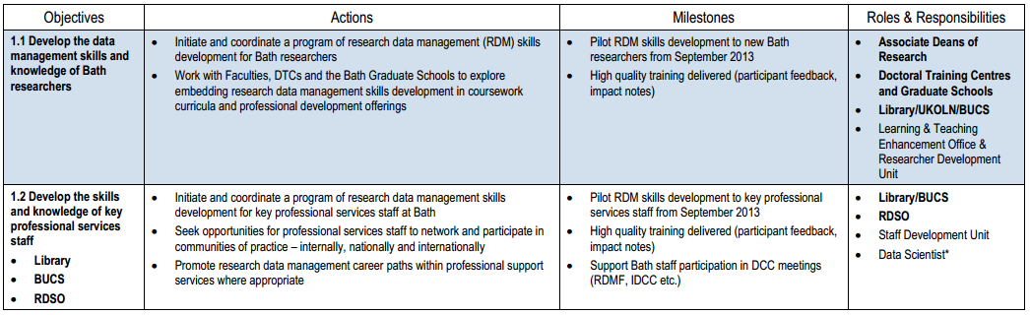
Sample roadmaps: University of Bath
Based on Monash University RDM strategy
Identifies the current position and proposes activity
Defines roles and responsibilities and timeframes
http://www.bath.ac.uk/rdso/University-of-Bath-Roadmap-for-EPSRC.pdf

Slide 50
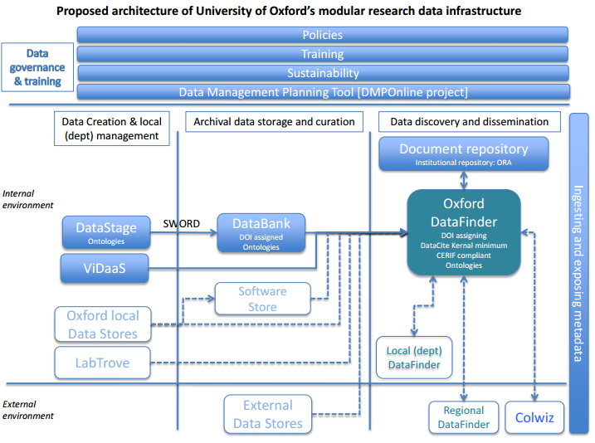
Architecture models
Diagram courtesy of Sally Rumsey, University of Oxford

Slide 51

Thanks – any questions?
DCC guidance, tools and case studies:
www.dcc.ac.uk/resources
Follow us on twitter:
@digitalcuration and #ukdcc

