Slide 1
Open Data – one researcher’s experience
Sarah Callaghan sarah.callaghan@stfc.ac.uk @sorcha_ni

Slide 2
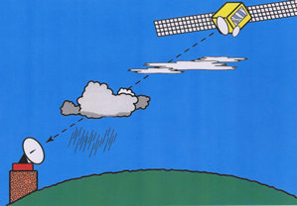
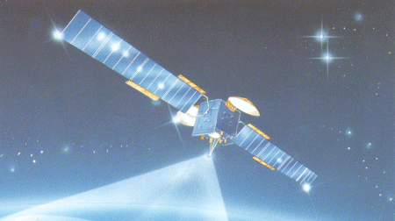
Creating data: a radio propagation dataset
The problem: rain and cloud mess up your satellite radio signal. How can we fix this?
Italsat F1: Owned and operated by Italian Space Agency (ASI). Launched January 1991, ended operational life January 2001.

Slide 3
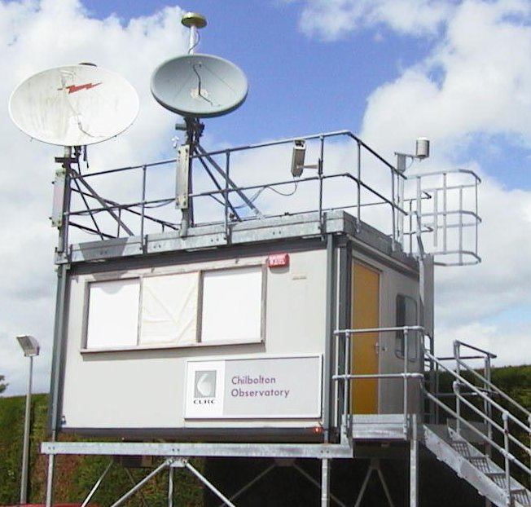
The receive cabin at Sparsholt in Hampshire
Inside the receive cabin – the instruments my data came from

Slide 4
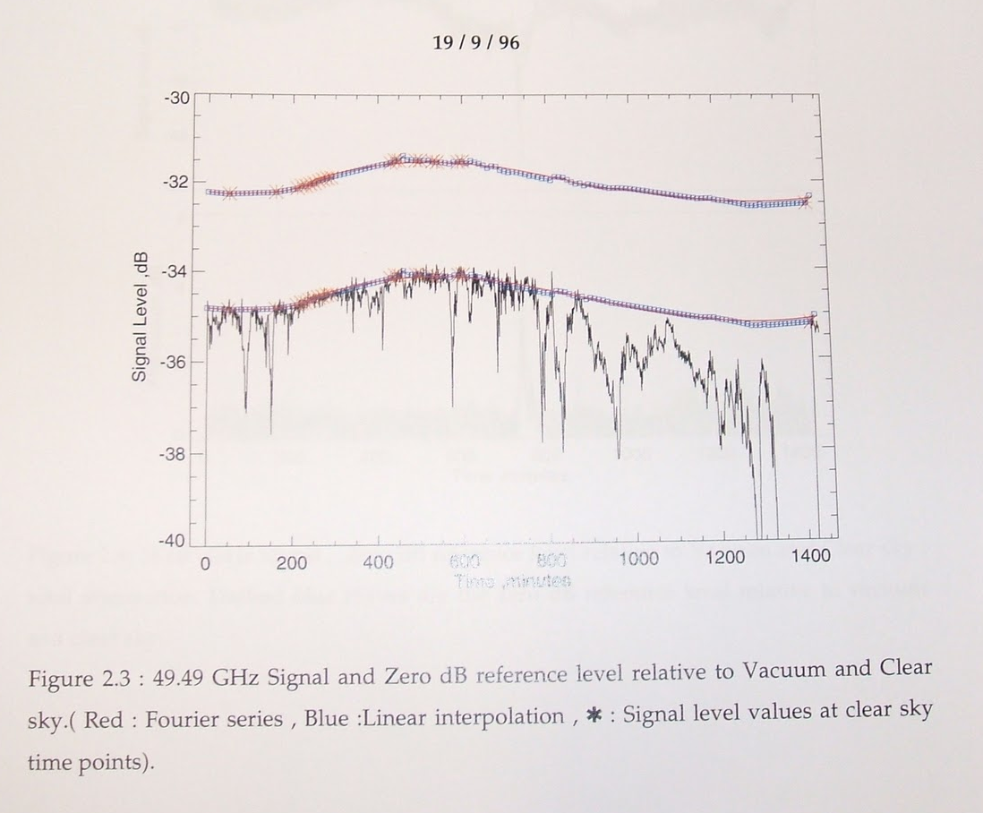
Creating/processing data
One day’s worth of raw data from one of the receivers
My job was to take this...
...turn it into this....

Slide 5
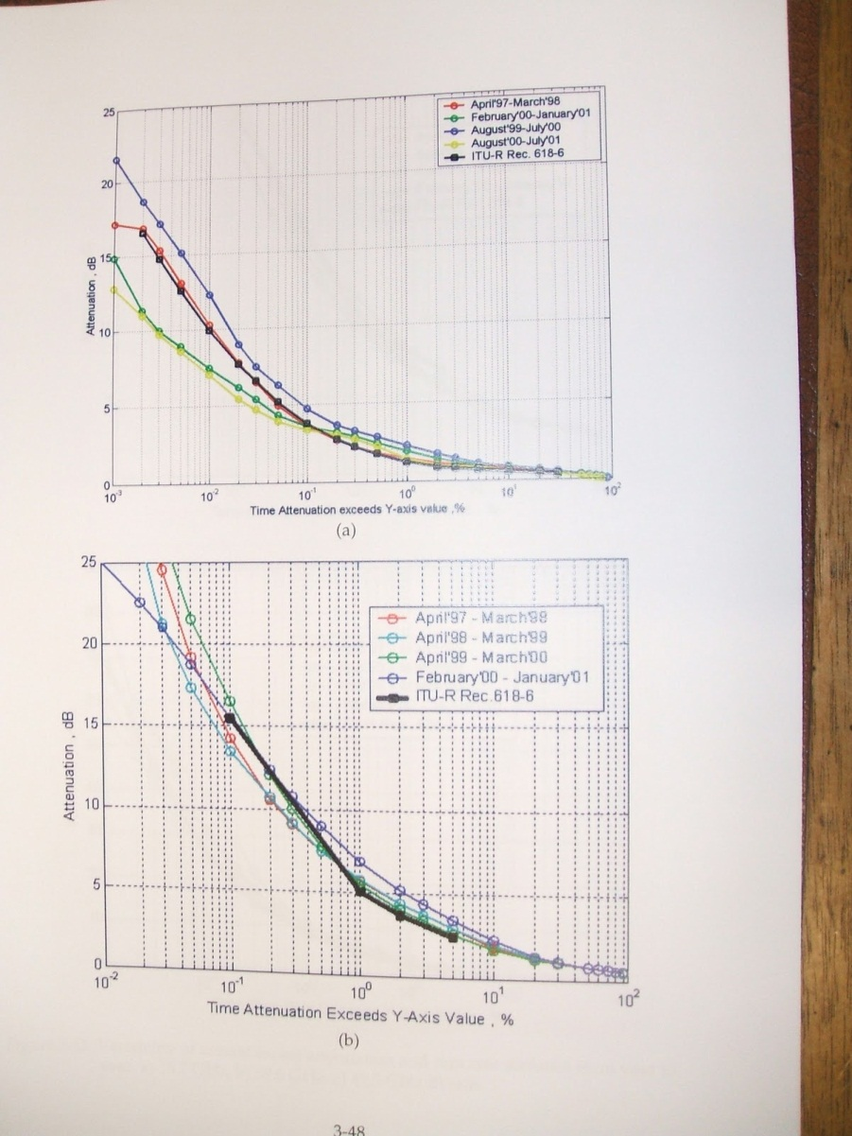
Analysing data
…a process which involved 4 major steps, 4 different computer programmes, and 16 intermediate files for each day of measurements.
Each month of preproccessed data represented somewhere between a couple of days and a week's worth of effort.
It was a job where attention to detail was important, and you really had to know what you were looking at from a scientific perspective.
...with the final result being this.

Slide 6
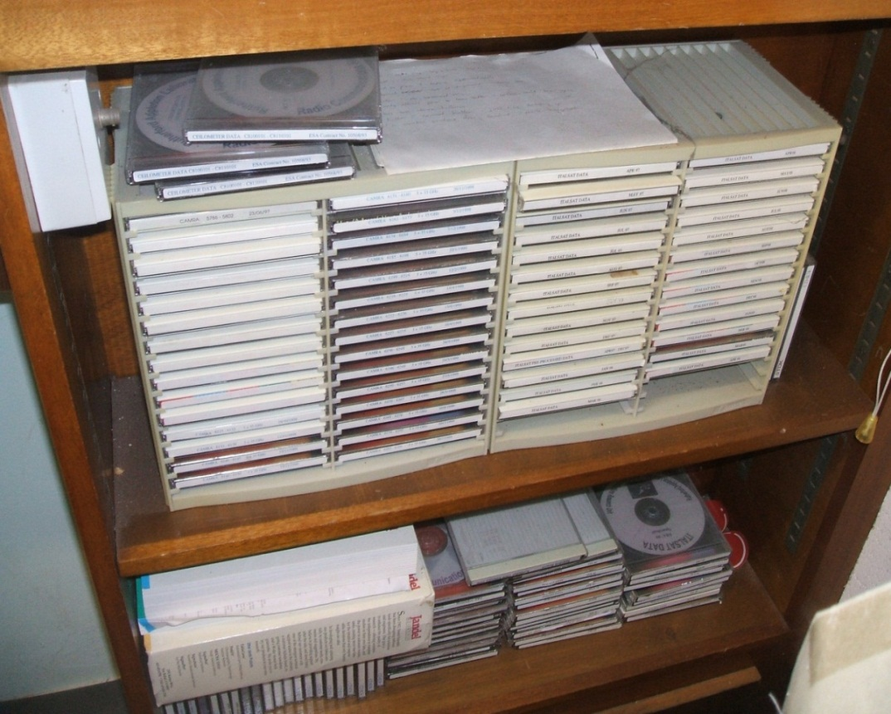
Preserving data (the wrong way!)
Part of the Italsat data archive – on CDs in a shelf in my office

Slide 7
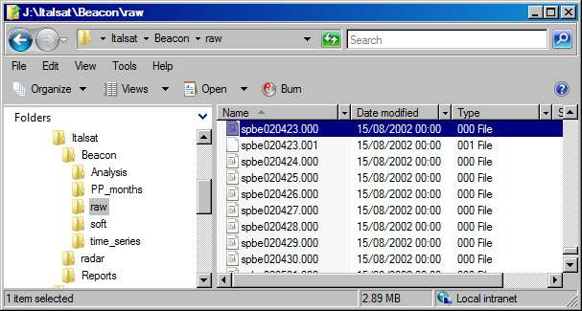
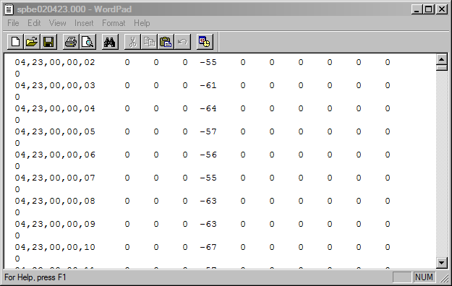
What the processed data set looks like on disk
What the raw data files looked like.
(I do have some Word documents somewhere which describe what all this is…)

Slide 8
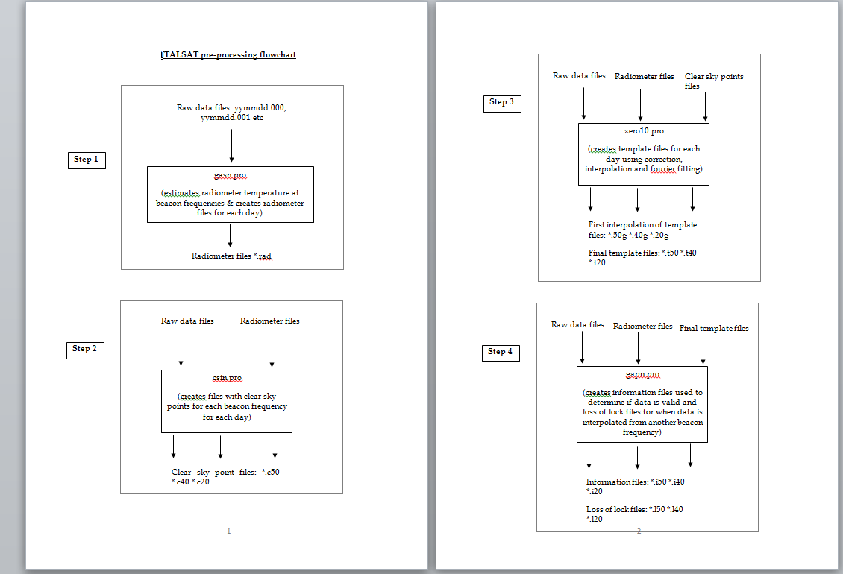
Example documentation
Note the software filenames in the documentation.
I still have the IDL files on disk somewhere, but I’d be very surprised if they’re still compatible with the current version of IDL

Slide 9
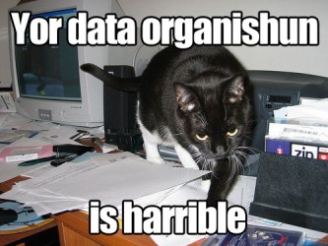
What it all came down to:
Composite image from Flickr user bnilsen and Matt Stempeck (NOI), shared under Creative Commons license
And I wasn’t even preserving my data properly!

Slide 10
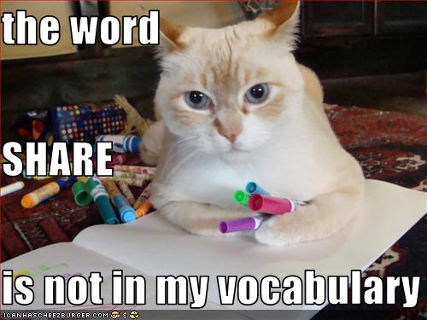
As for sharing the data…
I did share, but there was a lot of non-disclosure agreements (I am not a lawyer!)
And I didn’t feel like I got the credit for it.(The first publication based on the data wasn’t written by me, and I didn’t even get my name in the acknowledgements.)

Slide 11
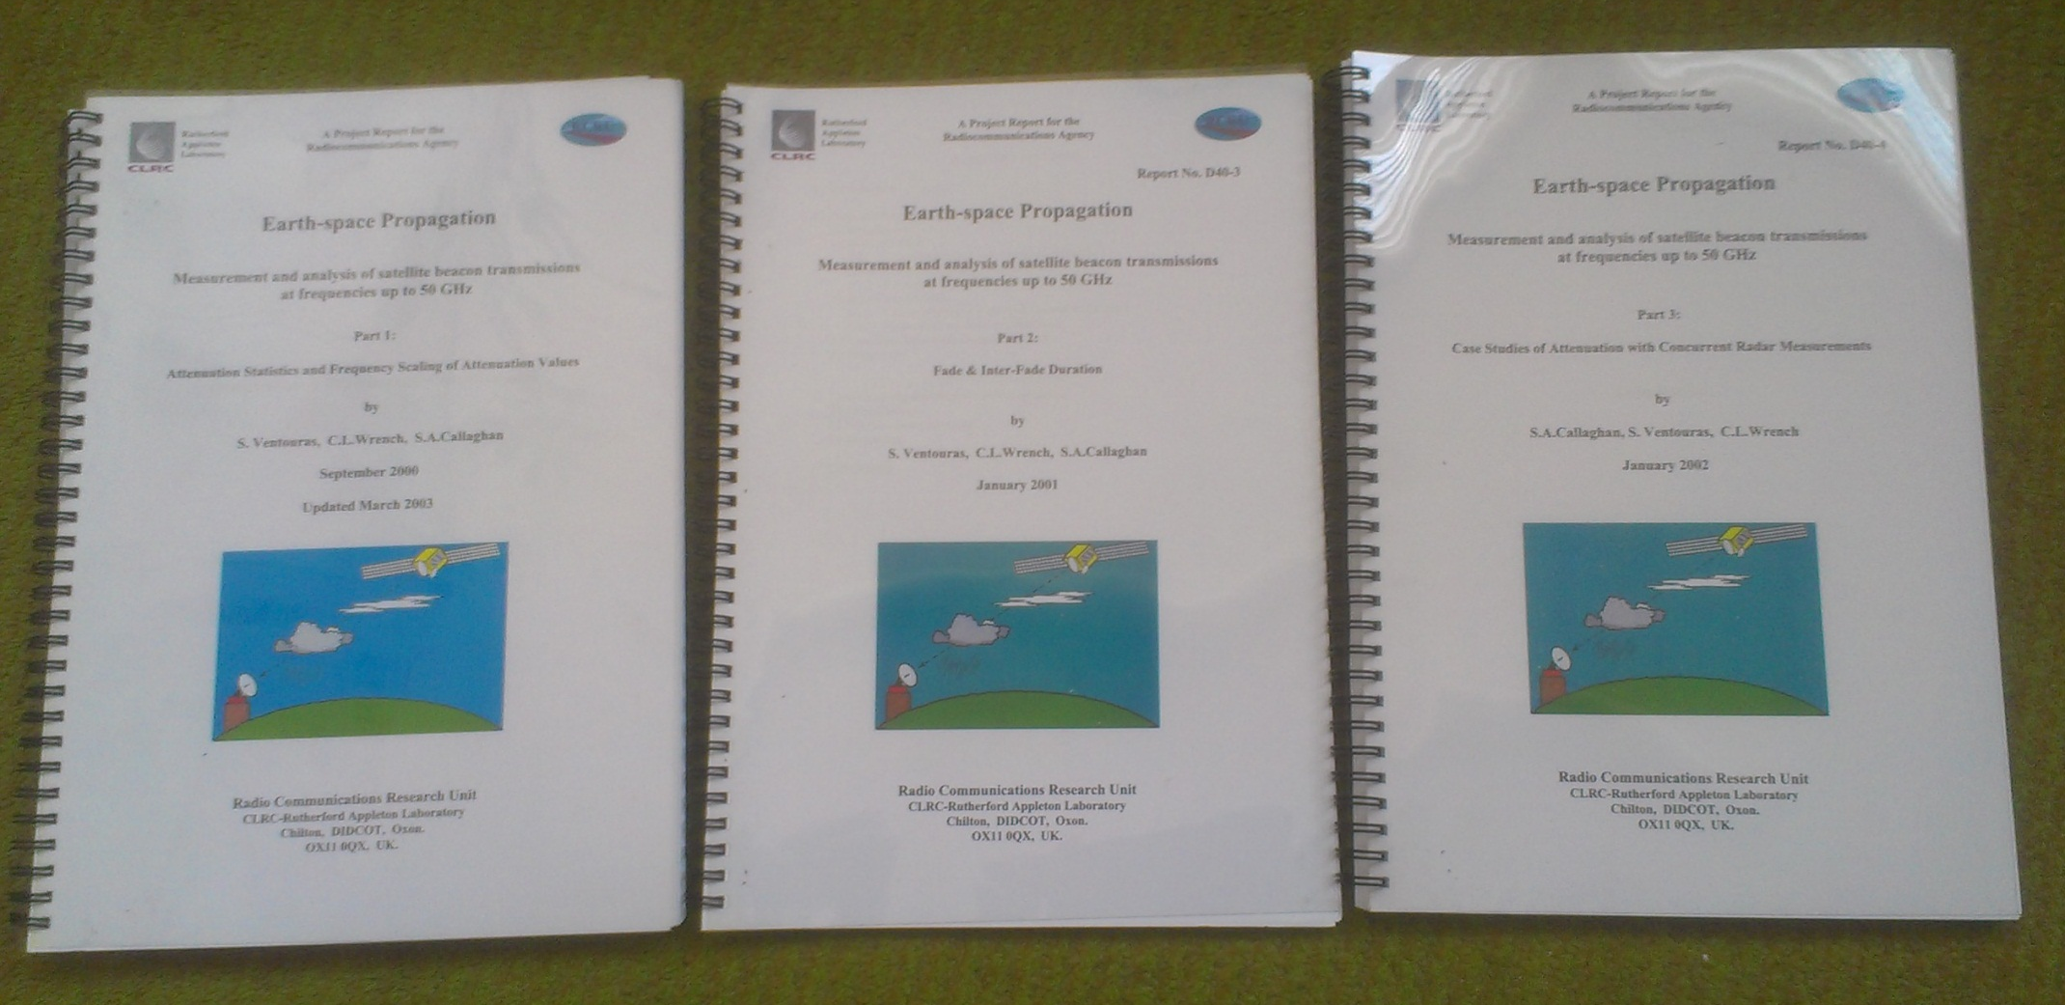
Publications – grey literature

Slide 12
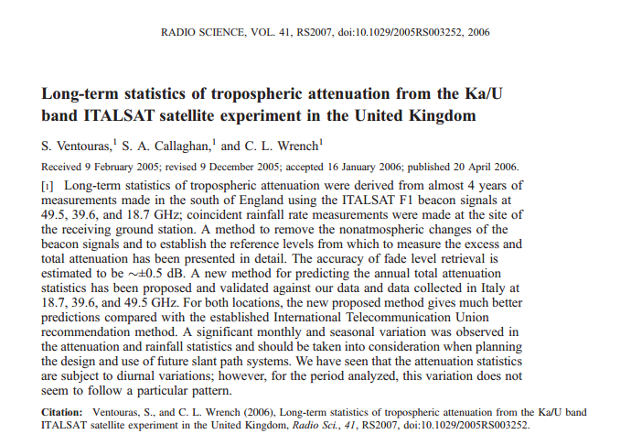
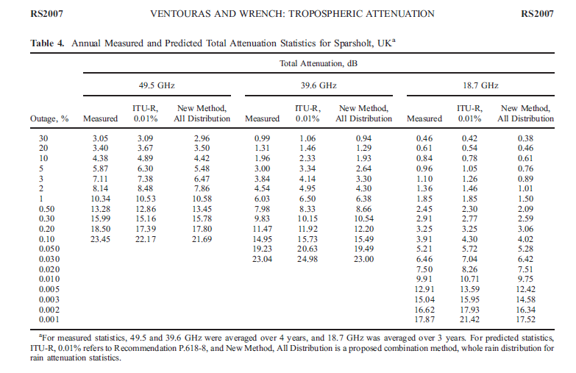
Publications – journal paper
Where’s the data?

Slide 13
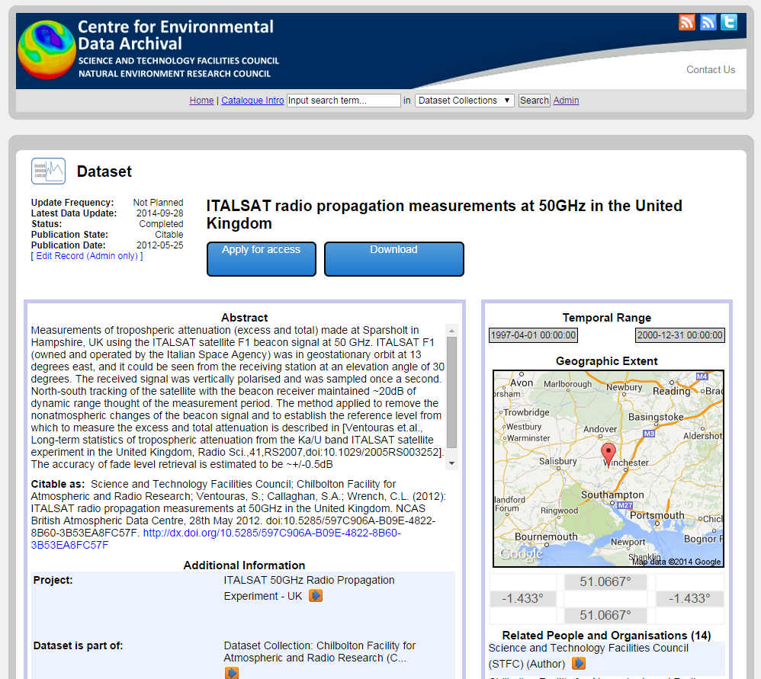
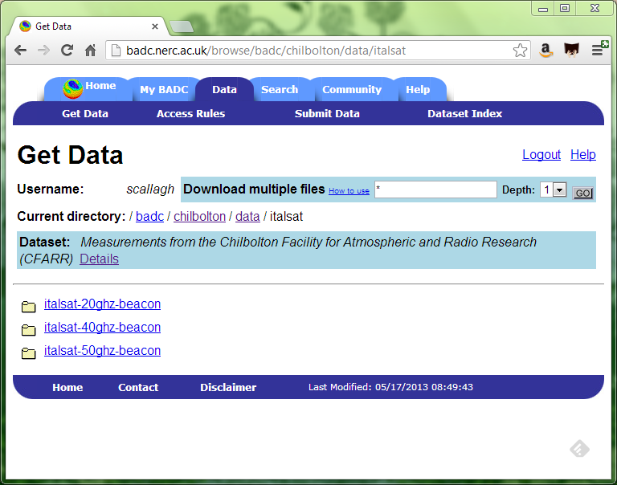
Good news: the data is all on the BADC now

Slide 14
Who are we and why do we care about data?
The UK’s Natural Environment Research Council (NERC) funds six data centres which between them have responsibility for the long-term management of NERC's environmental data holdings.
We deal with a variety of environmental measurements, along with the results of model simulations in:
Atmospheric science
Earth sciences
Earth observation
Marine Science
Polar Science
Terrestrial & freshwater science, Hydrology and Bioinformatics

Slide 15
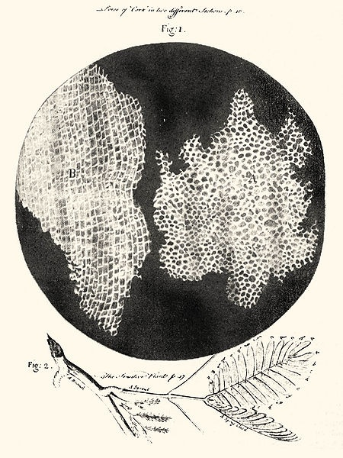
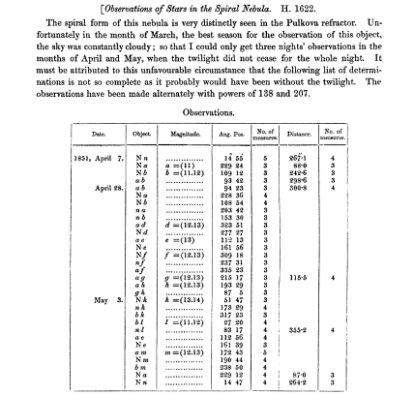
Journals have always published data…
The Scientific Papers of William Parsons, Third Earl of Rosse 1800-1867
Suber cells and mimosa leaves. Robert Hooke, Micrographia, 1665
…but datasets have gotten so big, it’s not useful to publish them in hard copy anymore

Slide 16
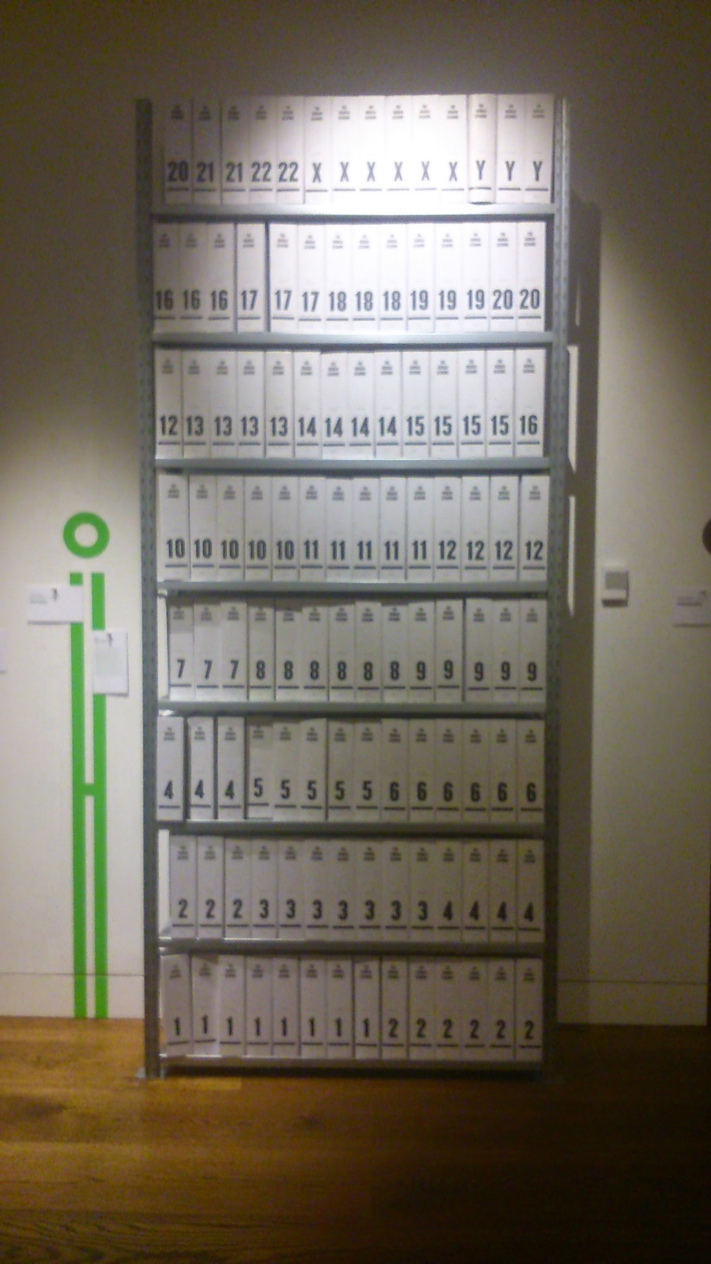
Hard copy of the Human Genome at the Wellcome Collection, London

Slide 17
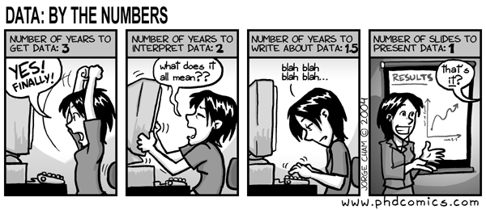
Creating a dataset is hard work!
"Piled Higher and Deeper" by Jorge Cham
www.phdcomics.com
Managing and archiving data so that it’s understandable by other researchers is difficult and time consuming too.
We want to reward researchers for putting that effort in!

Slide 18
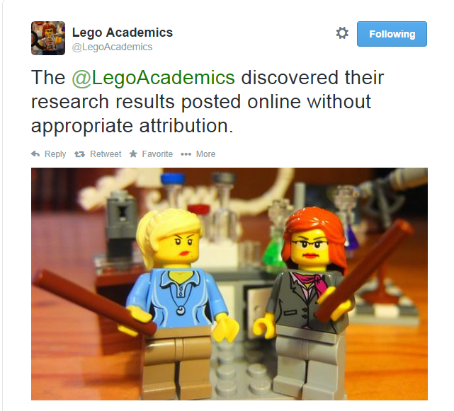

Slide 19
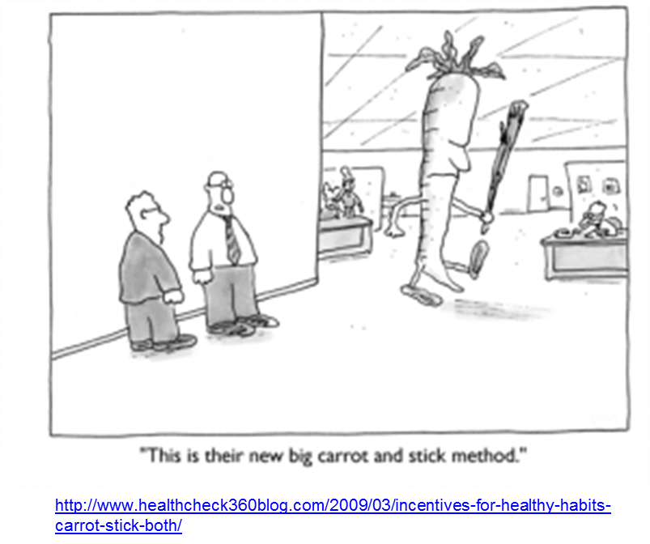
Why make data open?
Pressure from government to make data from publicly funded research available for free.
Scientists want attribution and credit for their work
Public want to know what the scientists are doing
Good for the economy if new industries can be built on scientific data/research
Research funders want reassurance that they’re getting value for money
Relies on peer-review of science publications (well established) and data (starting to be done!)
Allows the wider research community and industry to find and use datasets, and understand the quality of the data
Need reward structures and incentives for researchers to encourage them to make their data open – data citation and publication

Slide 20
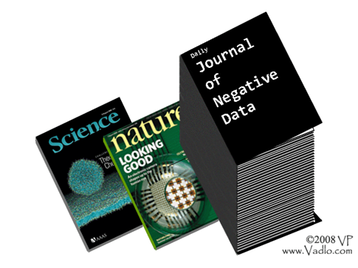
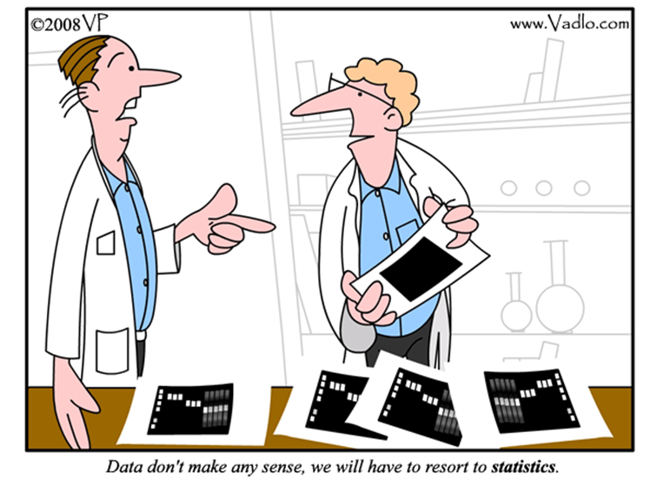
Why bother linking the data to the publication? Surely the important stuff is in the journal paper?
If you can’t see/use the data, then you can’t test the conclusions or reproduce the results! It’s not science!

Slide 21
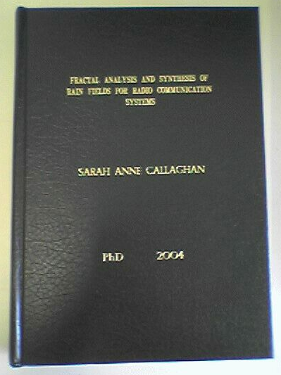
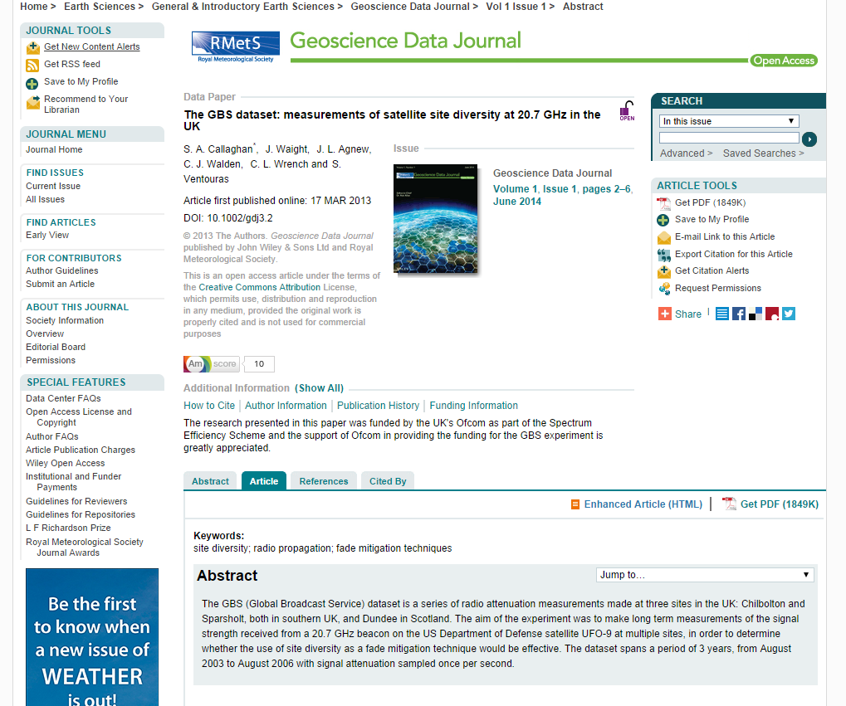
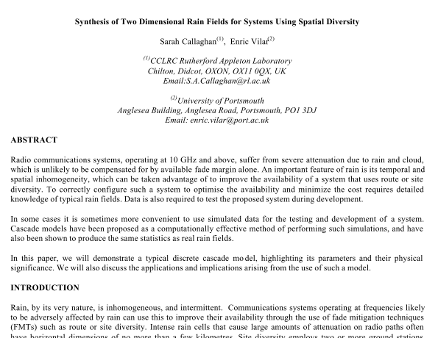
Most people have an idea of what a publication is

Slide 22
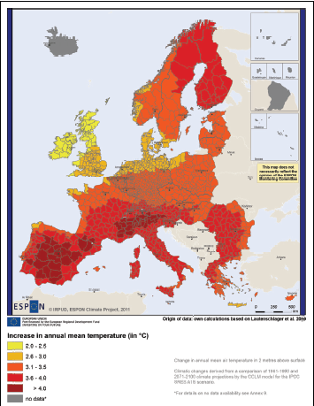
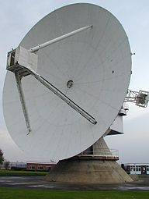
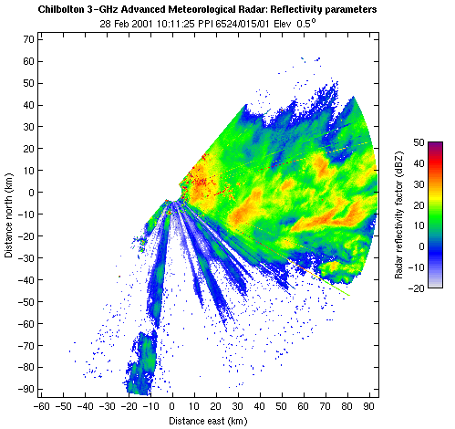
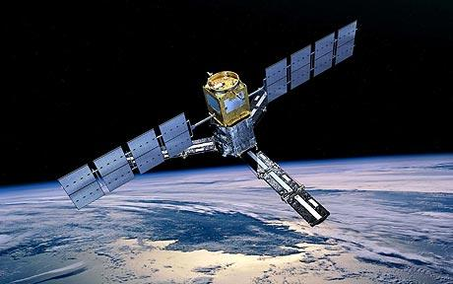
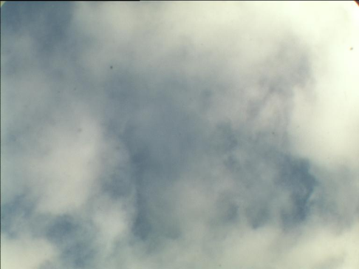
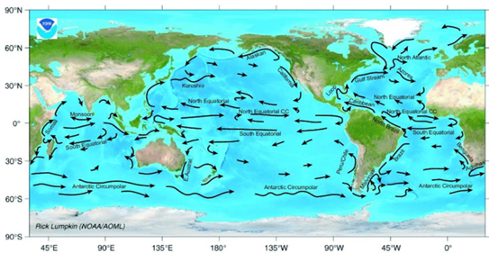
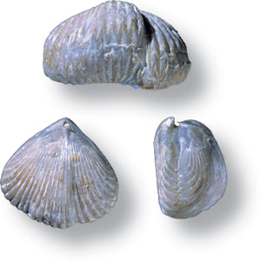
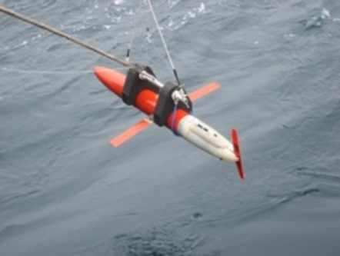
Some examples of data (just from the Earth Sciences)
Time series, some still being updated e.g. meteorological measurements
Large 4D synthesised datasets, e.g. Climate, Oceanographic, Hydrological and Numerical Weather Prediction model data generated on a supercomputer
2D scans e.g. satellite data, weather radar data
2D snapshots, e.g. cloud camera
Traces through a changing medium, e.g. radiosonde launches, aircraft flights, ocean salinity and temperature
Datasets consisting of data from multiple instruments as part of the same measurement campaign
Physical samples, e.g. fossils

Slide 23
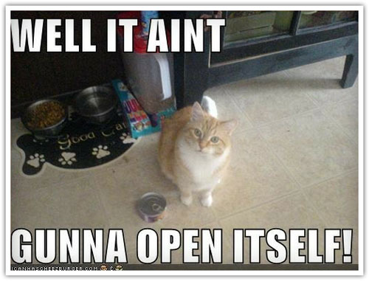
Should ALL data be open?
Most data produced through publically funded research should be open.
But!
Confidentiality issues (e.g. named persons’ health records)
Conservation issues (e.g. maps of locations of rare animals at risk from poachers)
Security issues (e.g. data and methodologies for building biological weapons)
There should be a very good reason for publically funded data to not be open.

Slide 24
Open is not enough!
“When required to make the data available by my program manager, my collaborators, and ultimately by law, I will grudgingly do so by placing the raw data on an FTP site, named with UUIDs like 4e283d36-61c4-11df-9a26-edddf420622d. I will under no circumstances make any attempt to provide analysis source code, documentation for formats, or any metadata with the raw data. When requested (and ONLY when requested), I will provide an Excel spreadsheet linking the names to data sets with published results. This spreadsheet will likely be wrong -- but since no one will be able to analyze the data, that won't matter.”
- http://ivory.idyll.org/blog/data-management.html
https://flic.kr/p/awnCQu

Slide 25
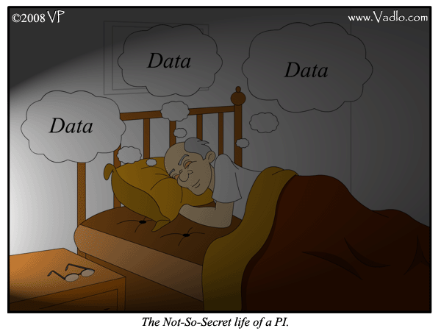
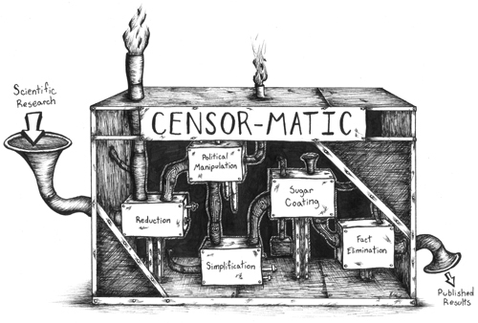
Summary and maybe conclusions?
Data is important, and becoming more so for a wider range of the population
Conclusions and knowledge are only as good as the data they’re based on
Science is supposed to be reproducible and verifiable
It’s up to us as scientists to care for the data we’ve got and ensure that the story of what we did to the data is transparent
So we and others can use the data again
And so people will trust our results
http://scienceblogs.com/clock/2007/04/framing_politics_based_on_scie_1.php
Notes:
Censormatic picture from: http://scienceblogs.com/clock/2007/04/framing_politics_based_on_scie_1.php

Slide 26
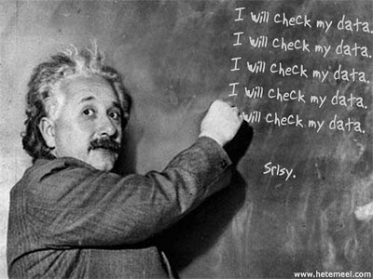
“Publishing research without data is simply advertising, not science” - Graham Steel
http://blog.okfn.org/2013/09/03/publishing-research-without-data-is-simply-advertising-not-science/
Thanks!
Any questions?
sarah.callaghan@stfc.ac.uk
@sorcha_ni
http://citingbytes.blogspot.co.uk/
Image credit: Borepatch http://borepatch.blogspot.com/2010/06/its-not-what-you-dont-know-that-hurts.html

