Slide 1
Open SCIENCE in the digital humanities
Boostcamp Open Science Leuven
24 October 2014
Boostcamp Open Science Leuven
24 October 2014
Katrien Verbert
HCI research group - KU Leuven
@katrien_v
Barbara Bordalejo
Faculty of Arts - KU Leuven
@TextualScholar, @bordalejo
Katrien Verbert
HCI research group - KU Leuven
@katrien_v
Barbara Bordalejo
Faculty of Arts - KU Leuven
@TextualScholar, @bordalejo

Slide 2
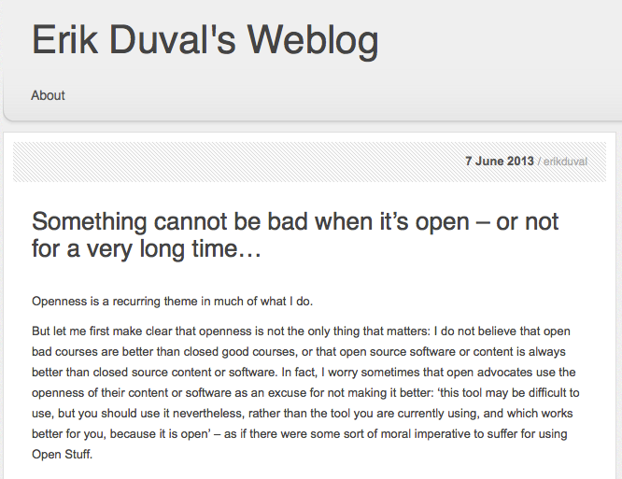
http://erikduval.wordpress.com/2013/06/07/something-cannot-be-bad-when-its-open-or-not-for-a-very-long-time/

Slide 3
Introducing the Open Scholar
The Open Scholar, as I'm defining this person, is not simply someone who agrees to allow free access and reuse of his or her traditional scholarly articles and books; no, the Open Scholar is someone who makes their intellectual projects and processes digitally visible and who invites and encourages ongoing criticism of their work and secondary uses of any or all parts of it--at any stage of its development.
http://www.academicevolution.com/2009/08/the-open-scholar.html

Slide 4
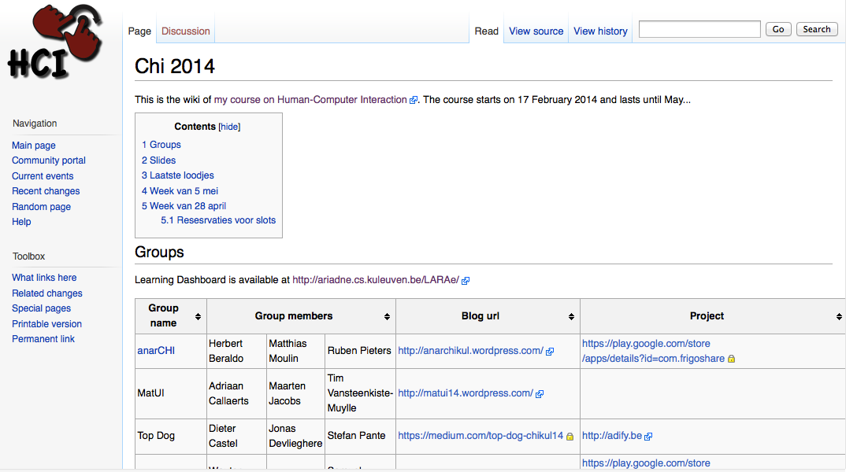

Slide 5
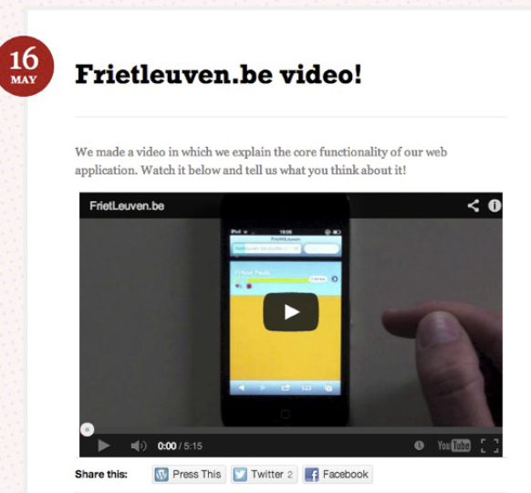

Slide 6
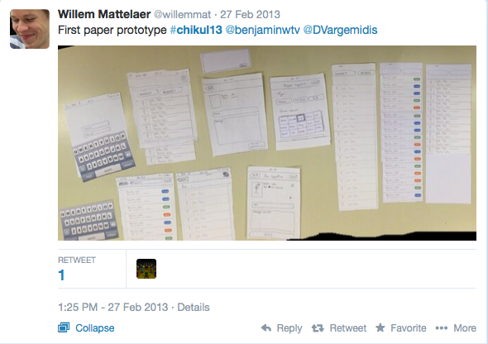

Slide 7
OPEN Analytics

Slide 8
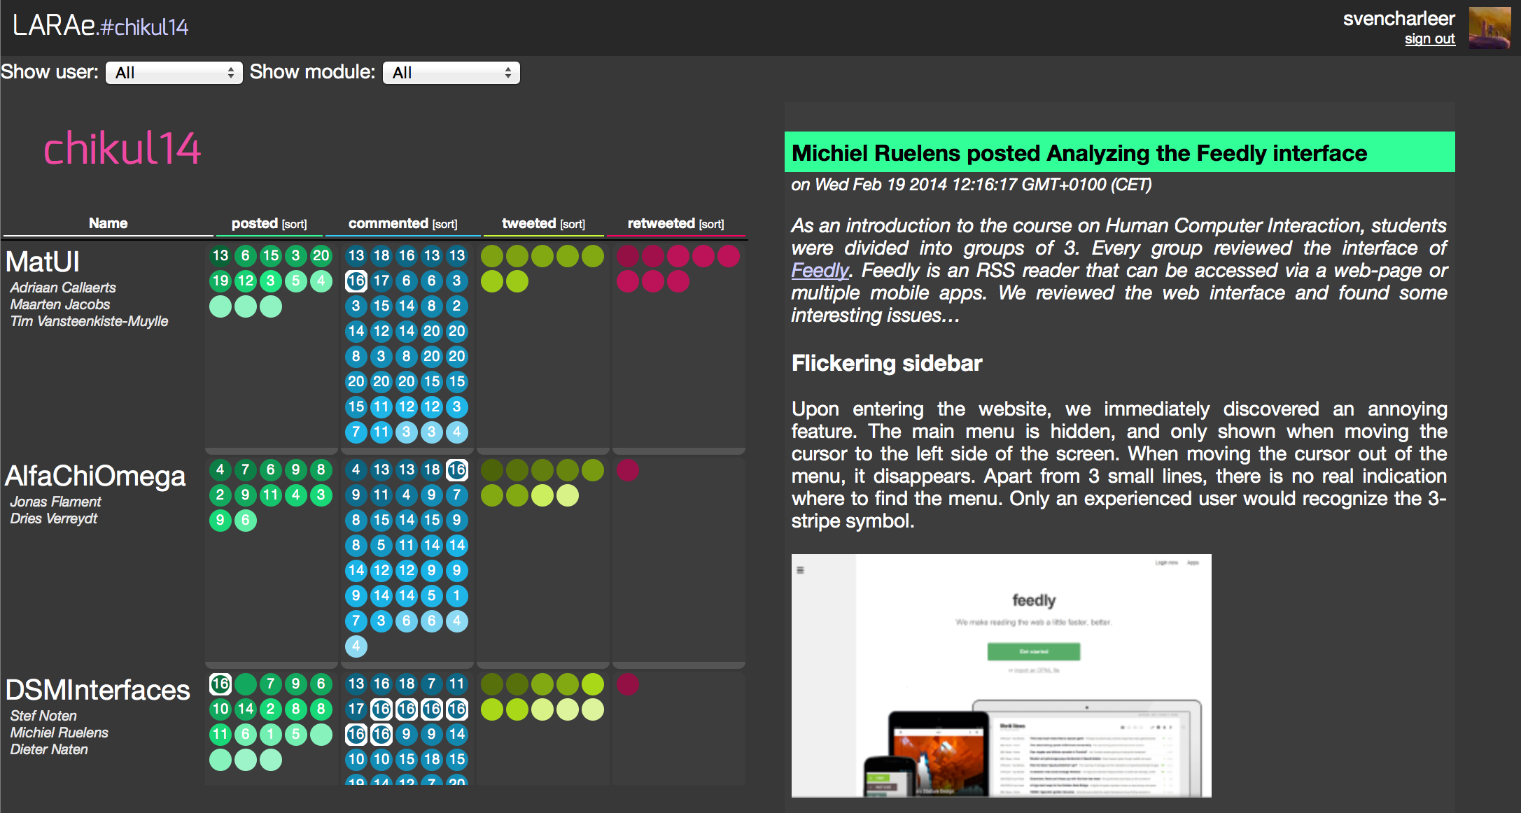
￼
http://ariadne.cs.kuleuven.be/LARAe/
ARTEL 2014 . Graz, Austria

Slide 9
OPEN ACCREDITATION

Slide 10
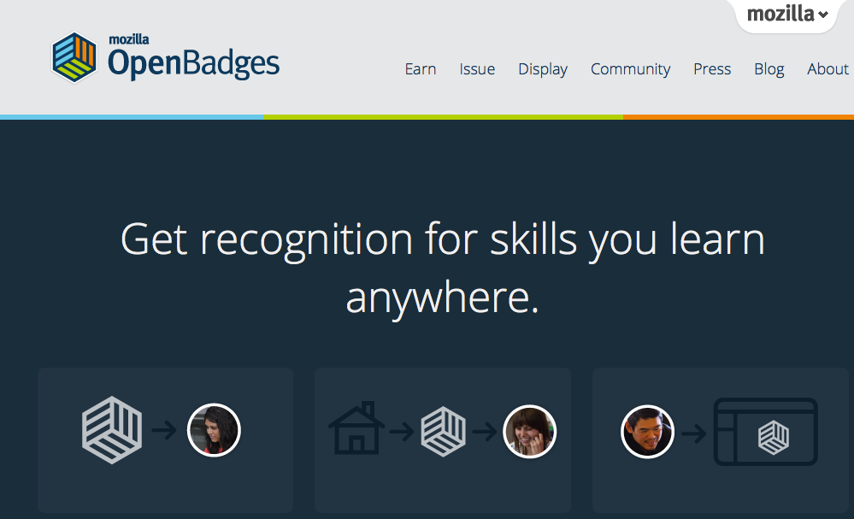
http://openbadges.org/
Notes:
a new online standard to recognize and verify learning
Get recognition for the things you learn;
We researched the use of open badges for increasing motivation.

Slide 11
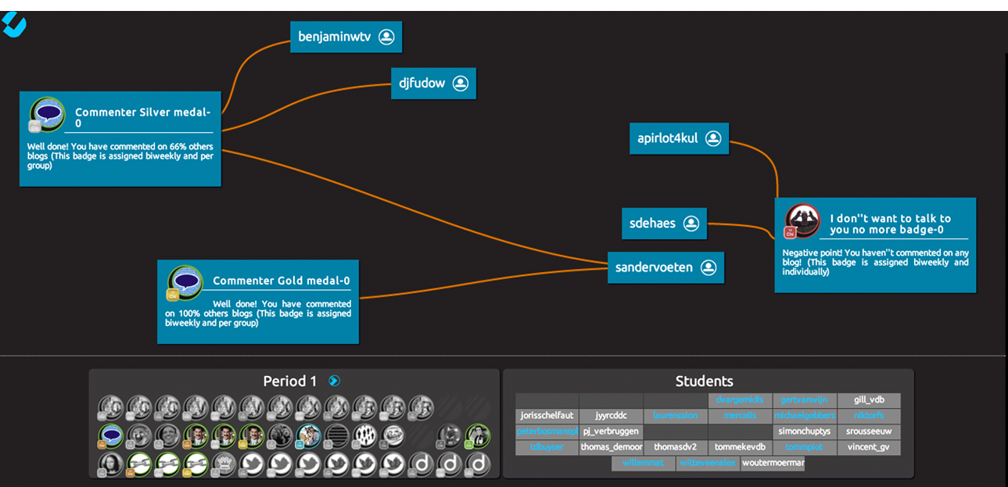
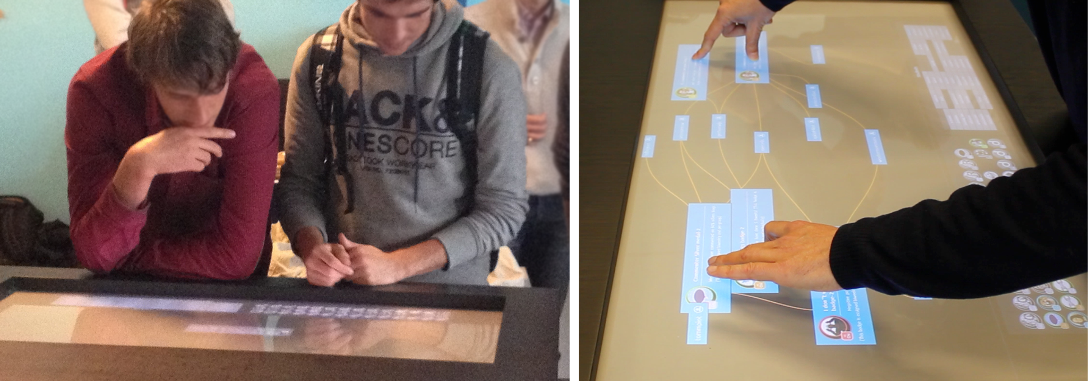
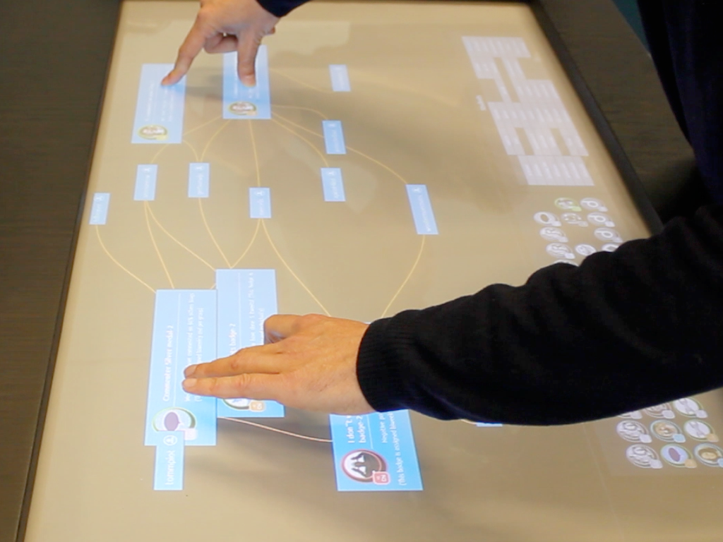
Charleer, S., Klerkx, J., Santos, J. L., & Duval, E. Improving awareness and reflection through collaborative, interactive visualizations of badges. In Proceedings of the 3rd Workshop on Awareness and Reflection in Technology-Enhanced Learning, pages 69-81. CEUR Workshop Proceedings, 2013
￼
ARTEL 2013
ARTEL 2014 . Graz, Austria

Slide 12
OPEN DATA

Slide 13
http://bit.ly/datatel

Slide 14
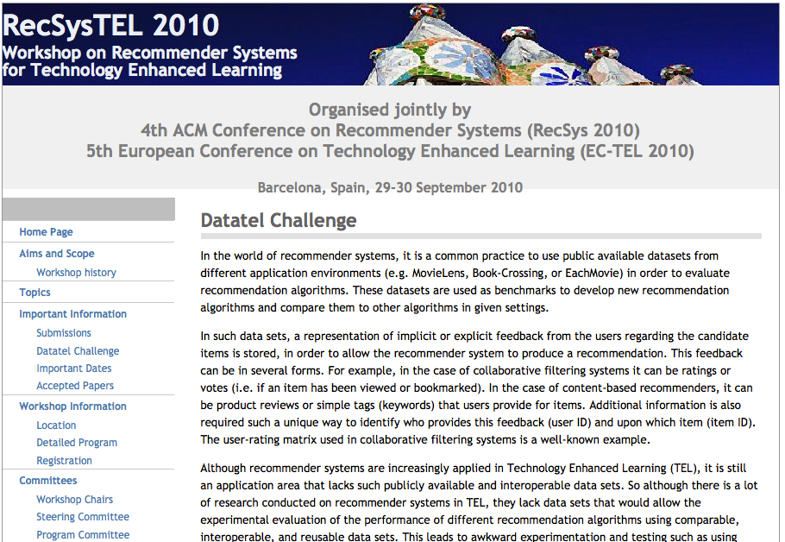

Slide 16
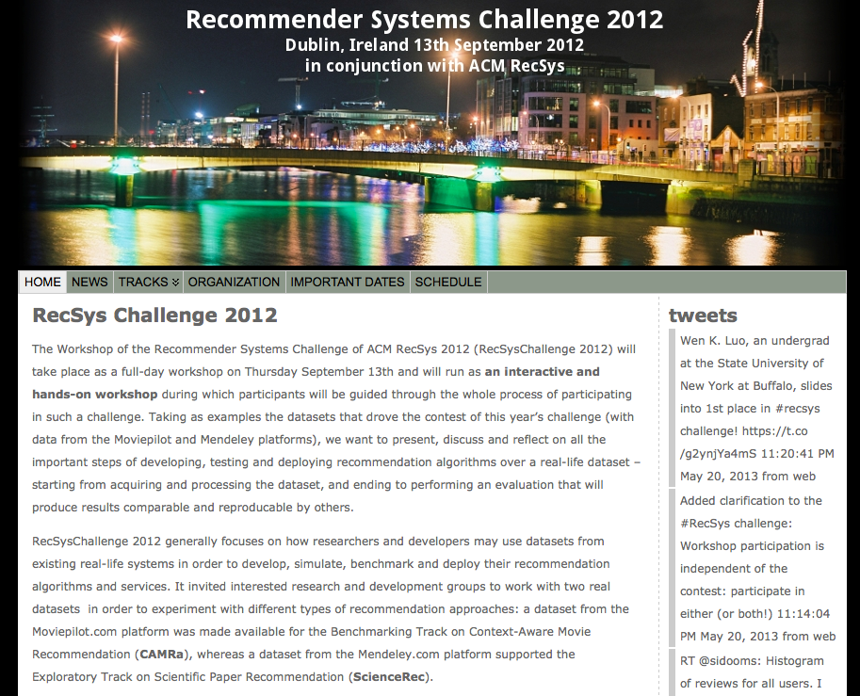
http://recsys.acm.org/2012/

Slide 17
In summary
Open content
Open learning
Open analytics
Open accreditation
Open data

Slide 18
Ensuring the Future: Open Culture
Creative Commons Licenses without commercial restrictions
Independence from the interface
Educating academics
Engaging the general public
Making Open Culture sustainable

Slide 19
CC Without Commercial Restrictions
It truly ensures the long-term survival of the data:
by allowing its modification in any context
by permitting derivative works
by encouraging commercial development and exploitation

Slide 20
Independence of the Interface
Raw data deposited in institutional repositories
Made truly available to anyone for any purposes

Slide 21
Educating academics
Highlighting benefits
Developing reliable versioning systems
Encouraging a culture of acknowledgment

Slide 22
Engaging the General Public
Through participative projects (crowdsourcing)
By developing products with practical uses

Slide 23
Making Open Culture Sustainable
Thinking of ways in which commercial entities can take advantage of the raw data
Encouraging data use for both commercial and non-commercial projects
Remember “Information wants to be free” refers to “free” as in “freedom,” not “free” as in “gratis.”

Slide 24
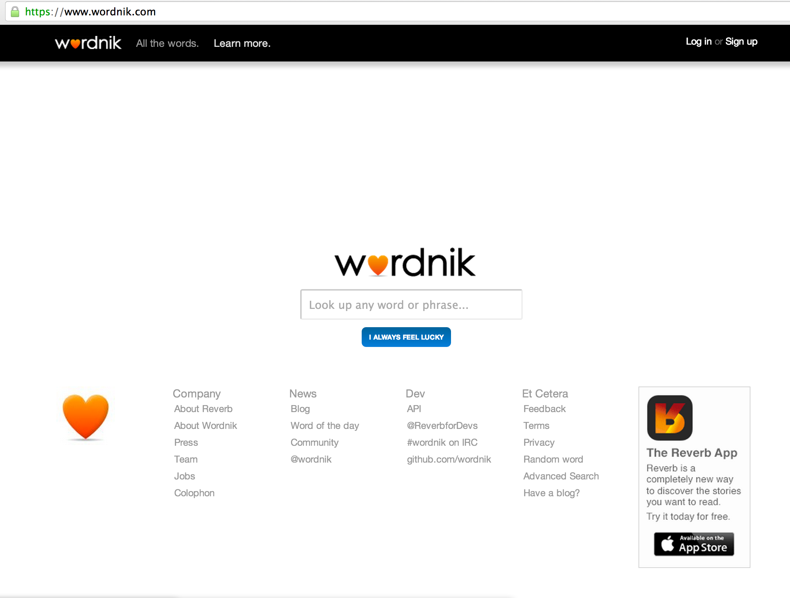

Slide 25
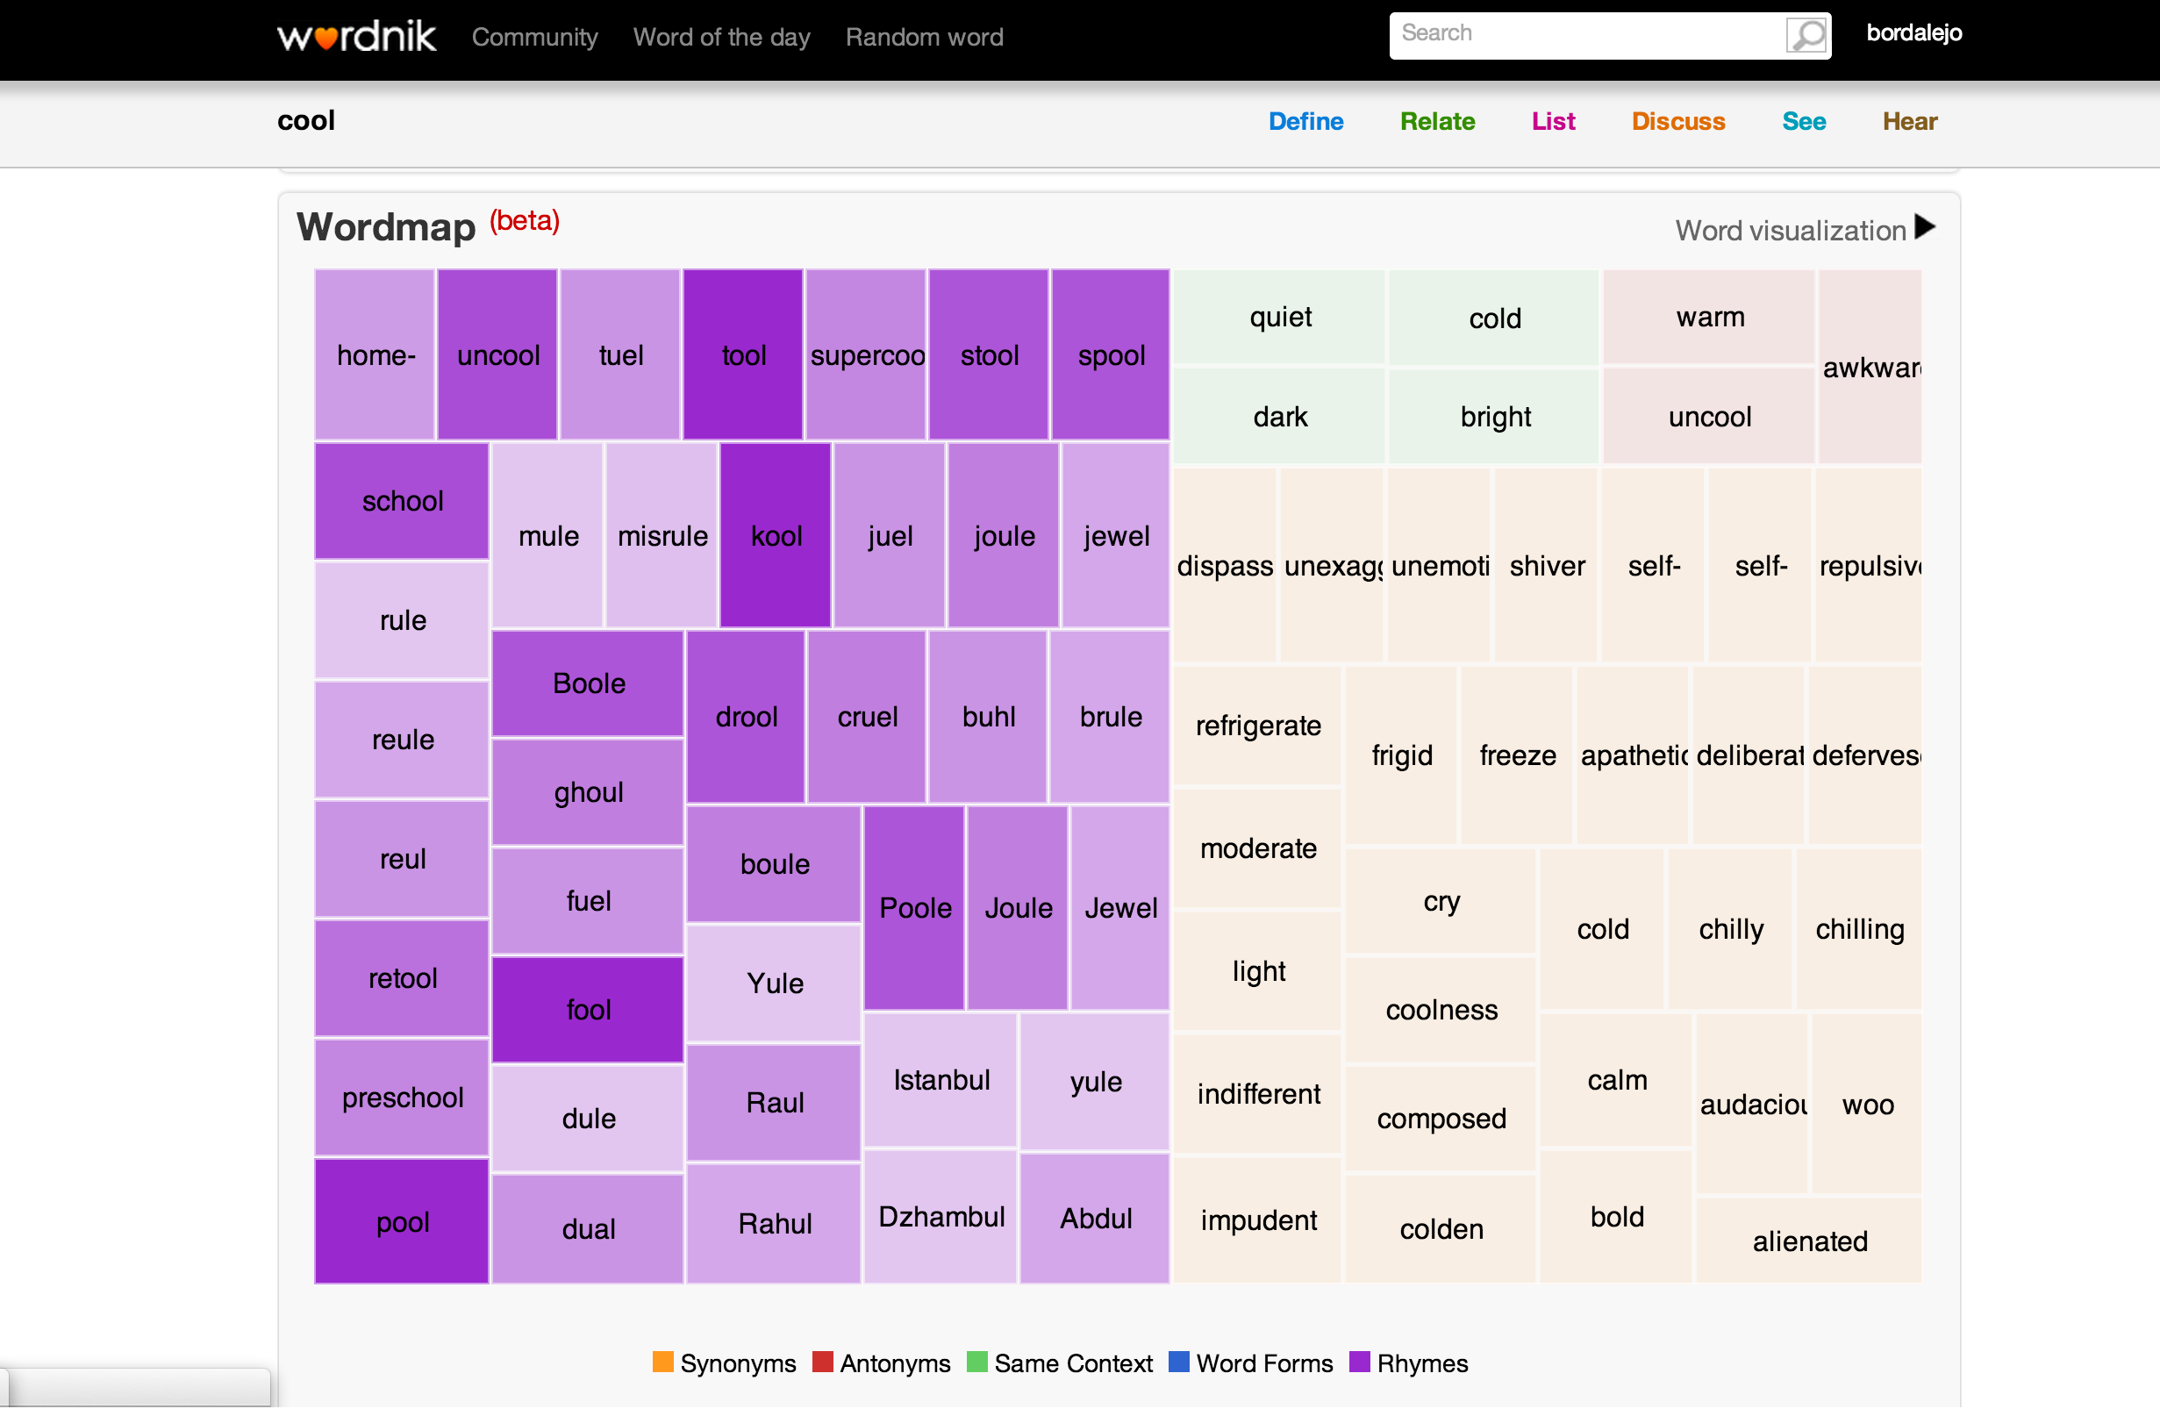

Slide 26
Thank you!
Boostcamp Open Science Leuven
24 October 2014
Boostcamp Open Science Leuven
24 October 2014
Katrien Verbert
HCI research group - KU Leuven
@katrien_v
Barbara Bordalejo
Faculty of Arts - KU Leuven
@TextualScholar, @bordalejo
Katrien Verbert
HCI research group - KU Leuven
@katrien_v
Barbara Bordalejo
Faculty of Arts - KU Leuven
@TextualScholar, @bordalejo

