Slide 1
Research Data Management Services at Royal Holloway
Dr Dace Rozenberga, Research Information Manager
dace.rozenberga@royalholloway.ac.uk

Slide 2
Definition of Research Data
“
Research data is the recorded information (regardless of the form or the media) necessary to support or validate a research project’s observations, findings or outputs.
The effective and efficient management of research data is fundamental to high quality research and academic integrity.
”
Royal Holloway Research Data Management Policy

Slide 3
Why Research Data Management?
“
Royal Holloway acknowledges its obligations to its research funders, the research community and the wider public to ensure that the management of research data is not only effective and efficient but also complies with the generally accepted principles of open access: that research data is a public good produced in the public interest and should be made freely and openly available with as few restrictions as possible in a timely and responsible manner.
”
Royal Holloway Research Data Management Policy

Slide 4
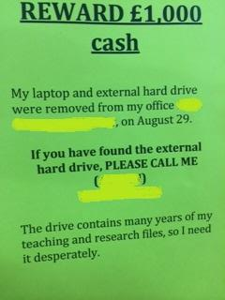
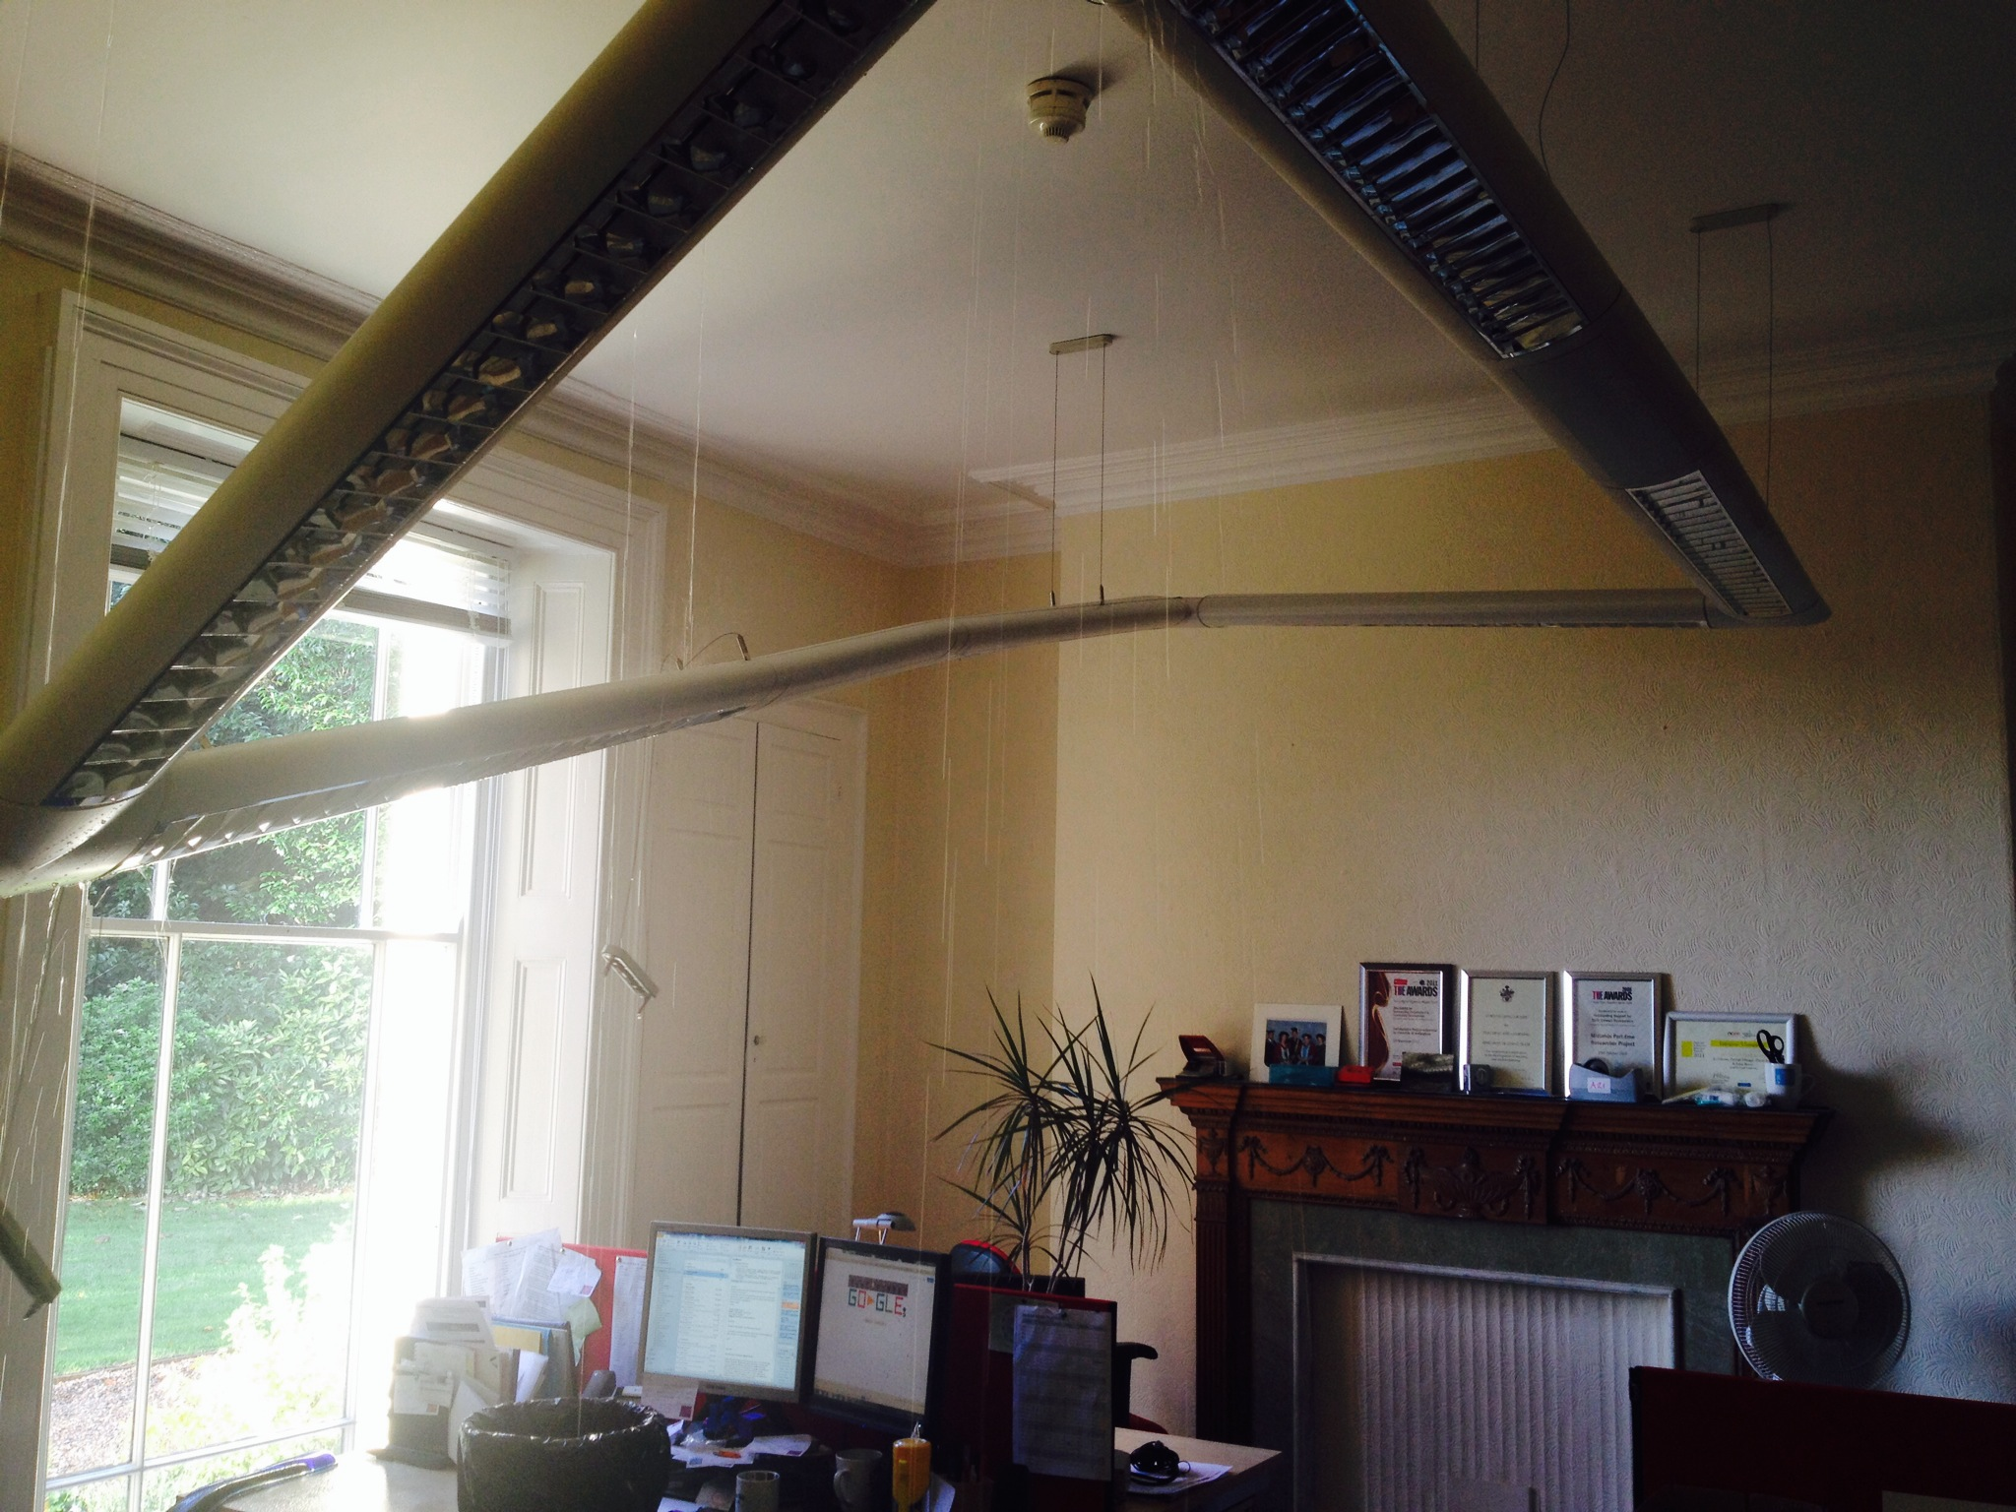
Why Research Data Management?
Photo by L.Horton
Photos by T.Parsons

Slide 5
Survey of Research Data Management Practices
Principal storage medium:
Hard drive on laptop / netbook – 102 (60%)
Hard drive on campus computer – 90 (53%)
No security measures applied to data storage – 52 (31%)
Main requirements regarding RDM support:
Advice and training
Storage

Slide 6
Research Data Management Stages
1. Plan
2. Create
3. Preserve

Slide 7
Stage 1: Plan
A good data management plan (DMP) is fundamental
Consider all aspects of data management before starting data creation
Use the DCC online tool DMPOnline
Help is available from R&E, Library Services and IT

Slide 8
Stage 2: Create data
As you create your data, implement your DMP!
Store and back-up your data safely – Y: drive (10GB), N: drive
Enable access for research partners via OneDrive (1TB)
Publish “as you go” information about research data – easy to do through Pure

Slide 9
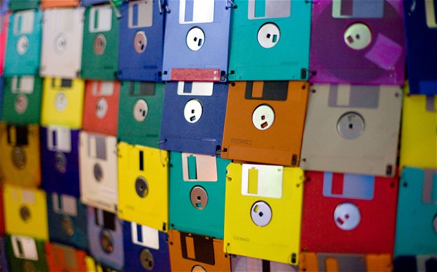
Stage 3: Preserve data
As your project comes to an end, continue to implement your DMP!
Be selective and document your data well
Deposit your research data in a suitable location, ensuring safe, accessible, long term storage
Support will be available from Library Services

Slide 10
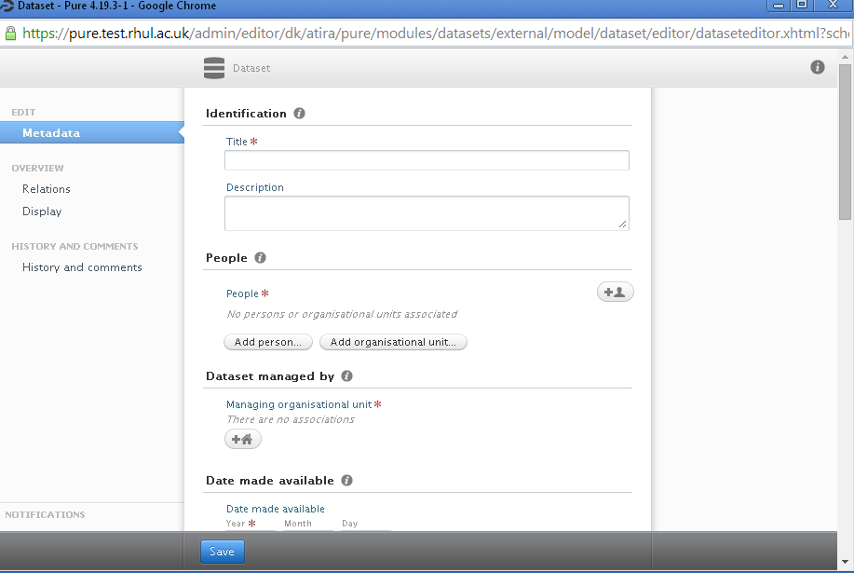
Research Data Management Services
Website & RDM@royalholloway.ac.uk
Customised DMP Online template
College’s data storage and sharing services
Research data records in Pure
Training for staff and PhD students

Slide 11
Sources
Slide 4: Photos by L.Horton (poster), T.Parsons
Slide 7: http://rtbconsulting.biz/blog/
Slide 8: http://www.mindmapart.com/create-mind-map-paul-foreman/
Slide 9: http://www.telegraph.co.uk/science/10553626/Can-DNA-reign-supreme-in-the-digital-dark-age.html
Slide 10: DMPOnline logo from https://dmponline.dcc.ac.uk/

Slide 12
To be continued…
Any questions?

