Slide 1
Facilitate Open Science Training for European Research
Martin Donnelly
Digital Curation Centre
University of Edinburgh
Open Access week training event
Royal Holloway University of London
22 October 2014

Slide 2

Facilitate Open Science Training for European Research
“Research Data Management: Policies and Plans (and Best Practices)”
OVERVIEW
1. Definitions
  Research Data (Management)
  Types of RDM activities
2. Drivers, including funder policies
3. Focus on Data Management Planning
4. Best Practices for RDM
5. About the FOSTER project

Slide 3
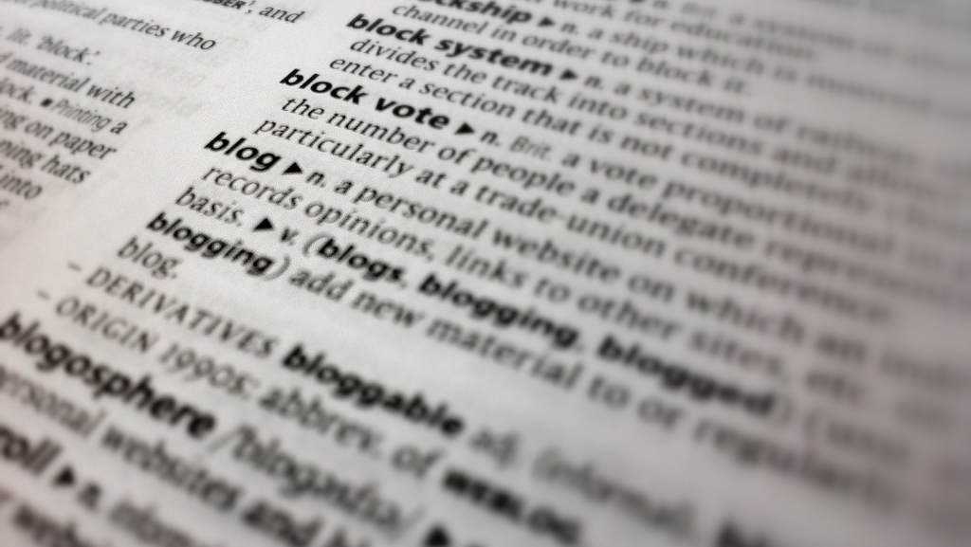
1. DEFINITIONS
Notes:
Slide 3 (Definitions) – http://www.flickr.com/photos/dougbelshaw/

Slide 4
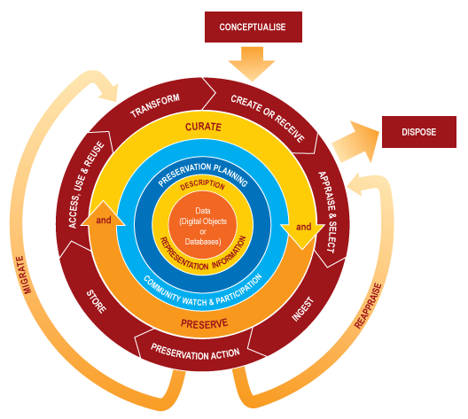
What is RDM? A definition…
“the active management and appraisal of data over the lifecycle of scholarly and scientific interest”

Slide 5
What sort of activities?
Planning and describing data-related work before it takes place
Documenting your data so that others can find and understand it
Storing it safely during the project
Depositing it in a trusted archive at the end of the project
Linking publications to the datasets that underpin them
Data management is a part of good research practice.
- RCUK Policy and Code of Conduct on the Governance of Good Research Conduct

Slide 6
Okay, but what is ‘data’ exactly?
Definitions vary from discipline to discipline, and from funder to funder
Here’s a science-centric definition:
  “Research data is defined as recorded factual material commonly retained by and accepted in the scientific community as necessary to validate research findings” (EPSRC policy framework on research data)
And another from the visual arts:
  “Evidence which is used or created to generate new knowledge and interpretations. ‘Evidence’ may be intersubjective or subjective; physical or emotional; persistent or ephemeral; personal or public; explicit or tacit; and is consciously or unconsciously referenced by the researcher at some point during the course of their research.”
  (Leigh Garrett, KAPTUR project: see http://kaptur.wordpress.com/2013/01/23/what-is-visual-arts-research-data-revisited/)

Slide 7
Goodbye data, hello research objects?
“Research object” is a term that is gaining in popularity, not least in the humanities where the relevance of the term ‘data’ is not always recognised…
Research objects can comprise any supporting material which underpins or otherwise enriches the (written) outputs of research
  Data (numeric, written, audiovisual….)
  Software code
  Workflows and methodologies
  Slides, logs, lab books, sketchbooks, notebooks, you name it!
See http://www.researchobject.org/ for more info

Slide 8
Helicopter view: What are the benefits of active RDM?
TRANSPARENCY: The evidence that underpins research can be made open for anyone to scrutinise, and attempt to replicate findings.
EFFICIENCY: Data collection can be funded once, and used many times for a variety of purposes.
RISK MANAGEMENT: A pro-active approach to data management reduces the risk of inappropriate disclosure of sensitive data, whether commercial or personal.
PRESERVATION: Lots of data is unique, and can only be captured once. If lost, it can’t be replaced.

Slide 9
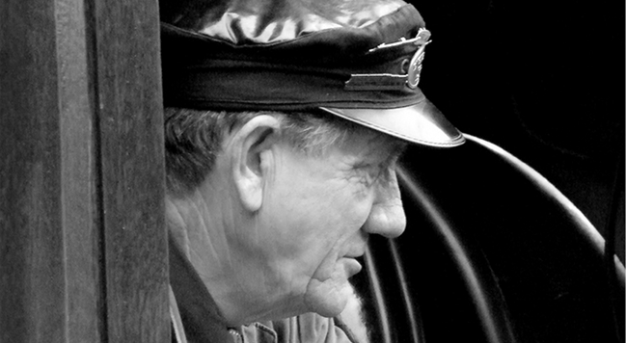
2. DRIVERS FOR RDM
  Technological developments
  Value for money / Return on investment
    Government
    Research funders
  Risk management
  Transparency, integrity and good scholarly practice
Notes:
Slide 9 (Drivers) – http://www.flickr.com/photos/rpmarks/

Slide 10
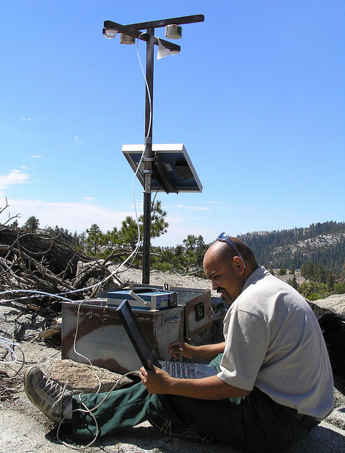
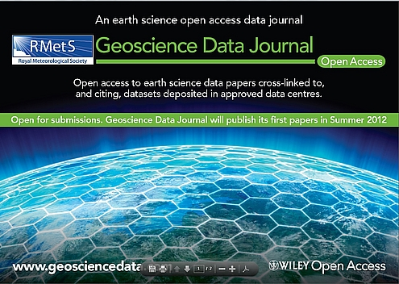
Technology
Developments in sensor technology, networking and digital storage enable new research and scientific paradigms
As costs also fall, possibilities for data sharing, citation and re-use become much more widespread
Journals dedicated solely to publishing data have even started to appear. That’s not to say it’s an entirely new thing: journals have always published data, just never before at such scale…

Slide 11

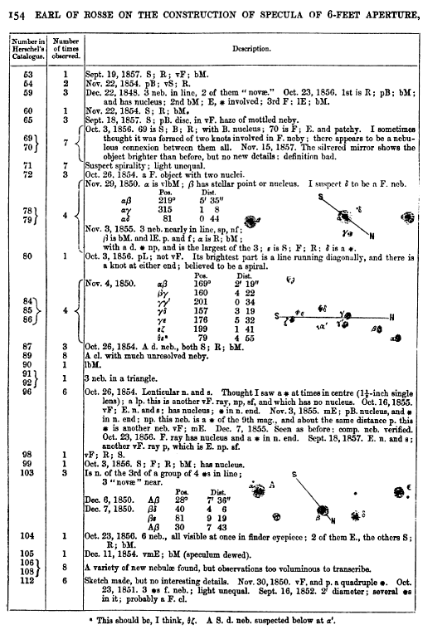
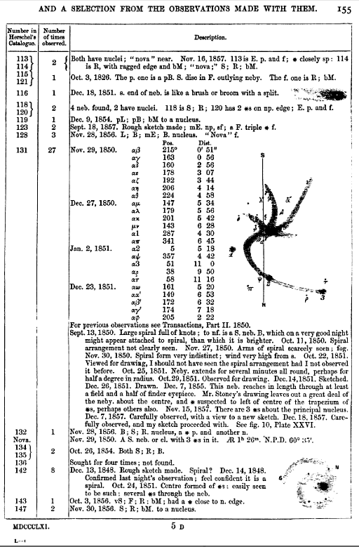
Rosse
from Philosophical Transactions of the Royal Society, (MDCCCLXI) (or 1861 if you’d prefer)

Slide 12

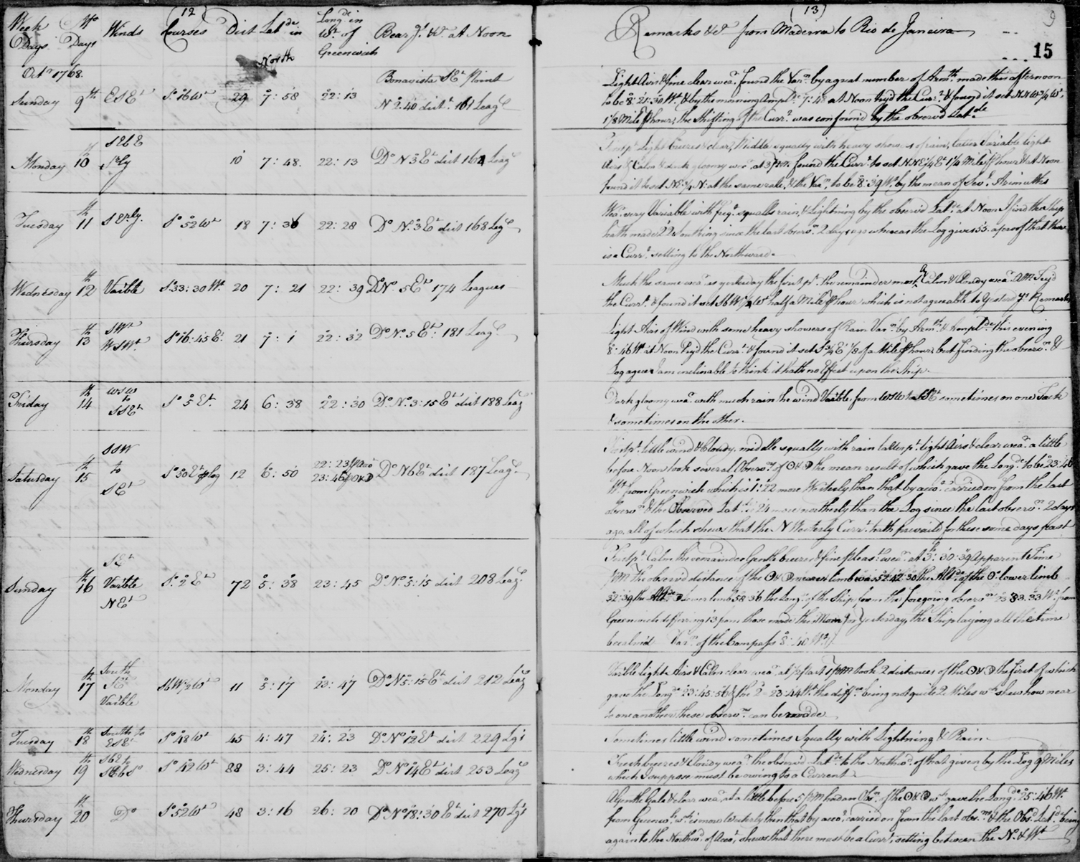
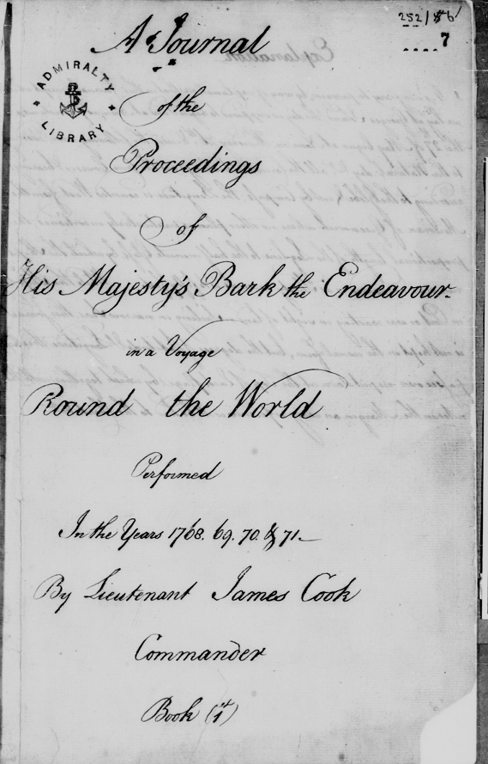
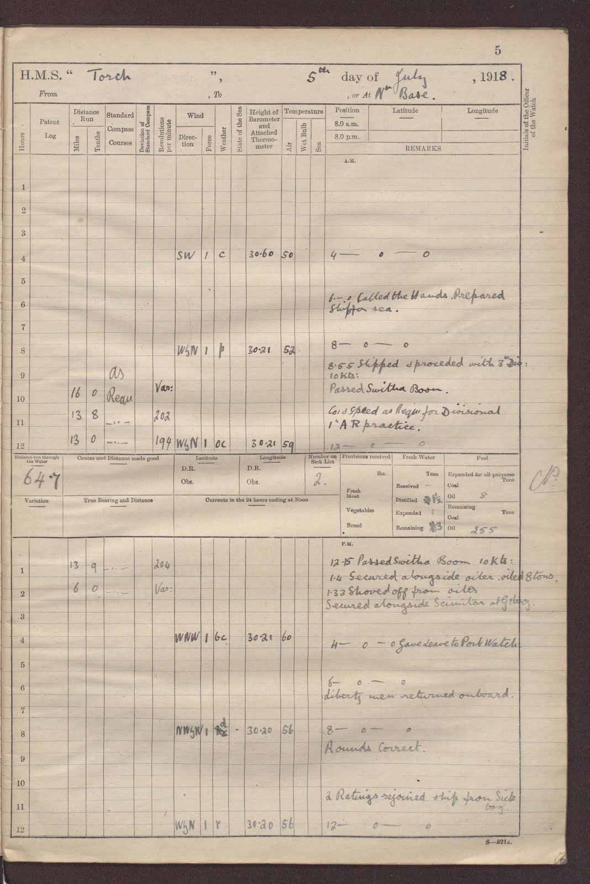
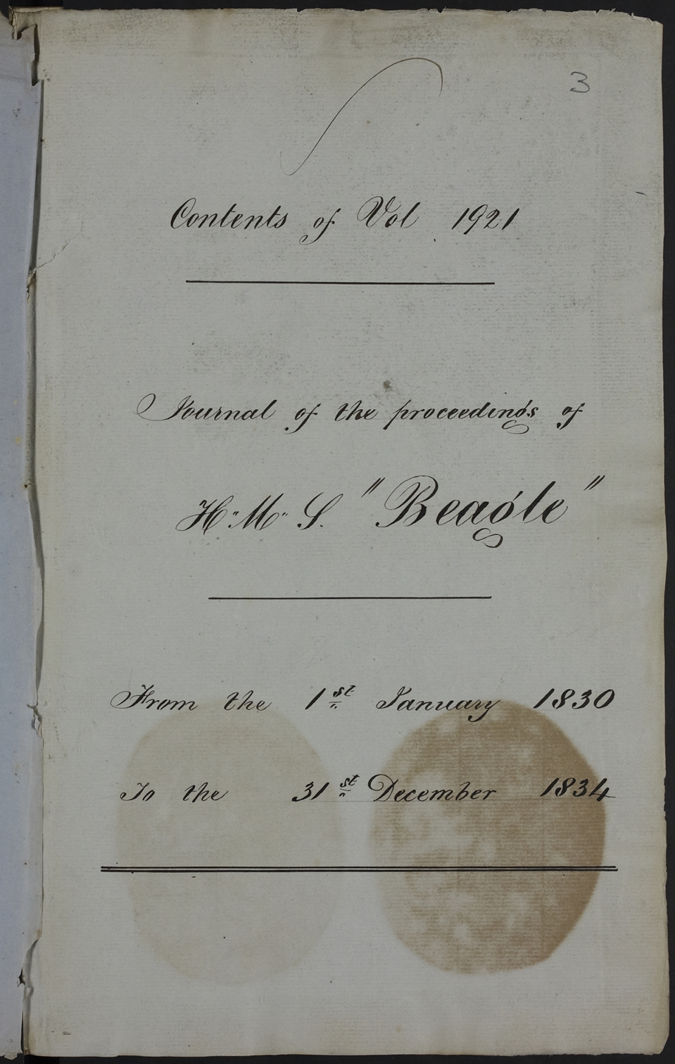
Repurposing / VfM via data re-use
Ships’ log books build picture of climate change 14 October 2010
You can now help scientists understand the climate of the past and unearth new historical information by revisiting the voyages of First World War Royal Navy warships.
Visitors to OldWeather.org will be able to retrace the routes taken by any of 280 Royal Navy ships. These include historic vessels such as HMS Caroline, the last survivor of the 1916 Battle of Jutland still afloat. By transcribing information about the weather and interesting events from images of each ship's logbook, web volunteers will help scientists build a more accurate picture of how our climate has changed over the last century.
http://www.nationalarchives.gov.uk/news/503.htm
Detail from Royal Navy Recruitment poster, RNVR Signals branch, 1917 (Catalogue reference: ADM 1/8331)
Endeavour, 1768-71 (Captain Cook)
HMS Beagle, 1830-34
HMS Torch, 1918

Slide 13
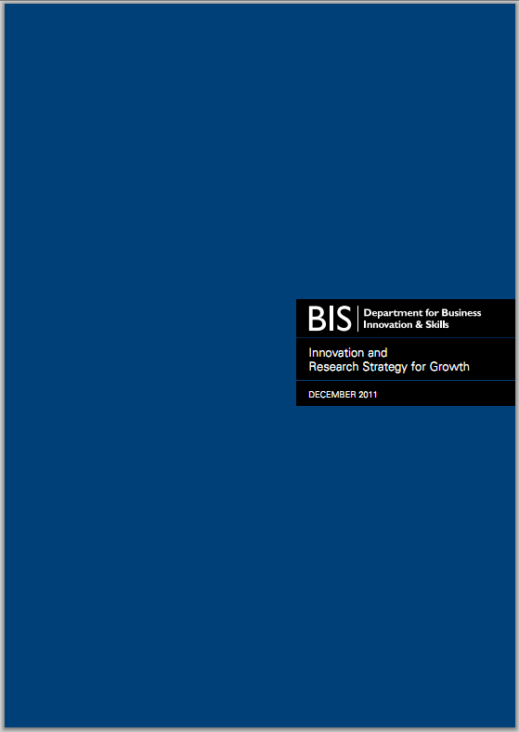
Government pressure/support
6.9 The Research Councils expect the researchers they fund to deposit published articles or conference proceedings in an open access repository at or around the time of publication. But this practice is unevenly enforced. Therefore, as an immediate step, we have asked the Research Councils to ensure the researchers they fund fulfil the current requirements. Additionally, the Research Councils have now agreed to invest £2 million in the development, by 2013, of a UK ‘Gateway to Research’. In the first instance this will allow ready access to Research Council funded research information and related data but it will be designed so that it can also include research funded by others in due course. The Research Councils will work with their partners and users to ensure information is presented in a readily reusable form, using common formats and open standards.
http://www.bis.gov.uk/assets/biscore/innovation/docs/i/11-1387-innovation-and-research-strategy-for-growth.pdf

Slide 14
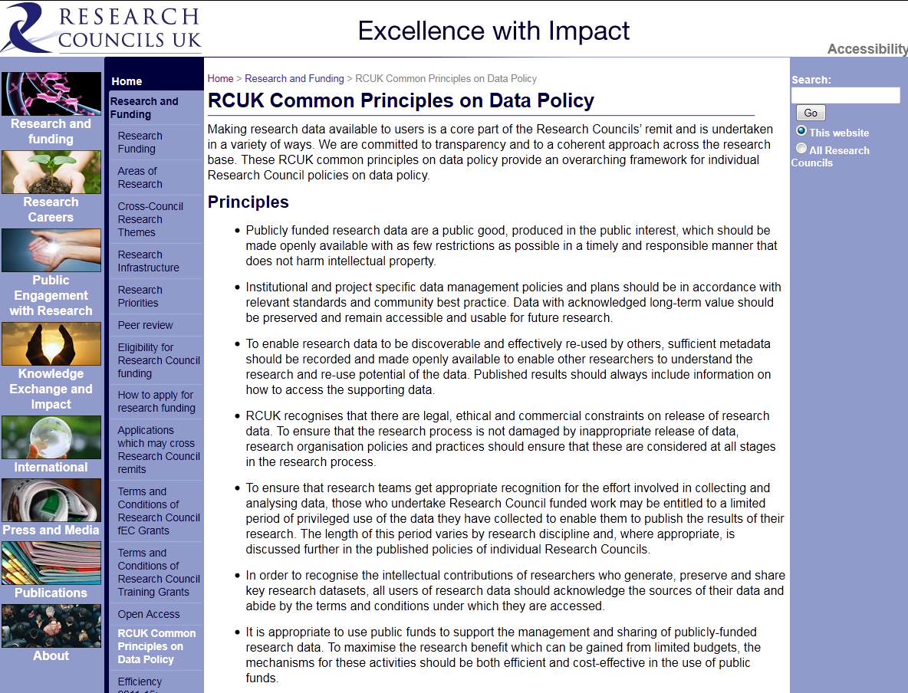
Funder principles/expectations
Public good
Preservation
Discovery
Confidentiality
First use
Recognition
Public funding
Six of the seven RCUK councils require data management plans (or equivalent), as do Wellcome Trust, Cancer Research UK, EC, and more…

Slide 15
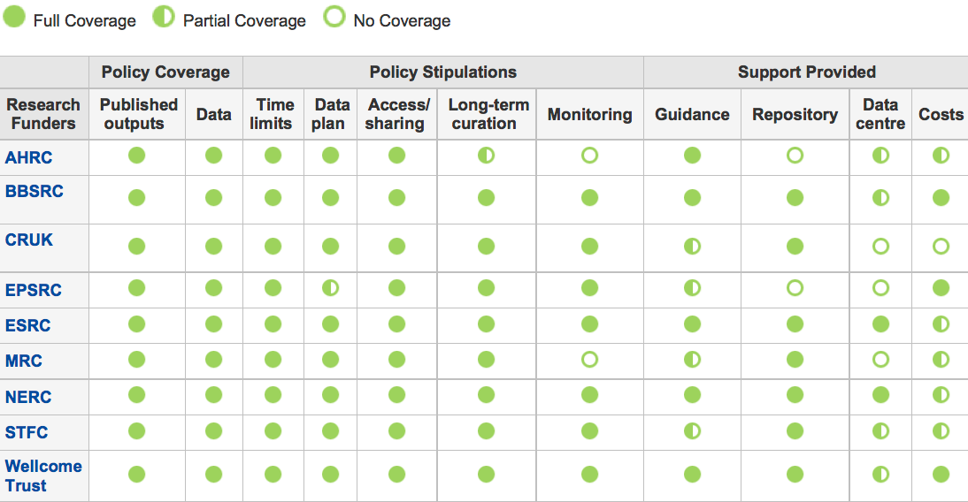
UK funder policies overview
http://www.dcc.ac.uk/resources/policy-and-legal/overview-funders-data-policies

Slide 16
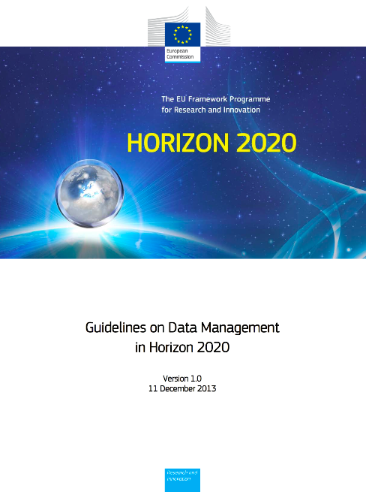
Horizon 2020
Horizon 2020 includes a data management planning pilot, spanning three phases
  http://ec.europa.eu/research/participants/data/ref/h2020/grants_manual/hi/oa_pilot/h2020-hi-oa-data-mgt_en.pdf
All project proposals submitted to “Research and Innovation actions” as well as “Innovation actions” should include a section on research data management which is evaluated under the criterion ‘Impact’
Where relevant, applicants must provide a short, general outline of their policy for data management, including the following issues:
  What types of data will the project generate/collect?
  What standards will be used?
  How will this data be exploited and/or shared/made accessible for verification and re-use? If data cannot be made available, explain why.
  How will this data be curated and preserved?
A detailed description and scope of the Open Research Data Pilot requirements is provided on the Participants Portal

Slide 17
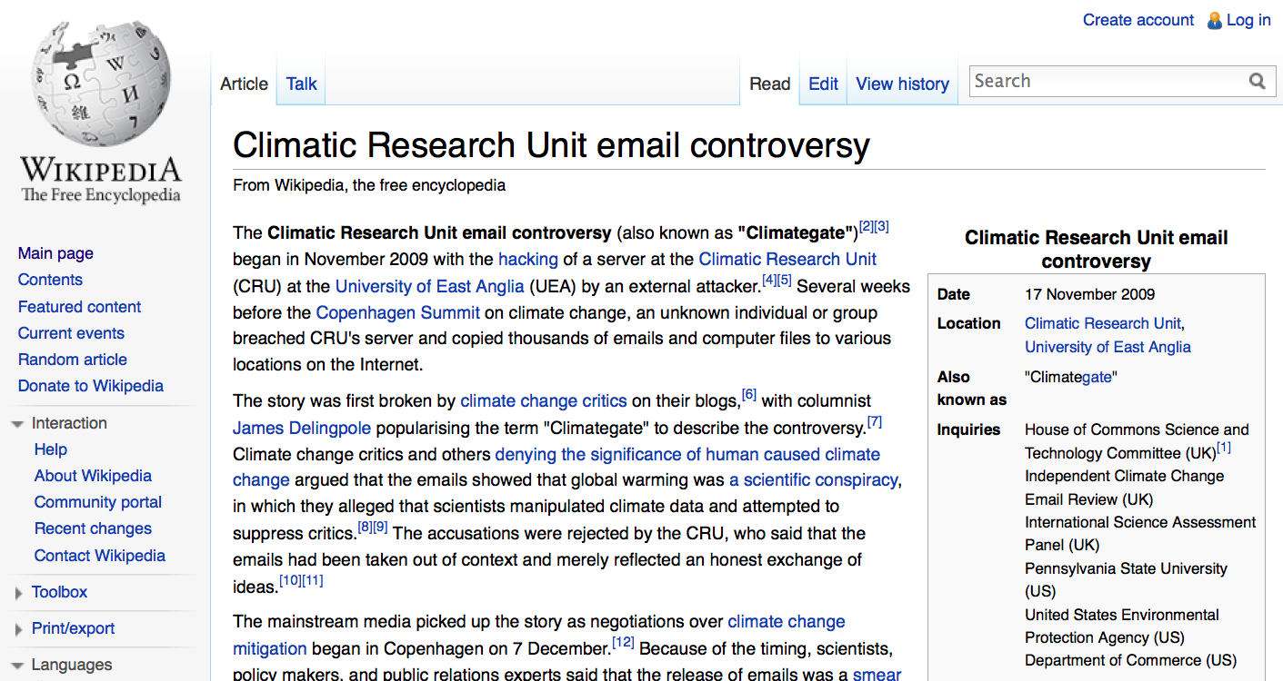
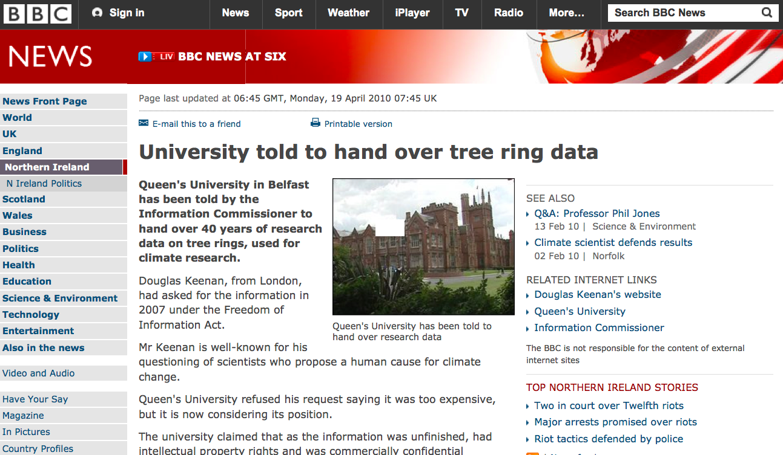
Risk management
Controversial FOI requests to…
University of East Anglia
Queens University Belfast
University of Stirling

Slide 18
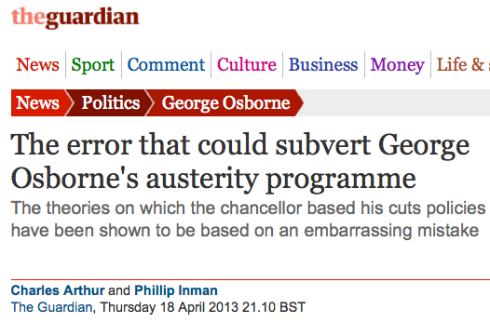
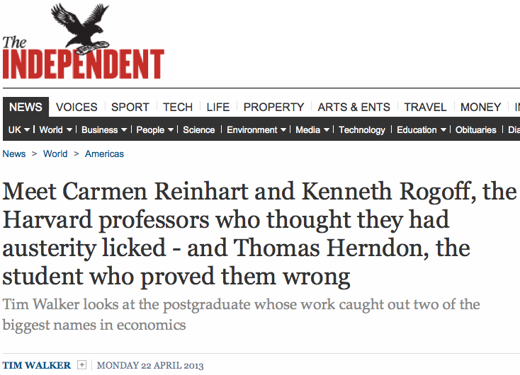
Research quality and integrity
Reinhart & Rogoff (2010) “Growth in a Time of Debt” - paper not peer-reviewed, data not initially made available…
Very influential and repeatedly cited by politicians to lend weight to economic strategy
Multiple issues (selective exclusions, unconventional weightings, coding error) identified by a postgrad researcher attempting to replicate the paper’s findings
Widespread embarrassment, but at least the errors were discovered!

Slide 19
3. FOCUS ON DATA MANAGEMENT PLANNING (DMP)
Data management planning is the process of planning, describing and communicating the activities carried out during the research lifecycle in order to…
  Keep sensitive data safe
  Maximise data’s reuse potential
  Support longer-term preservation
Research funders (and other bodies) often ask for a short statement/plan to be submitted alongside grant applications. HEIs increasingly ask their researchers to do this too.
In general, they want to know:
  What kinds of data will be created, and how
  How will the data be documented and described?
  Are there ethical or Intellectual Property issues?
  What are the arrangements for data sharing and reuse?
  What is the strategy for longer-term preservation?
But they all have different requirements and emphases, and express them in different ways…

Slide 20
DMP requirements / expectations
6 of the 7 RCUK councils require data management plans at the application stage
  NERC also expect an expanded DMP during the project, prepared in collaboration with the appropriate NERC data centre
  EPSRC don’t require DMPs to be submitted to them, but do expect them to be created and maintained
Other major funders such as Cancer Research UK and the Wellcome Trust also require DMPs
Successful Horizon 2020 projects (within the pilot areas) must produce three iterations of a DMP: one within 6 months of award, one midway through, and one at end of project

Slide 21
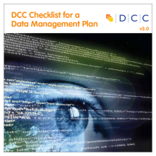
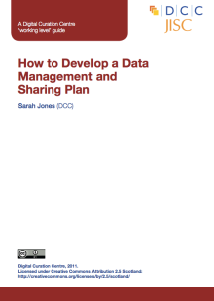
DMP resources
Guidance, e.g. “How-To Develop a Data Management and Sharing Plan”
DCC Checklist for a Data Management Plan: http://www.dcc.ac.uk/resources/data-management-plans/checklist
DMPonline: https://dmponline.dcc.ac.uk/
Links to all DCC DMP resources via http://www.dcc.ac.uk/resources/data-management-plans
Book chapter
  Donnelly, M. (2012) “Data Management Plans and Planning”, in Pryor (ed.) Managing Research Data, London: Facet

Slide 22
4. BEST PRACTICES FOR RDM
DO | DON’T
Have a plan for your data | Make it up as you go along
Keep backups. Make this easy with automated syncing services like Dropbox, provided your data isn’t too sensitive | Carry the only copy around on a memory card, your laptop, your phone, etc
Describe your data as you collect it. This makes it possible for others to understand it, and for you to do the same a few years down the line | Leave this till later. The quality of metadata decreases with time, and the best metadata is created at the moment of data capture
Save your work in open file formats, where possible, and use accepted metadata standards to enable like-with-like comparison | Invent new ‘standards’ where community norms already exist
Deposit your data in a data centre or repository, and link it to your publications | Be afraid to ask for help. This will exist both within your institution, and via national support organisations like the DCC
Notes:
Take home messages

Slide 23
5. ABOUT THE FOSTER PROJECT
Facilitate Open Science Training for European Research

Slide 24
Facilitate Open Science Training for European Research
OBJECTIVES
Support different stakeholders, especially young researchers, in adopting open access in the context of the European Research Area (ERA) and in complying with the open access policies and rules of participation set out for Horizon 2020;
Integrate open access principles and practice in the current research workflow by targeting the young researcher training environment;
Strengthen the institutional training capacity to foster compliance with the open access policies of the ERA and Horizon 2020 (beyond the FOSTER project);
Facilitate the adoption, reinforcement and implementation of open access policies from other European funders, in line with the EC’s recommendation, in partnership with PASTEUR4OA project.

Slide 25
Facilitate Open Science Training for European Research
METHODS
Identifying already existing contents that can be reused in the context of the training activities and repackaging, reformatting them to be used within FOSTER, and develop/create/ enhance contents if/where they are needed.
Creation of the FOSTER Portal to support e-learning, blended learning, self-learning, dissemination of training materials/contents and Helpdesk.
Delivery of face-to-face training, especially training trainers/multipliers that can carry on further training and dissemination activities, within their institutions, countries or disciplinary communities.

Slide 26
THANK YOU
Martin Donnelly
Digital Curation Centre
University of Edinburgh
martin.donnelly@ed.ac.uk
Twitter: @mkdDCC
www.fosteropenscience.eu

