Slide 1
Webinar
Sectorial Variation of RRI and OS
18 June 2019
Harro van Lente, Maastricht University (UM), Netherlands

Slide 2
Key Questions
How do RRI-related dynamics vary across sectors, national contexts and other contextual factors?
How to understand the level of variability and the factors producing such a variability?

Slide 3
Five analytical interests
General trends
What is happening to RRI/OS or related phenomena in the different disciplinary and research sectors?
Barriers
What are the barriers to RRI/OS or similar concerns in different disciplinary and research sectors? What are the factors producing the science/society gap?
Drivers
What are the drivers of RRI/OS or similar concerns in different disciplinary and research sectors? What are the factors contrasting the gap?
Interests and values
What are the interests and values involved with RRI/OS or similar concerns in different disciplinary and research sectors? What are the interpretations, social recognitions and expectations to RRI/OS?
Experiences
Are there successful experiences of RRI/OS or similar initiatives in different disciplinary and research sectors?

Slide 4
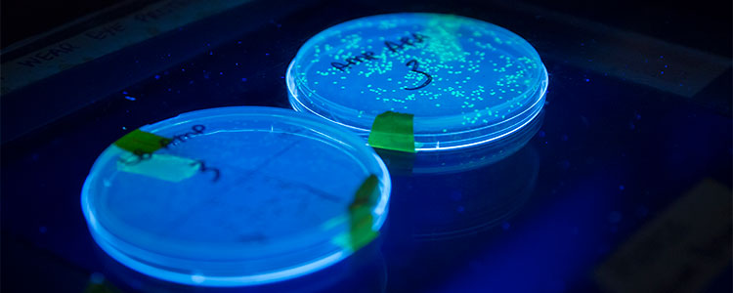
Explored sectors
Sustainable energy
and, if possible, specifically zero-emission innovations for the built environment
Materials science
and, if possible, specifically new coatings
Information and communication technologies
and, if possible, specifically big data
Biotechnology
and, if possible, specifically stem cell research and pilots, and personalised medicine
Photonics
and, if possible, specifically glass fibre technologies and new light-electron chips

Slide 5
Method and steps
Step 1
Literature review of sectors
Promises, concerns, societal engagement
Submitted Month 6
Step 2
National differences in workshops
Norway, Italy, Portugal, Finland, Netherlands
Promises, concerns, societal engagement
More or less according to plan; internally distributed
Conclusion
Integrating Step 1 and Step 2
To be used in WP 3 and 4
Submitted Month 15

Slide 6
Method: Literature Review & Information Gathering
Preparation of an internal note (May 2017)
refinement of the five core technological sectors to be compared
a methodological background for WP2
structure of the literature review and information gathering
Presentation and discussion at Kick-off Meeting (June 2017)
First round of analysis of the literature(May to October 2017)
five core technological sectors
first draft of the Report on the Literature Review
Presentation of the first draft at the Trondheim Meeting (Nov 2017)
alignment of Task 2.1 and Task 2.2 (sectoral workshops)
Second round of analysis (November to December 2017)
review of the text (completed on November 2017)
Development of the final version (December 2017)
submission of the report

Slide 7
Method: Workshops
Refinement of the five core technological sectors (May 2017)
and further refinement of the questions to be explored.
Preparation of the workshop format (July- September 2017)
by NTNU
Testing of the format (Sept - October 2017)
by NTNU in Trondheim
Demonstration of the format at Trondheim Meeting (Nov 2017)
and last refinement
Workshops according to agreed format (Nov 2017-Feb 2018)
in The Netherlands, Portugal, Italy and Finland
Reports of the workshops prepared (March 2018)
and sent to NTNU
Preparation of the Report from Task 2.2 (April 2018)
by NTNU, with input from UH, K&I, UM and CVIVA

Slide 8
Participants in Workshops (excluding the organizers)
43 representatives
from research and industry
five countries
Norway, The Netherlands, Portugal, Italy and Finland
five sectors
Sustainable Energy, Materials, ICT, Biotechnology, Photonics
numbers and diversity
unfit for statistical analysis
fit for revealing challenges and chances for RRI and OS in Research Funding and Performing Organisations (RFPO’s).

Slide 9
Results literature review RRI and OS in different sectors
Sustainable energy (buildings)
still promising and hardly contested
established actors position themselves in the new outlooks
Materials science (new coatings)
societally less visible
RRI and OS enter through research and science policy
ICT (big data)
societal visibility of promise and concern (including big data, AI)
mature sector with industry as highly influential in research
Biotechnology (stem cell and personalised medicine)
longer tradition of discussion about desirability and ethics
distance between research and application differ
Photonics (glass fibre and new light-electron chips)
appears as ingredient of data-driven knowledge society
power asymmetries in digital infrastructures

Slide 10
Results sectorial workshops
National differences in RRI and OS
institutions
national systems of research funding
less differences in views and strategies of participants
Sectorial differences
promises of the research
links to industry
communication with wider public

Slide 11
Sectorial and national variability: other factors
Participants truly care about RRI and OS
But not necessarily in the same language
Many challenges for research
the pressure of economic interests
Many, different suggestions for RRI and OS
depending on individual experiences
Ambiguous relationship to industry
important as user, supporter and partner
yet sometimes too directive

Slide 12
General lessons for RRI and OS
Relating to industry
Ambiguous role of industry: helps to connect to society but can be too forceful as well
Public engagement
Go beyond one-way communication (explaining to the public) and connect to other views, concerns and priorities
Target and route
Improving research ethics or connect with views and needs of stakeholders
Timeframes
Short-term (applications) or long-term gains of research and innovation (agendas)
Revolutionary
RRI and OS are not totally new but not business as usual either

