Slide 1
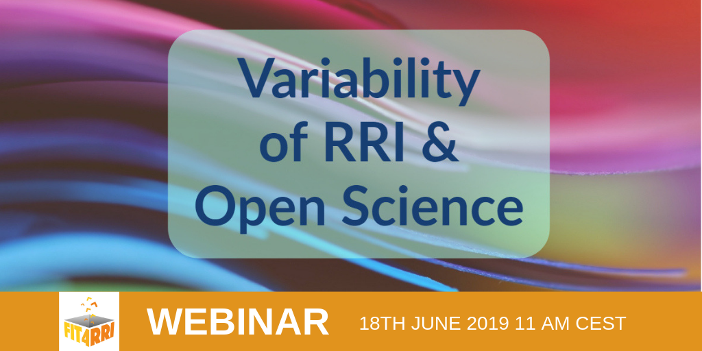

Slide 2
Fostering Improved Training Tools for Responsible Research & Innovation
Helene Brinken
June 18th 2019

Slide 3
Responsible Research & Innovation
Science & technology can create risks & ethical dilemmas
RRI seeks to bring R&I into the open, to anticipate consequences, & to involve society
Societal actors, (e.g. researchers, citizens, policy makers, business, NGOs), work together during the R&I process to better align processes & outcomes with values, needs & expectations of society.
Involve all stakeholders at all levels to minimize potential negative impact of R&I.
www.rri-tools.eu/about-rri
www.fit4rri.eu/project

Slide 4
Responsible Research & Innovation
Many definitions with different focus:
Mutual responsiveness between innovators and social actors (Von Shomberg)
Responsibility for the future impacts of R&I (Owen)
Alignment to R&I process and its outcomes to values, needs and expectations of European society (M. Georhean-Quinn)
Reflexivity on the (moral) acceptability of new technology and innovation (Van den Hoven)
Luciano D’Andrea https://www.fosteropenscience.eu/content/critical-trends-shaping-science-benchmarking-report-fit4rri-project

Slide 5
RRI as umbrella concept
Conceptual dimensions
Diverse & inclusive
Anticipative & reflective
Open & transparent
Responsive & adaptive to change
Key criteria
Gender equality
Ethics
Open access/open science
Science education
Public engagement
Governance
Sustainability
Social justice/inclusion.
www.rri-tools.eu/about-rri
EC 2015: Indicators for promoting and monitoring Responsible Research and Innovation
http://ec.europa.eu/research/swafs/pdf/pub_rri/rri_indicators_final_version.pdf

Slide 6
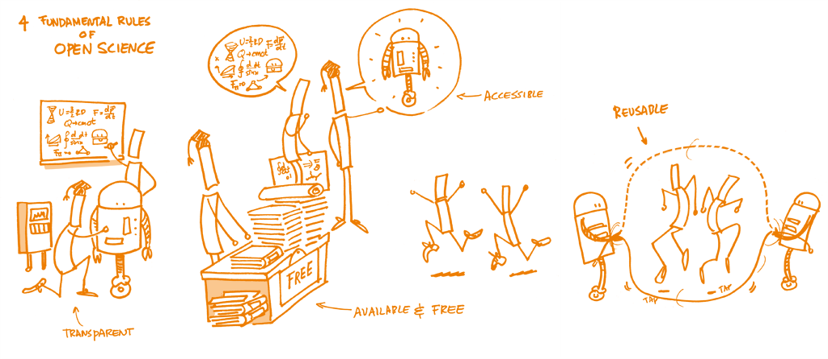
Open Science
Open Science is the practice of science in such a way that others can collaborate & contribute, where research data, lab notes & other research processes are freely available, under terms that enable reuse, redistribution & reproduction of the research & its underlying data & methods.
The movement to make scientific research, data and dissemination accessible to all levels of an inquiring society.
[FOSTER, Open Science Definition https://www.fosteropenscience.eu/taxonomy/term/7]
[FOSTER, Open Science Definition: https://www.fosteropenscience.eu/foster-taxonomy/open-science-definition]
Open Science Training Handbook. https://book.fosteropenscience.eu/

Slide 7
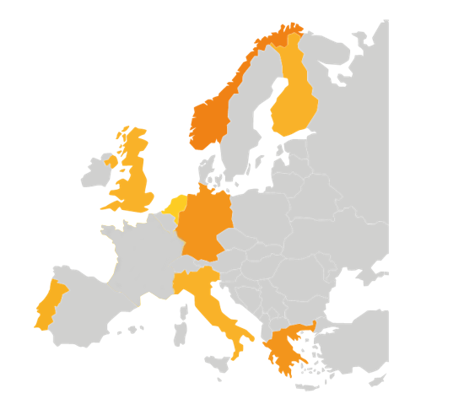
FIT4RRI is intended to help mainstream RRI & OS in RFPOs through transforming them into a set of strategies & means.
The Project

Slide 8
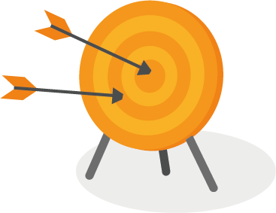
Objectives
The project will act on 2 key factors to bridge the gap and activate institutional changes in RFPOs:
Training
Governance

Slide 9
Context & Approach
Understanding
Promotion & Sharing
Analysis
Trends, barriers, drivers, interests & values
Activity
Training tools & guidelines for governance settings
Testing
Observation
RRI & OS in action through co-creation experiments

Slide 10
Activities
Mapping and benchmarking
Key question: Why is RRI less widespread, accepted, embedded in research organizations than it was expected?
Approach:
Literature review
Set of focus groups
Benchmarking exercise
Analysis of diffusion & embedment of RRI and OS in RFPOs (focus: governance settings)
Mapping general trends, barriers to and drivers of RRI & OS

Slide 11
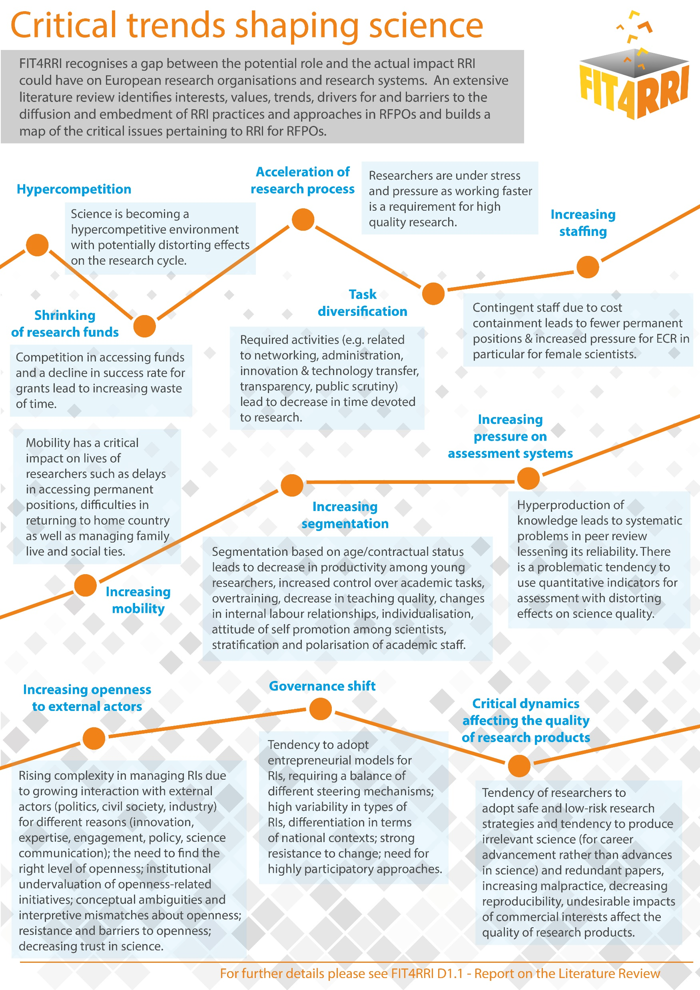
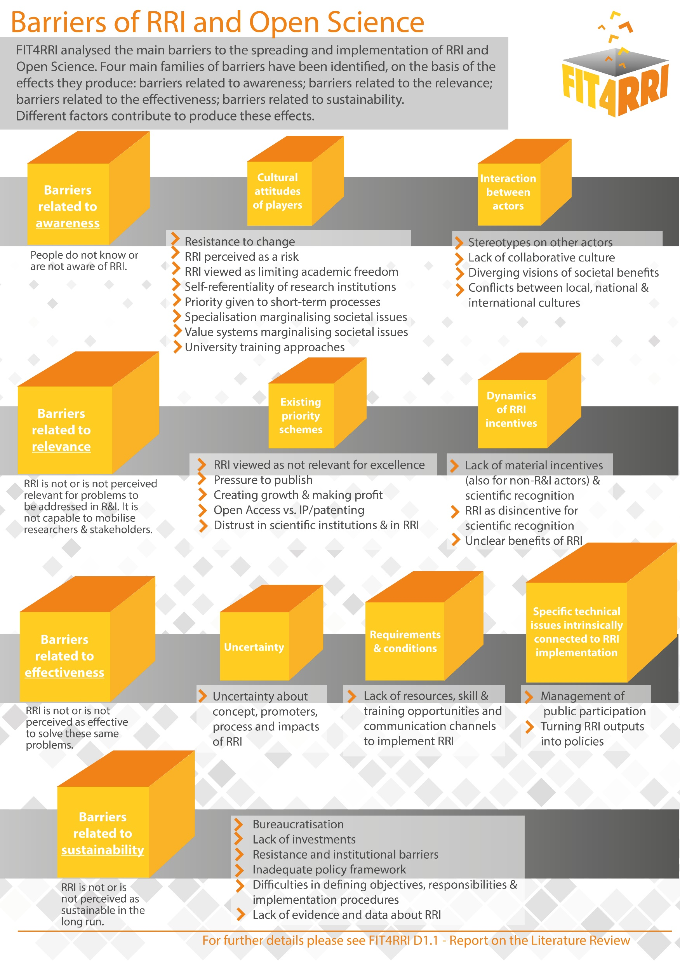

Slide 12
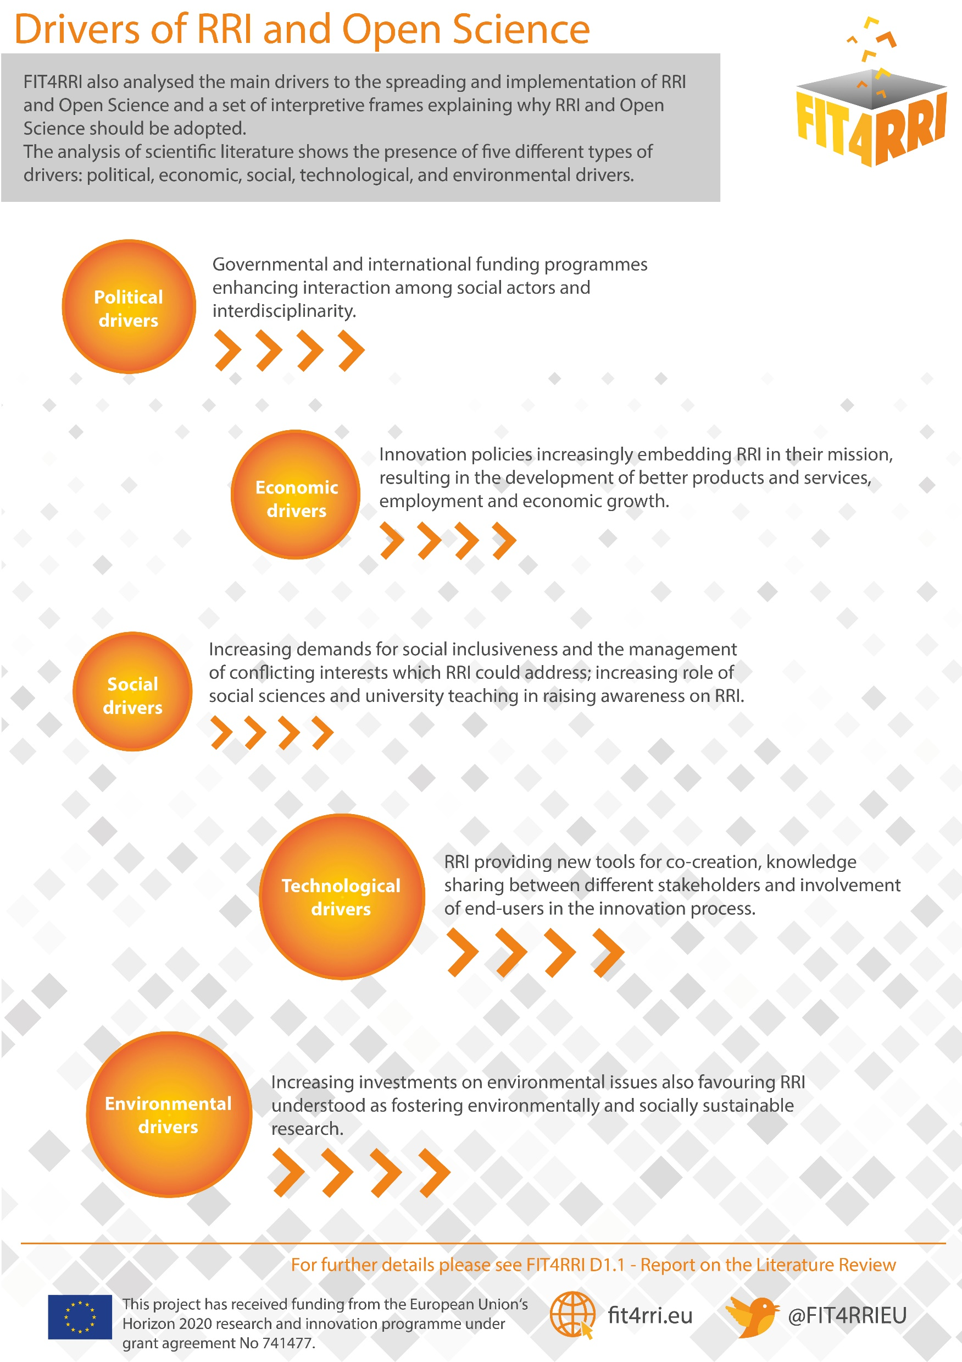
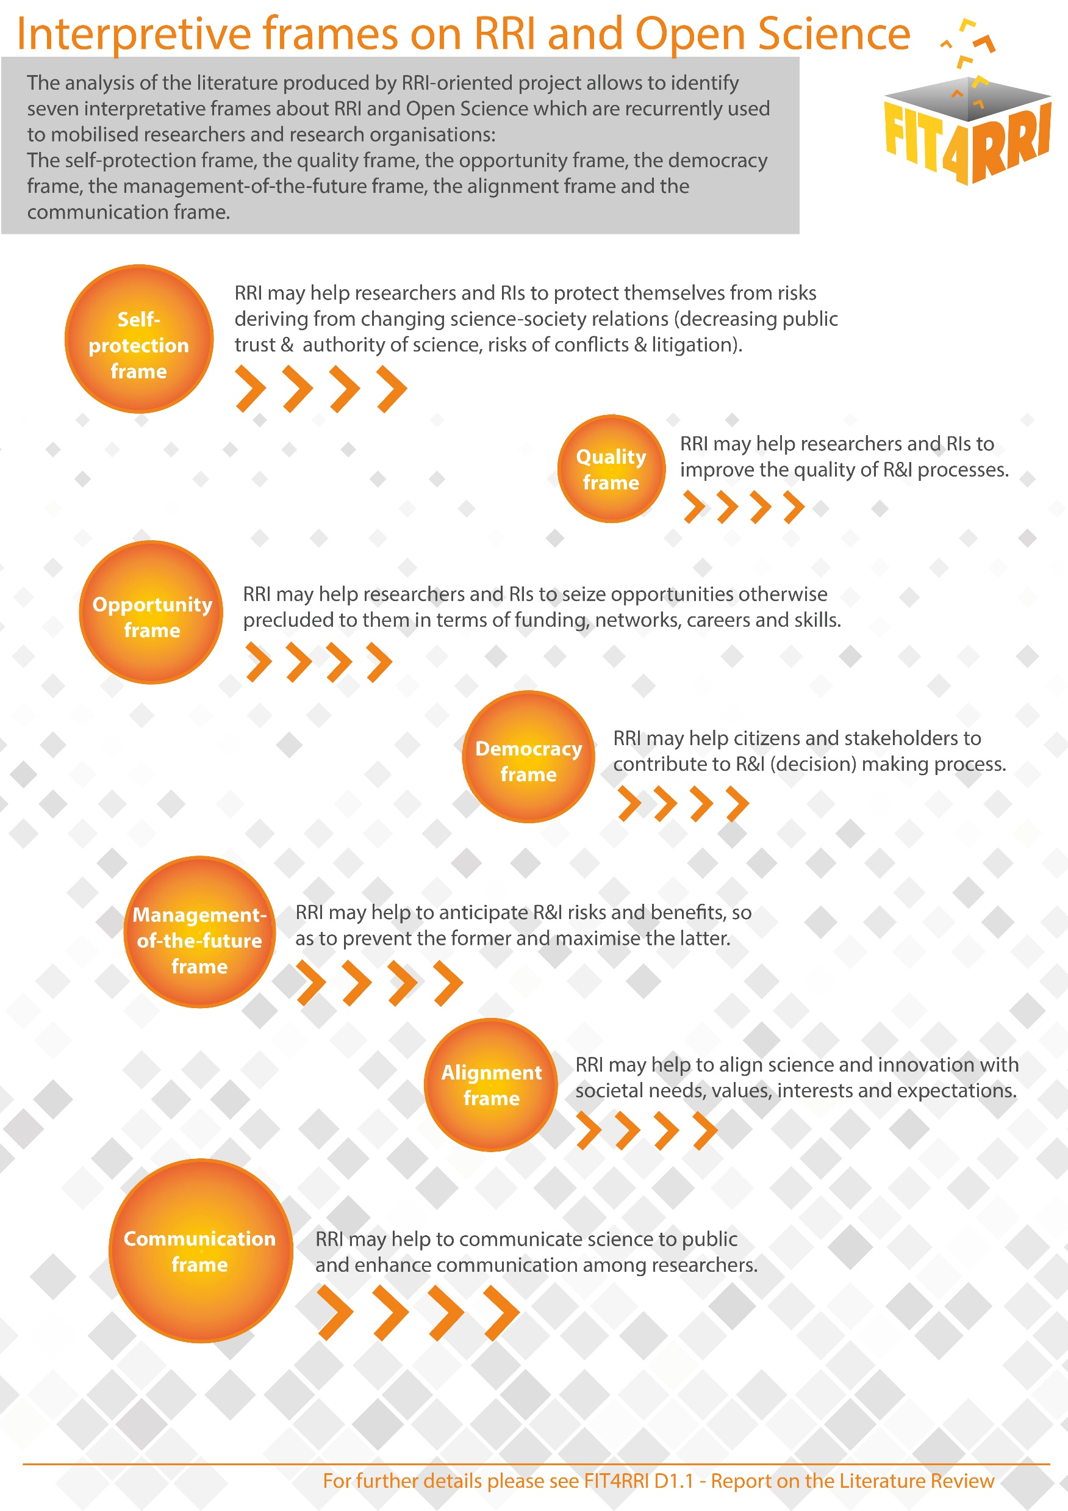

Slide 13
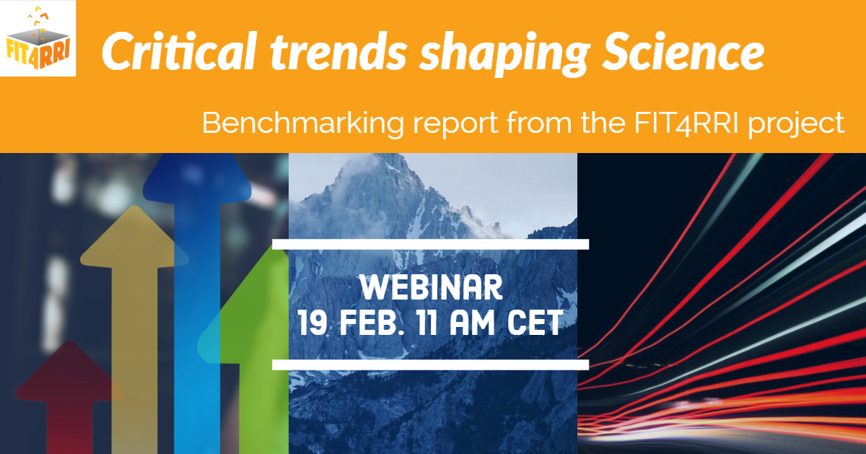
Understanding – Mapping & Benchmarking
FIT4RRI D1.1 - Report on the Literature Review https://doi.org/10.5281/zenodo.1434349
Summary: Critical trends shaping science https://doi.org/10.5281/zenodo.2268891
Webinar: Critical trends shaping science https://fit4rri.eu/training/
https://www.fosteropenscience.eu/node/2640

Slide 14
Activities
4 co-creation experiments to observe RRI and Open Science in action:
Exercise of engaging the quadruple helix (university, industry, policy makers, society) into design & implementation of research projects
understand how institutions need to change their organizational frameworks to allow better RRI embedment & to provide an enhanced value to the quadruple helix actor
Experiment 1 Energy Efficiency
Experiment 3 Material Science
Experiment 2 Photonics
(Optical Monitoring)
Experiment 4
Text & Data Mining
www.fit4rri.eu/experiments/

Slide 15
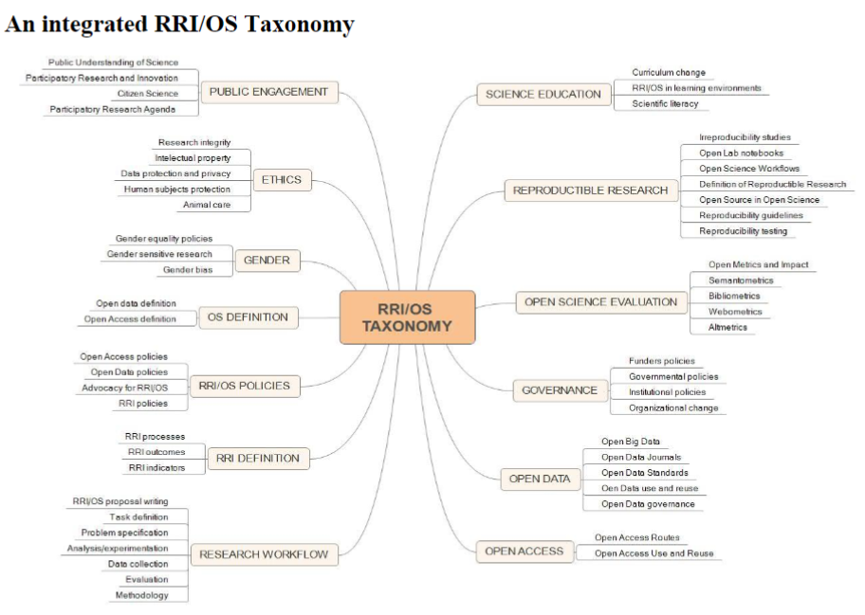
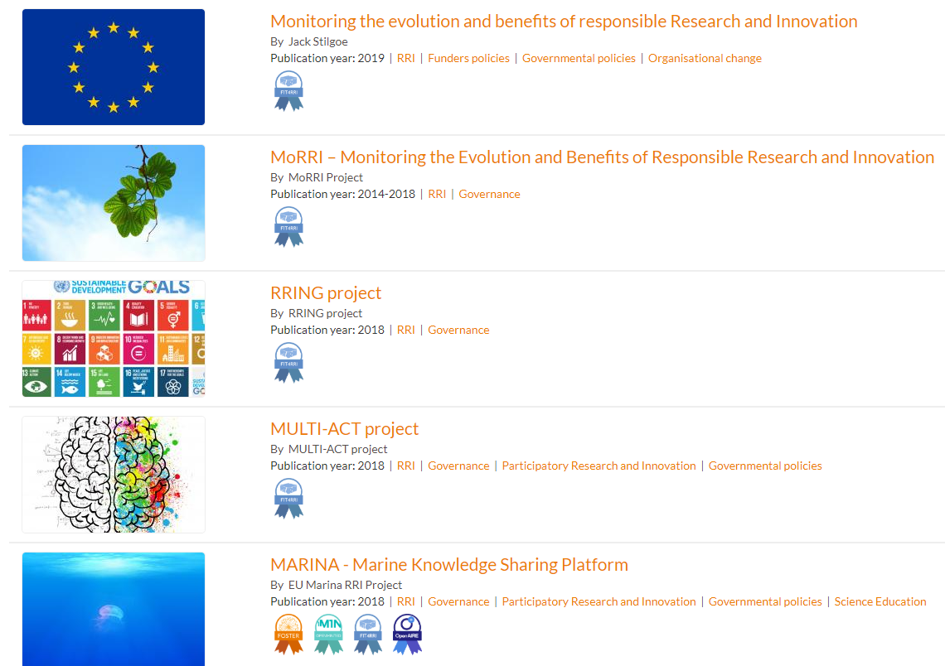
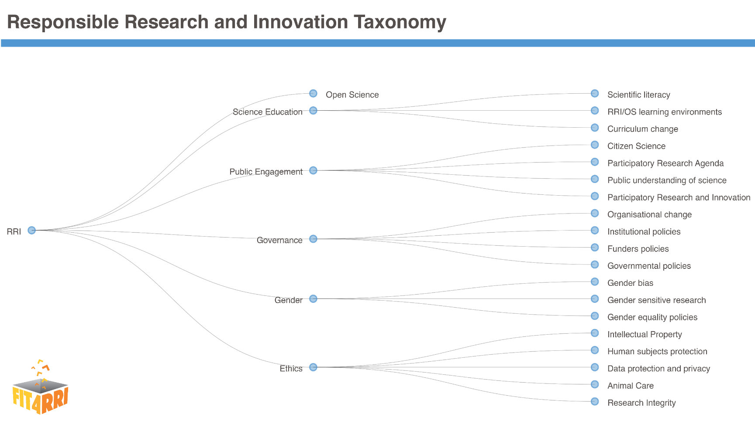
Activities
Content mapping & meta analysis of RRI & OS training
An integrated RRI/OS taxonomy
Collection of training materials on FOSTER portal
https://doi.org/10.5281/zenodo.1252296
https://www.fosteropenscience.eu/themes/fosterstrap/images/taxonomies/taxonomy_rri.png

Slide 16
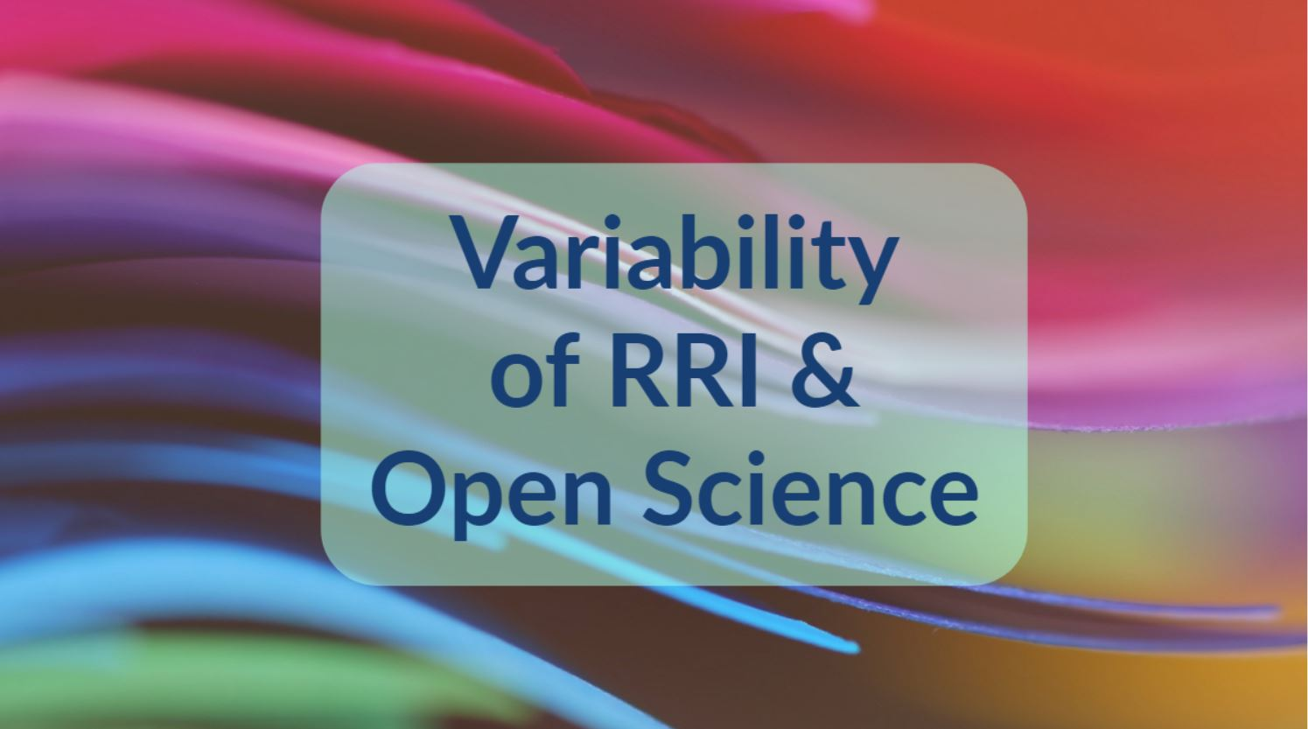
Today – Sectoral Diagnosis

Slide 17
Helene Brinken
brinken@sub.uni-goettingen.de
fit4rii.eu
@fit4rriEU
This project has received funding from the European Union’s Horizon 2020 research and innovation programme under grant agreement No 741477.

