Slide 1
Overview and definitions of Open Science, Open Access and Open Data
Iryna Kuchma, EIFL Open Access Programme Manager, Twitter: @irynakuchma
Dr. Nancy Pontika, Open Access Aggregation Officer, CORE, Twitter: @nancypontika

Slide 2
What is Open Science?
Open science is the movement to make scientific research, data and dissemination accessible to all levels of an inquiring society, amateur or professional
[https://en.wikipedia.org/wiki/Open_science]
Scope:
Transparency in experimental methodology, observation, and collection of data
Public availability and reusability of scientific data
Public accessibility and transparency of scientific communication
Using web-based tools to facilitate scientific collaboration
[The OpenScience Project, What exactly is open science http://www.openscience.org/blog/?p=269]

Slide 3
Open Access, Open Data, Open Science
EIFL Train-the-trainer programme
Bianca Kramer & Jeroen Bosman, Utrecht University Library
@MsPhelps
@jeroenbosman
(except logos)
Notes:
Motiverend en voor ons belangrijk, afgelopen 20 jaar en vooral laatste 5-10 jaar meer in onderzoek/publiceren veranderd dan 350 jaar daarvoor

Slide 4
Opening up the research workflow
Preparation
Define & crowdsource research priorities
Organize project, team, collaborations
Get funding / contract
Discovery
Search literature / data / code / …
Get access; Get alerts / recommendations
Read / view
Annotate
Assessment
Comment / peer review
Determine impact of research output
Determine impact of researchers
Outreach
Archive/share posters
Archive/share presentations
Tell about research outside academia
Researcher profiles/networks
Analysis
Collect, mine, extract data / experiment
Share protocols / notebooks / workflows
Analyze
Publication
Archive / share publications; data & code
Publish in OA journal
Writing
Write / code
Visualize
Cite
Translate

Slide 5
Open Science is …
Open to participation
Open to (re)use
Open to the world
?
?

Slide 6
Open Science practices
involve public / patients
in drafting
research proposals
share hypothesis before
starting research
(if possible/relevant)
openly share
project proposals
use easily attainable
software to allow anyone to reproduce your results
extensively search for
existing data before
generating your own

Slide 7
Open Science practices
store data in the most
open format possible
cite OA versions of
literature & provide
data and code citations
acknowledge
contributor roles
in a publication
publish preprints,
encourage feedback /
open peer review
translate research objects
in world languages

Slide 8
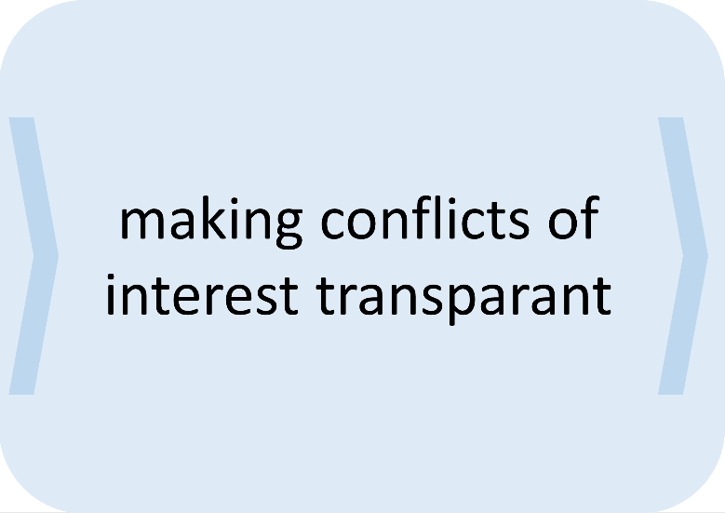
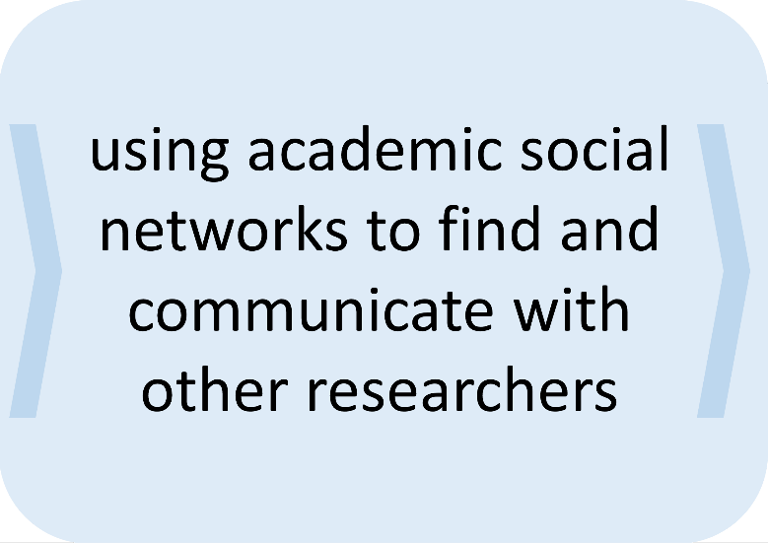
Open Science practices
publish pre-publication
history (version + reviews)
use metrics of
commercial /social
applications to
assess research
refuse to be part of
all male of all white
panels

Slide 9
Reproducibility & integrity

Slide 10
“Mostly due to current methods capture and data malpractice, approximately 50% of all research data and experiments is considered not reproducible, and the vast majority (likely over 80%) of data
never makes it to a trusted and sustainable repository.”
Source: Realising the European Open Science Cloud, EC DG Research & Innovation 2016 http://ec.europa.eu/research/openscience/pdf/realising_the_european_open_science_cloud_2016.pdf#view=fit&pagemode=none

Slide 11
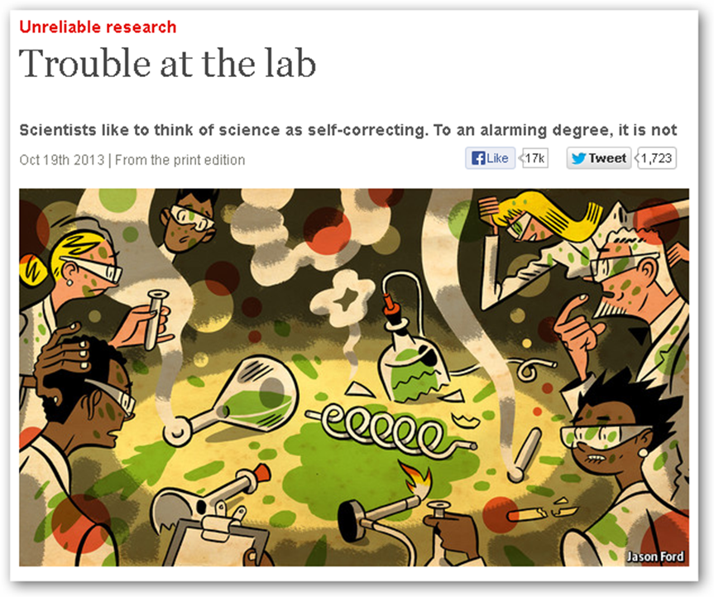
Reproducibility and replication
Economist article: Low reproducability
Psychology replication study: only 36/97 results reproducible
Cancer biology project

Slide 12
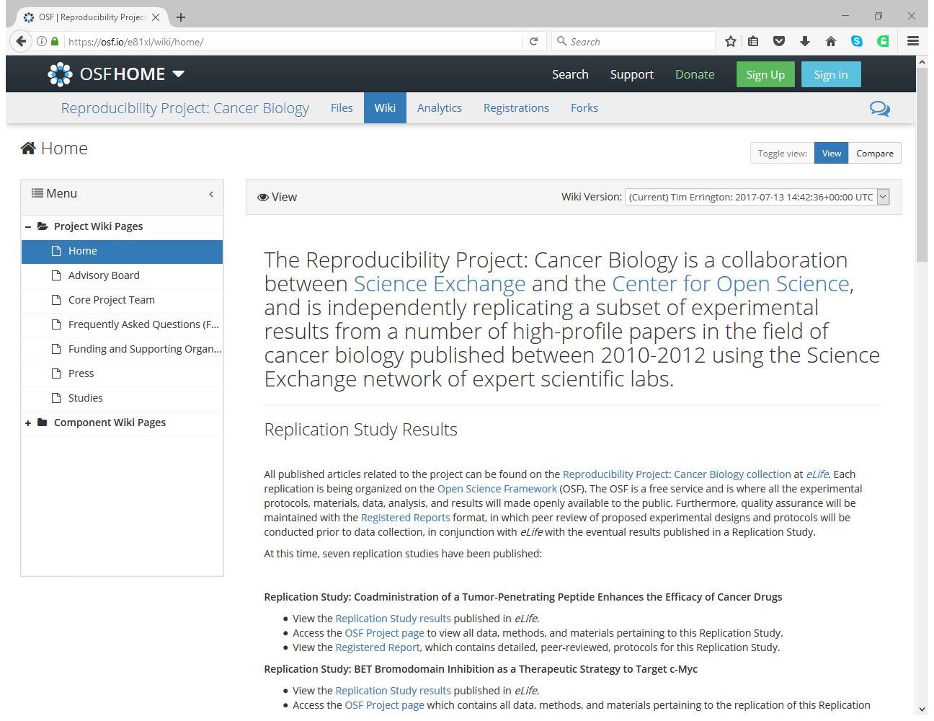

Slide 14
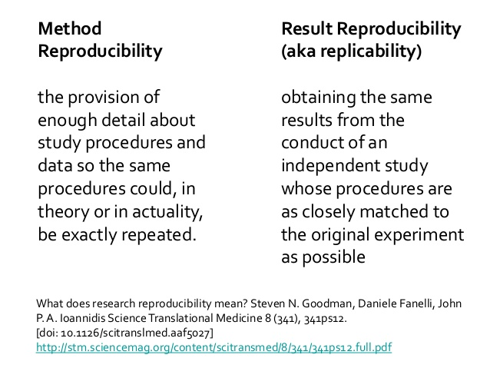
Reproducibility

Slide 15
Reproducibility in the research workflow
assessment
preparation
check (statistical) methods /reporting
welcome replication studies
pre-register (can be embargoed)
experimenting / analysis
publication
share protocols, scripts
use materials ids (RRIDs)
use open hardware
document steps, file management
share data
use executable/forkable publications
use IDs for preregistrations, data, methods, materials, contributors

Slide 16
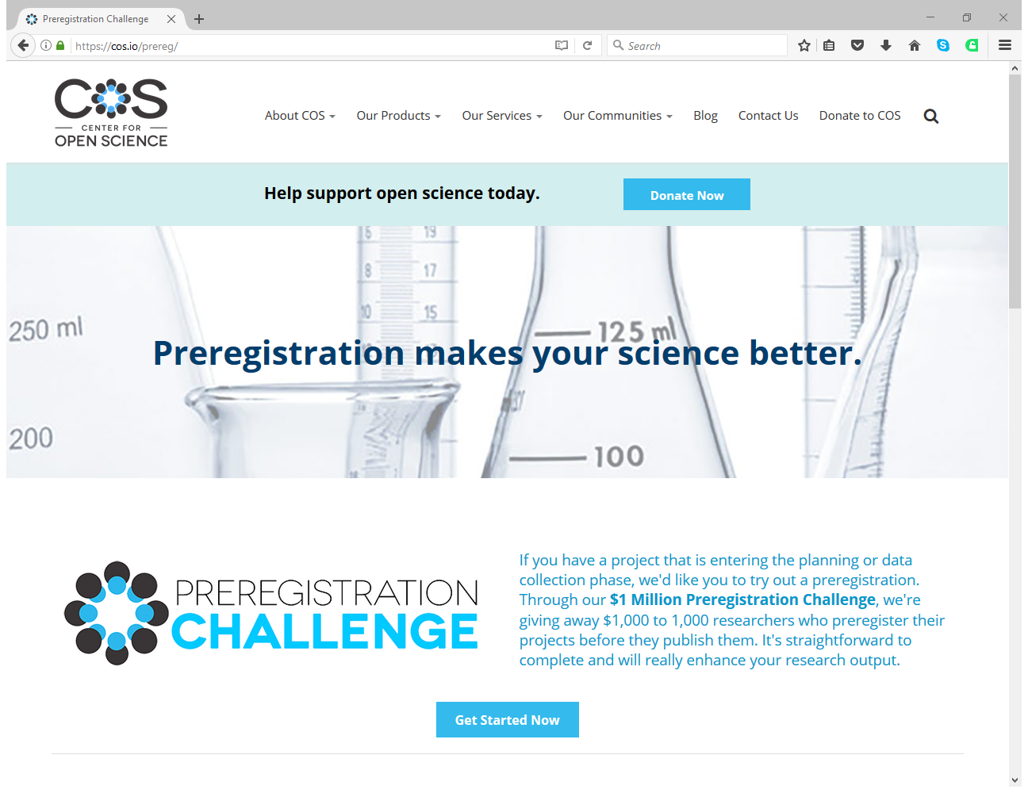

Slide 17
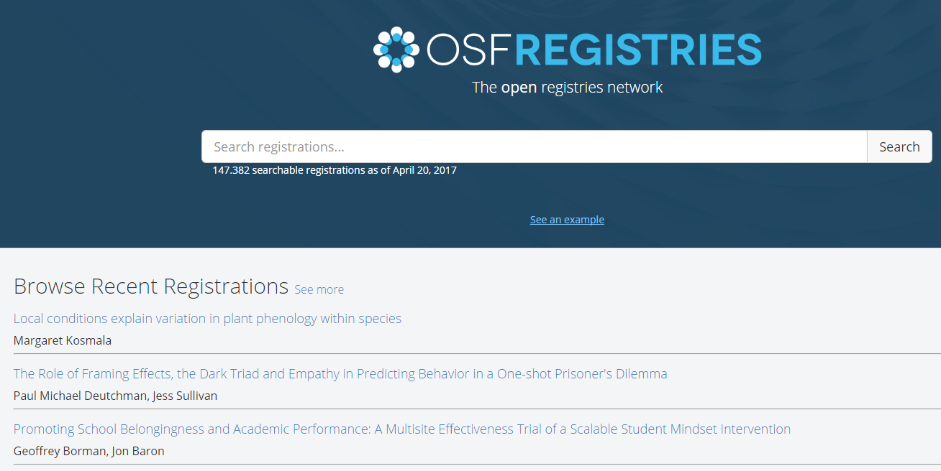
Pre-registering, e.g. at OSF or AsPredicted
Make it easy to verify your hypothesis and analysis plans. Prevent
p-hacking

Slide 18
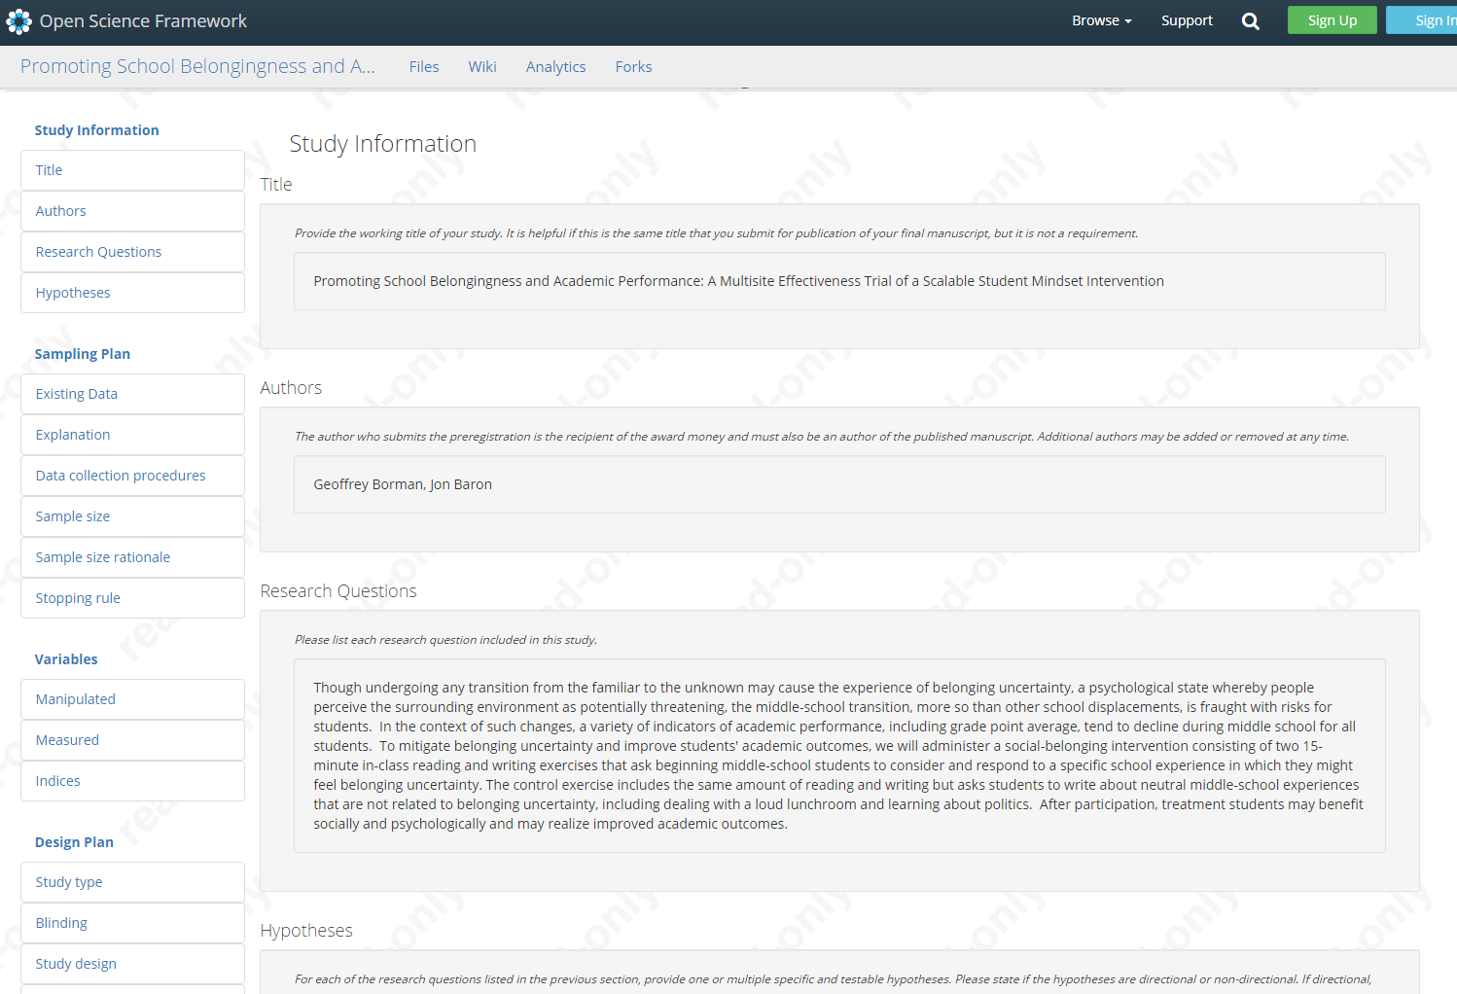
Pre-registering, e.g. at OSF or AsPredicted

Slide 19
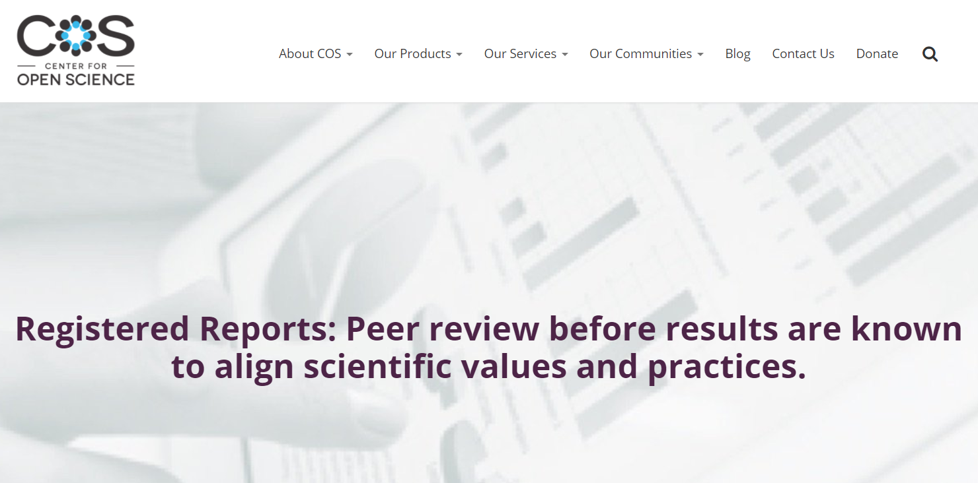
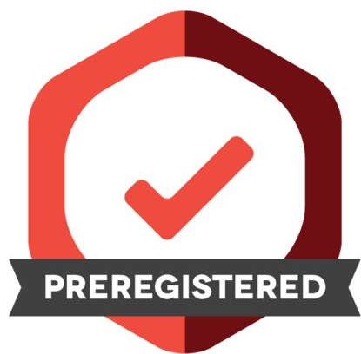
Pre-registering, e.g. at OSF or AsPredicted

Slide 20
Aspredicted.org
Source: https://aspredicted.org/

Slide 21
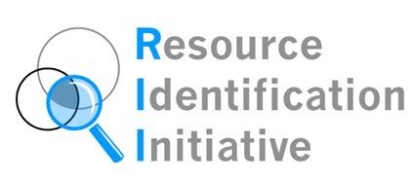
Sharing methods and materials, e.g. at Protocols.io or RRID

Slide 22
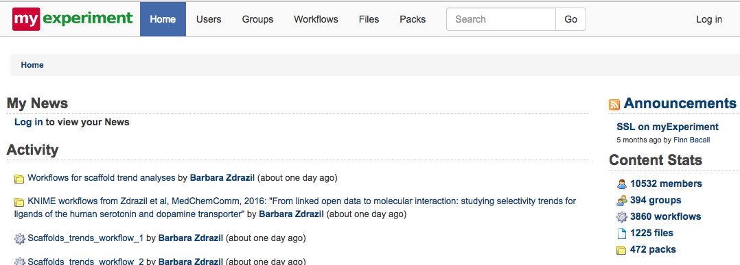
MyExperiment – research workflow
Source: https://www.myexperiment.org/home

Slide 23
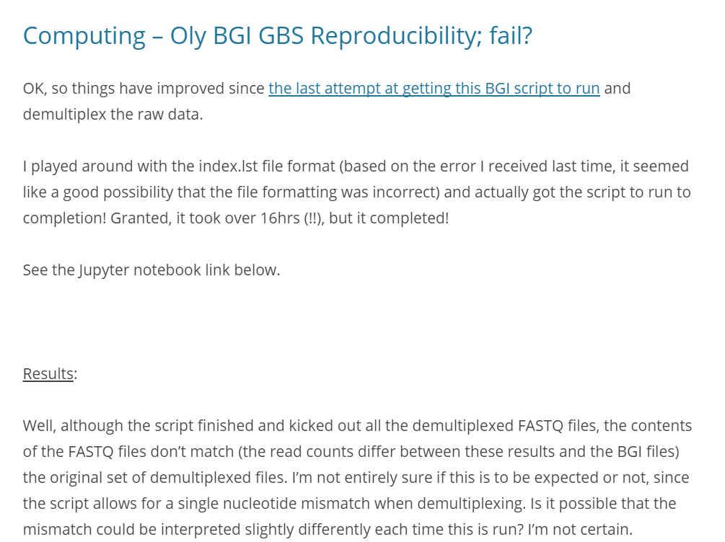
sharing notebooks e.g. at ONSNetwork or OSF
Get feedback from peers, help form your thoughts, feel less alone while doing the analyses. Spot mistakes early on.

Slide 24
Open Notebook Science Network
Source: http://onsnetwork.org/

Slide 25
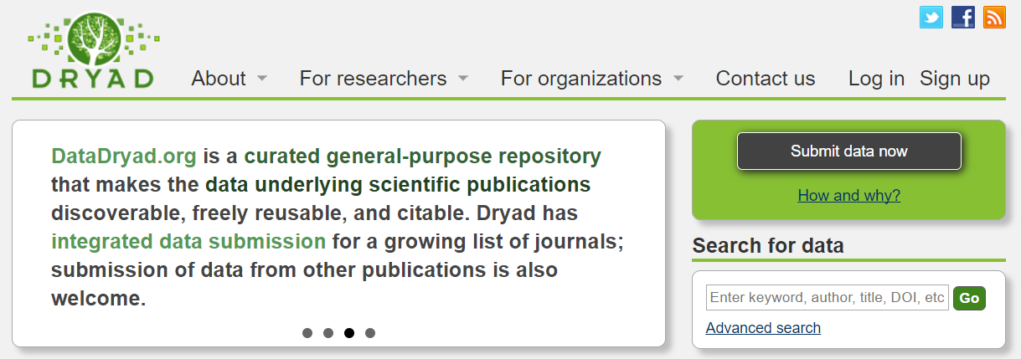
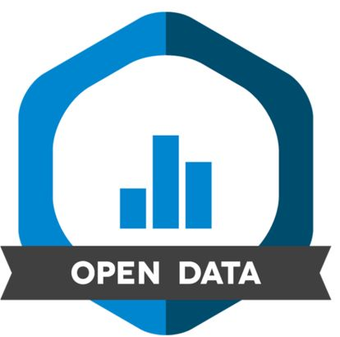
Sharing data, e.g. at Dryad, Figshare or Zenodo

Slide 26
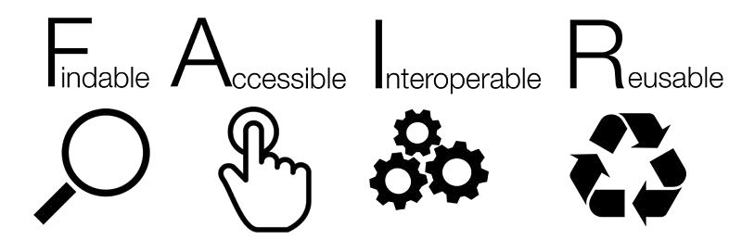
Sharing research data, e.g. at Dryad, Figshare or Zenodo

Slide 27
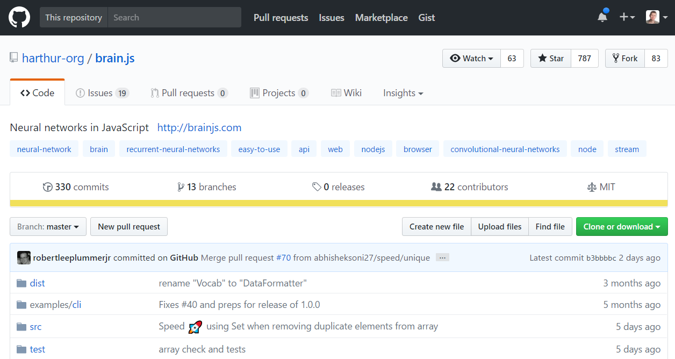
Sharing code e.g. at GitHub with GNU OR MIT license
Get people to check, contribute to and use and build on your code

Slide 29
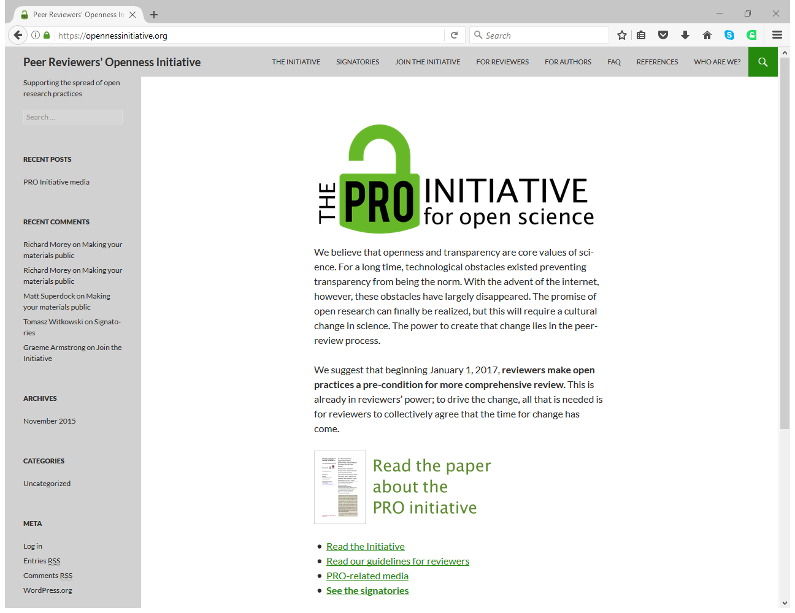

Slide 30
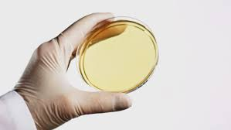
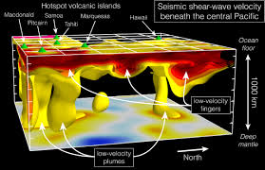
Variety of disciplines

Slide 31
Disciplinary variety and Open Science
 | ARTS & HUMANITIES | SOCIAL SCIENCE | LIFE/HEALTH | PHYSICAL SCIENCES
Research types | often exploratory research | often confirmatory research | often confirmatory research | often confirmatory research?
Data | often texual data | also qualitative data, sometimes sensitive data | sensitive patient data / big datasets | big datasets
Publ. Types | books, chapters, articles | mostly articles and chapters | mostly articles, (syst.) reviews | preprints, conf papers, articles
Collaboration | typically 1 | typically 1-4 | typically 3-10 | typically 3-many
Languages | native languge & some English | English, some native languages | English | English
Funding | small scale funding | small & medium scale funding | large scale funding | large scale funding
Review | double blind | double + single blind | single blind | single blind

Slide 32
Research characteristics and Open Science options/issues
Characteristic | Open Science options/issues
Research types | Preregistration different for exploratory research
Data | Costs of archiving large datasets / conderations of anonimity/sensitiveness / Patentable code/outcomes
Publ. Types | Limited OA Book options / Book publishers small and many / Preprints
Collaboration | Reaching agreements with co-authors
Languages | Not all languages always accepted / Non-native English researcherds at disadvantage
Funding | Large projects have funding but may ‘dictate’ way of archiving/publishing/communicating
Review | Closed and blind variants of peer review are deeply rooted

Slide 33
Advantages of Open Science for innovation and economic growth
early feedback
adds to quality of outcomes
results become available earlier
so problems can be solved earlier
having data & code freely available for (re)use
saves time & input costs in research projects of other researchers
no barriers to (re)use data/code, no patents
more people and (small) companies can use research outcomes
having more research outcomes available
enhances intellectual creativity by confrontation with alternatives
having more research outcomes and project information available
makes larger projects possible through collaboration

Slide 34
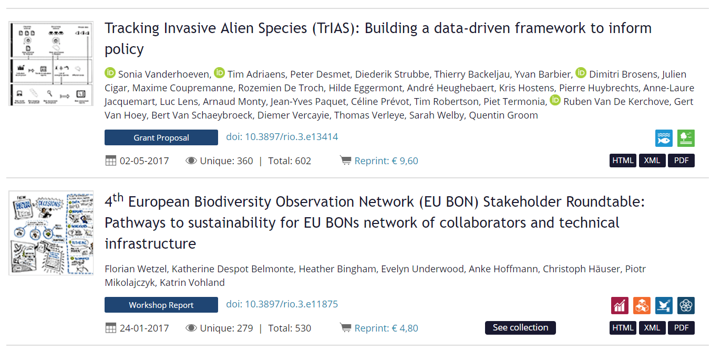
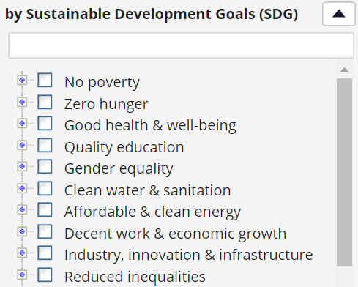
Connecting outcomes to social goals e.g. UN sustainable development goals in RIO journal

Slide 35
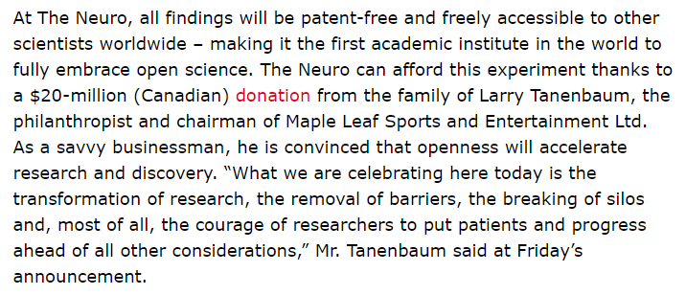
Open Science and innovation, contribution to social and economic goals
From: The Globe and Mail, 20161220

Slide 36
Denmark

Slide 37
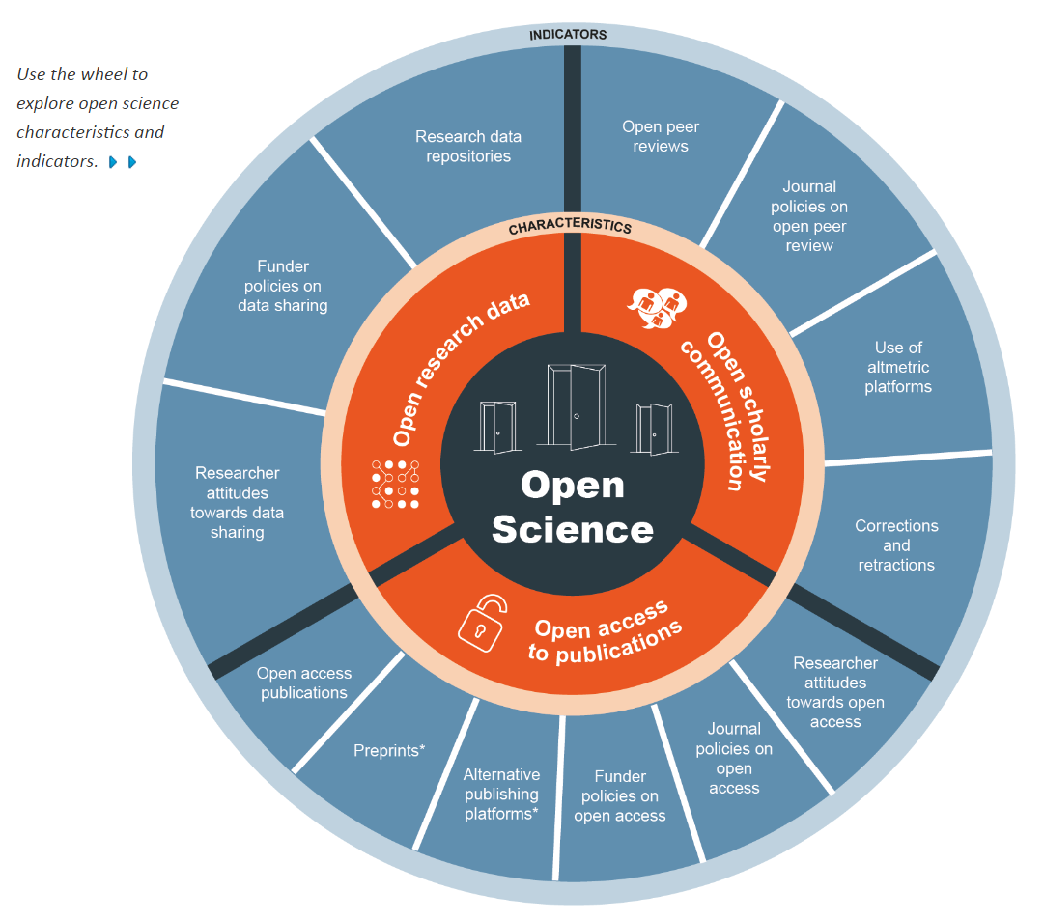
Open Science monitor (European Union)
http://ec.europa.eu/research/openscience/index.cfm?pg=home&section=monitor

Slide 38
Saving wasted time
Open Access helps to reduce time spent finding/accessing material: “If around 60 minutes were characteristic for researchers (the average time spent trying to access the last research article they had difficulty accessing), then in the current environment the time spent dealing with research article access difficulties might be costing around DKK 540 million (EUR 72 million) per year among specialist researchers in Denmark alone.”
Access to research and technical information in Denmark, Houghton, Swan & Brown (2011)
http://eprints.ecs.soton.ac.uk/22603

Slide 39
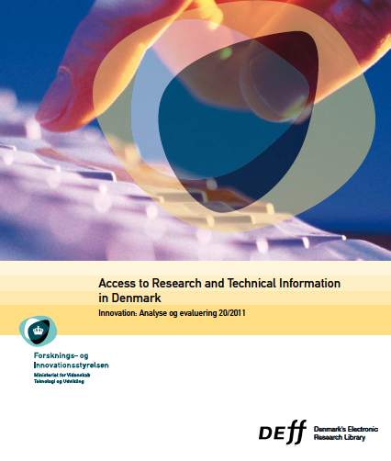
Open Science contributes to Economic Growth
19% of the processes developed would have been delayed or abandoned without access to research
a 2.2 years delay would cost around EUR 5 million per firm in lost sales
Source: Houghton, J., Swan, A. & Brown, S. Access to research and technical information in Denmark. (2011) http://eprints.soton.ac.uk/272603

Slide 40
Acceleration of the research process
“As more papers are deposited and more scientists use the repository, the time between an article being deposited and being cited has been shrinking dramatically, year upon year. This is important for research uptake and progress, because it means that in this area of research, where articles are made available at – or frequently before – publication, the research cycle is accelerating.”
Open Access: Why should we have it? Alma Swan www.keyperspectives.co.uk

Slide 41
Benefits of Open Access
Involve citizens and society: Making research openly available is potentially beneficial not only for the individual citizen but also for NGOs and other non-for profit organisations, which often cannot afford subscriptions to a large number of academic journals but for whom academic research is nevertheless very important, e.g. in the field of climate change. A recent study has shown that health NGO staff utilize more research in the course of their work as a result of increasing Open Access to research.

Slide 42
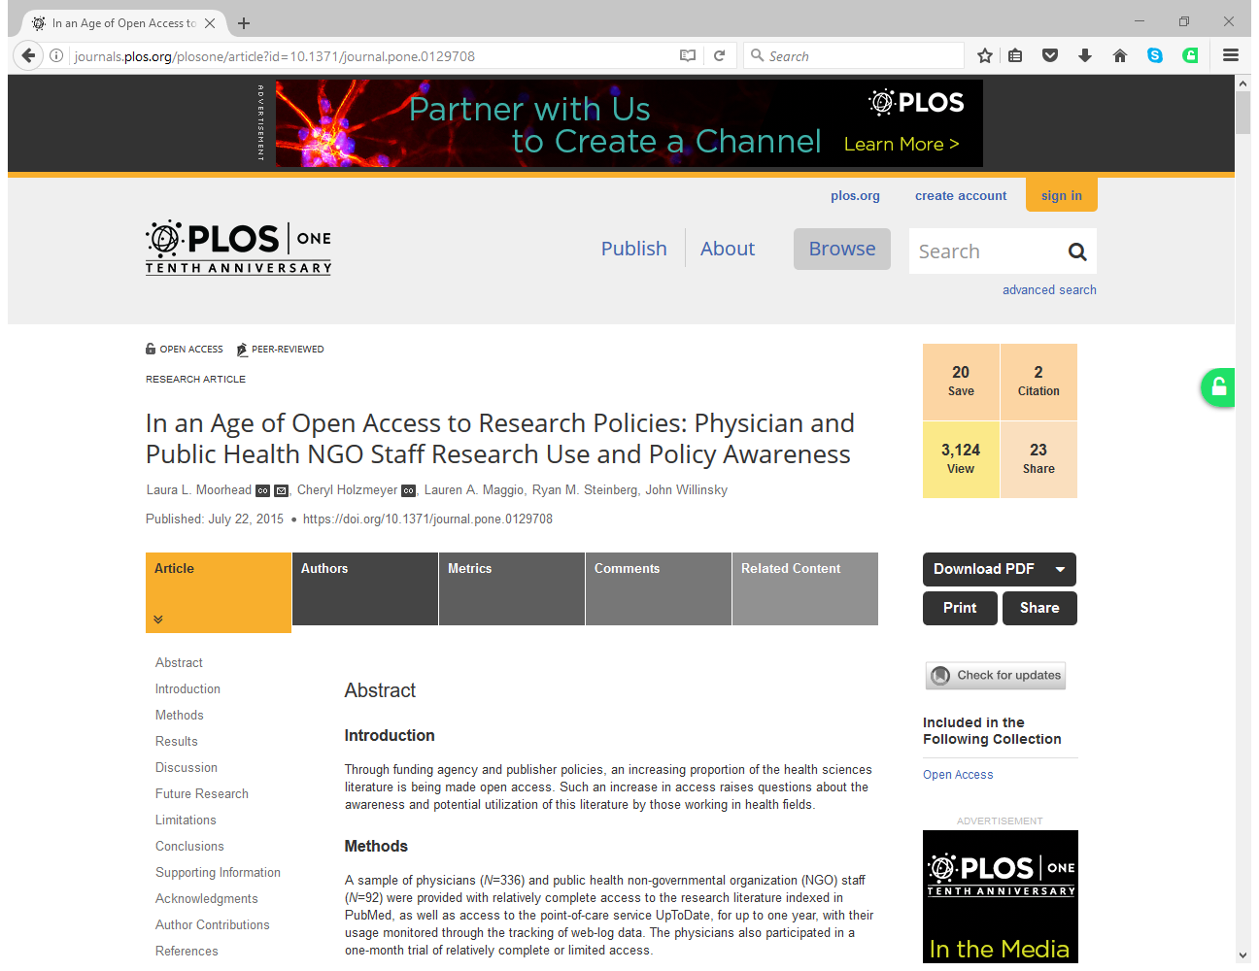

Slide 43
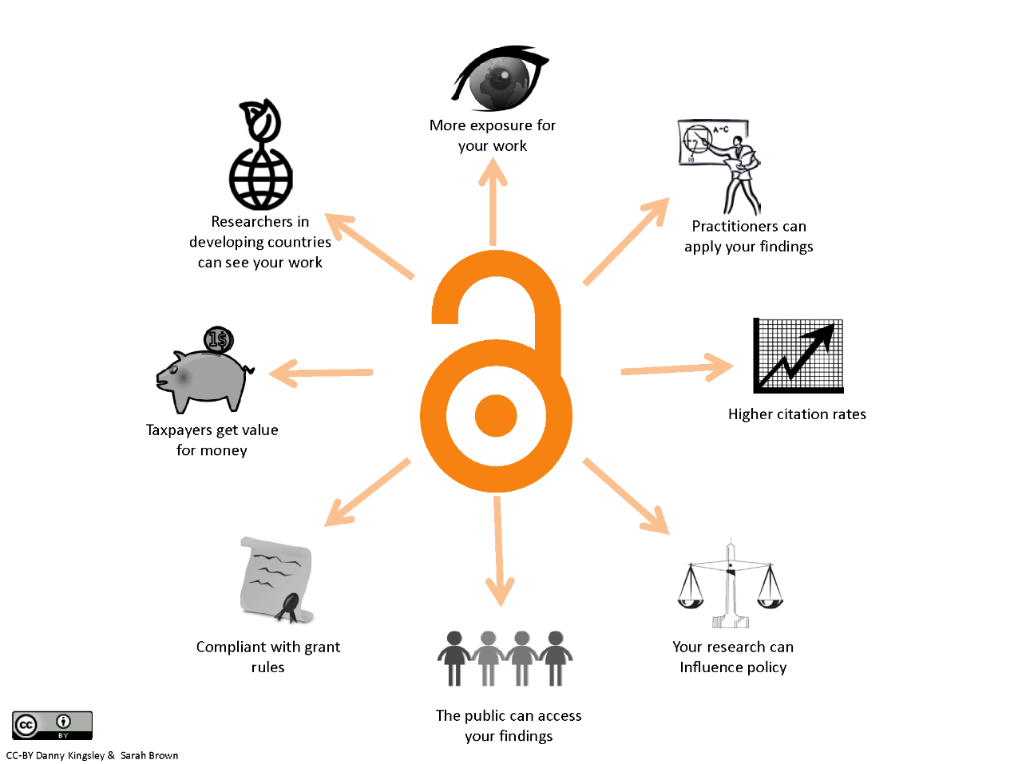

Slide 44
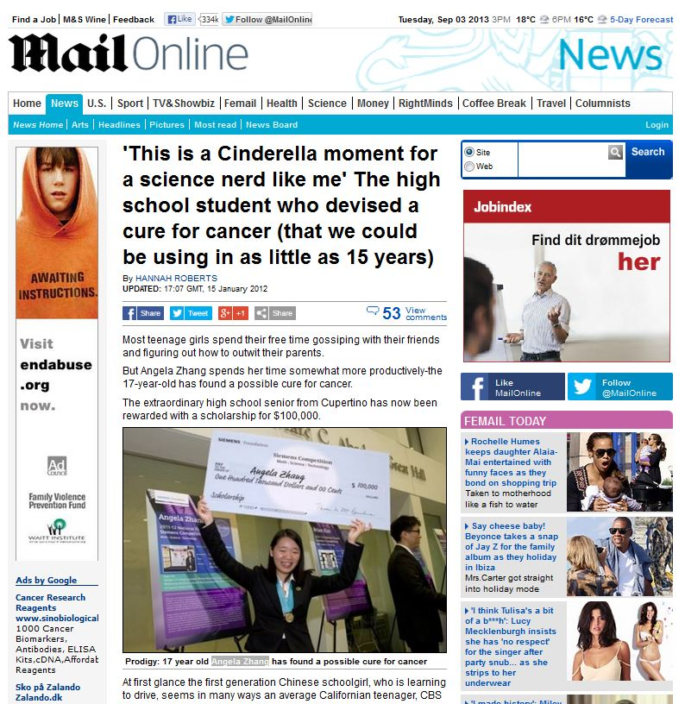
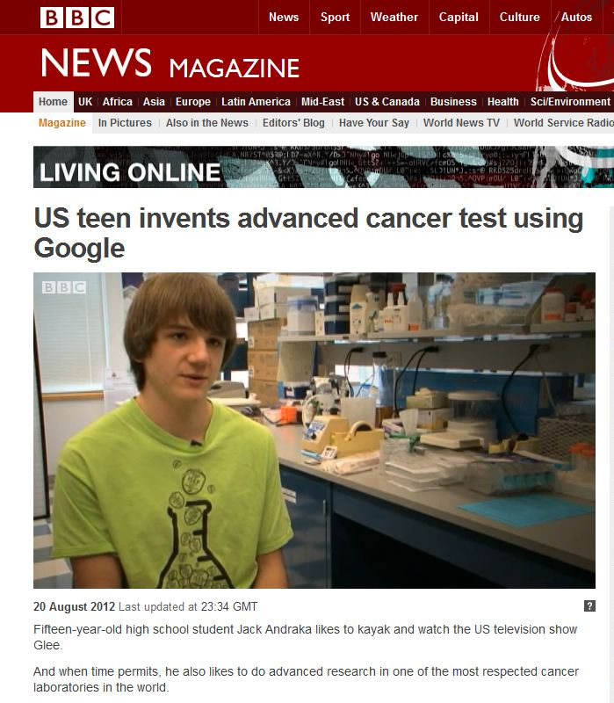
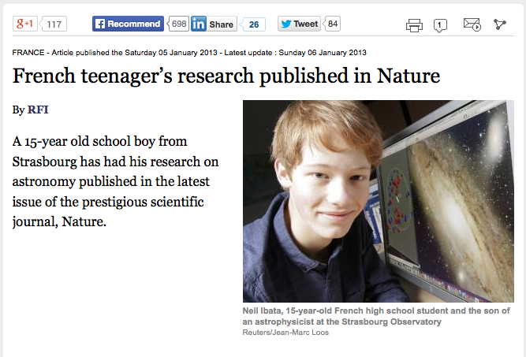
Open Science can Multiply Serendipity in research …

Slide 45
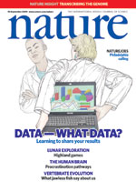
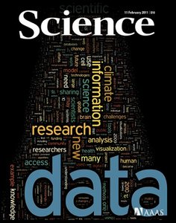
”If we wait 5 years for (Arctic) data to be released,
the Arctic is going to be a very different place”
Parsons, Arctic Research Scientist
Source: http://www.nature.com/nature/journal/v461/n7261/index.html

Slide 46
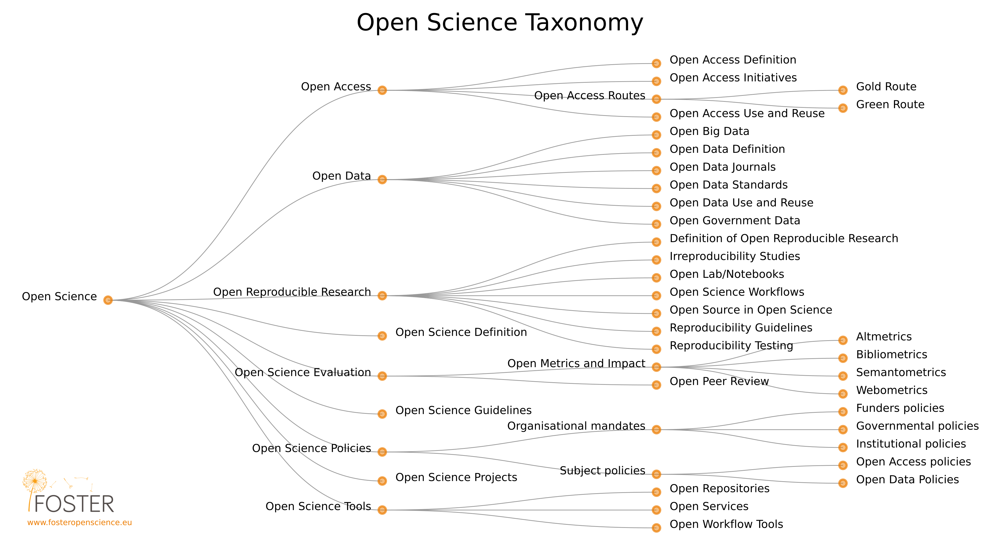
Open Science taxonomy
Paper available at http://oro.open.ac.uk/44719/. Image available at http://oro.open.ac.uk/47806/

Slide 47
Image courtesy of http://aukeherrema.nl CC-BY

Slide 48
Open data
“Open data and content can be freely used, modified and shared by anyone for any purpose”
http://opendefinition.org
Tim Berners-Lee’s proposal for five star open data - http://5stardata.info
⬆ | make your stuff available on the Web (whatever format) under an open licence
⬆⬆ | make it available as structured data (e.g. Excel instead of a scan of a table)
⬆⬆⬆ | use non-proprietary formats (e.g. CSV instead of Excel)
⬆⬆⬆⬆ | use URIs to denote things, so that people can point at your stuff
⬆⬆⬆⬆⬆ | link your data to other data to provide context

Slide 49
How to make data open?
Choose your dataset(s)
What can you open? You may need to revisit this step if you encounter problems later.
Apply an open license
Determine what IP exists. Apply a suitable licence e.g. CC-BY
Make the data available
Provide the data in a suitable format. Use repositories.
Make it discoverable
Post on the web, register in catalogues…
https://okfn.org

Slide 50
Why should you be open?
Image by wonderwebby CC-BY-NC-SA www.flickr.com/photos/wonderwebby/2723279491

Slide 51
Image courtesy of http://aukeherrema.nl CC-BY

Slide 52
It’s part of good research practice
Notes:
I like the quote from Ewan Birney that it was never acceptable to publish papers without making data available. If you can evidence and validate your findings, how do others know that they’re right?

Slide 53
Science as an open enterprise
“Much of the remarkable growth of scientific understanding in recent centuries is due to open practices; open communication and deliberation sit at the heart of scientific practice.”
Royal Society report calls for ‘intelligent openness’ whereby data are accessible, intelligible, assessable and usable.
https://royalsociety.org/policy/projects/science-public-enterprise/Report

Slide 54
Cut down on academic fraud
www.nature.com/news/2011/111101/full/479015a.html

Slide 55
Validation of results
“It was a mistake in a spreadsheet that could have been easily overlooked: a few rows left out of an equation to average the values in a column.
The spreadsheet was used to draw the conclusion of an influential 2010 economics paper: that public debt of more than 90% of GDP slows down growth. This conclusion was later cited by the International Monetary Fund and the UK Treasury to justify programmes of austerity that have arguably led to riots, poverty and lost jobs.”
www.guardian.co.uk/politics/2013/apr/18/uncovered-error-george-osborne-austerity
Notes:
The validation of results is key. This article references an inadvertent error in a economics paper by Reinhadt and Rogoff. Missing some rows out of an average gave drastically different results – what was published suggested that countries with 90% debt ratios see their economies shrink by 0.1%. Instead, it should have found that they grow by 2.2% – less than those with lower debt ratios, but not a spiralling collapse. This mistake wasn’t picked up on initially as the data hadn’t been shared. The mistake fed into government policy - the findings of this paper were used as justification for austerity measures in the UK and various other countries in the EU.

Slide 56
More scientific breakthroughs
“It was unbelievable. Its not science the way most of us have practiced in our careers. But we all realised that we would never get biomarkers unless all of us parked our egos and intellectual property noses outside the door and agreed that all of our data would be public immediately.”
Dr John Trojanowski, University of Pennsylvania
www.nytimes.com/2010/08/13/health/research/13alzheimer.html?pagewanted=all&_r=0
Notes:
Certain research communities have also seen the benefit of sharing data as it speeds up the process of discovery. This article shows how researchers in the field of Alzheimer’s research have agreed as a community to share data immediately to make scientific breakthroughs.

Slide 57
A citation advantage
A study that analysed the citation counts of 10,555 papers on gene expression studies that created microarray data, showed:
“studies that made data available in a public repository received 9% more citations than similar studies for which the data was not made available”
Data reuse and the open data citation advantage,
Piwowar, H. & Vision, T. https://peerj.com/articles/175
Notes:
There’s also a citation advantage for individual researchers. This study by Heather Piwowar and Todd Vision looked at 10,555 paper of gene expression studies that had shared the associated microarray data. Those studies that shared data received 9% more citations.

Slide 58
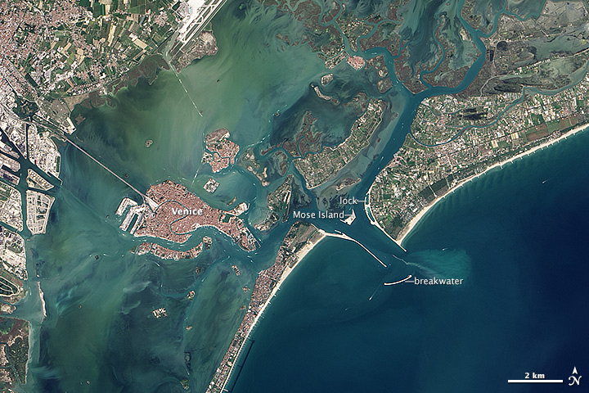
Increased use and economic benefit
The case of NASA Landsat satellite imagery of the Earth’s surface:
Up to 2008
Since 2009
Sold through the US Geological Survey for US$600 per scene
Sales of 19,000 scenes per year
Annual revenue of $11.4 million
Freely available over the internet
Google Earth now uses the images
Transmission of 2,100,000
scenes per year.
Estimated to have created value for the environmental management industry of $935 million, with direct benefit of more than $100 million per year to the US economy
Has stimulated the development of applications from a large number of companies worldwide
http://earthobservatory.nasa.gov/IOTD/view.php?id=83394&src=ve
Notes:
There’s also an economic benefit, as seen by the case of the NASA landsat satellite images. These were sold until 2008 for $600 a scene. Now they’re freely available and used by Google Earth. Previously they sold 19,000 images a year, whereas now they transmit 2.1 million. The revenue has gone up incredibly too from $11.4 million to an estimated value of $935 million with direct benefit of more than $100 million. The release has also stimulated the development of applications from companies worldwide.
This case study comes from the Royal Society Report on Science as an Open Enterprise.

Slide 60
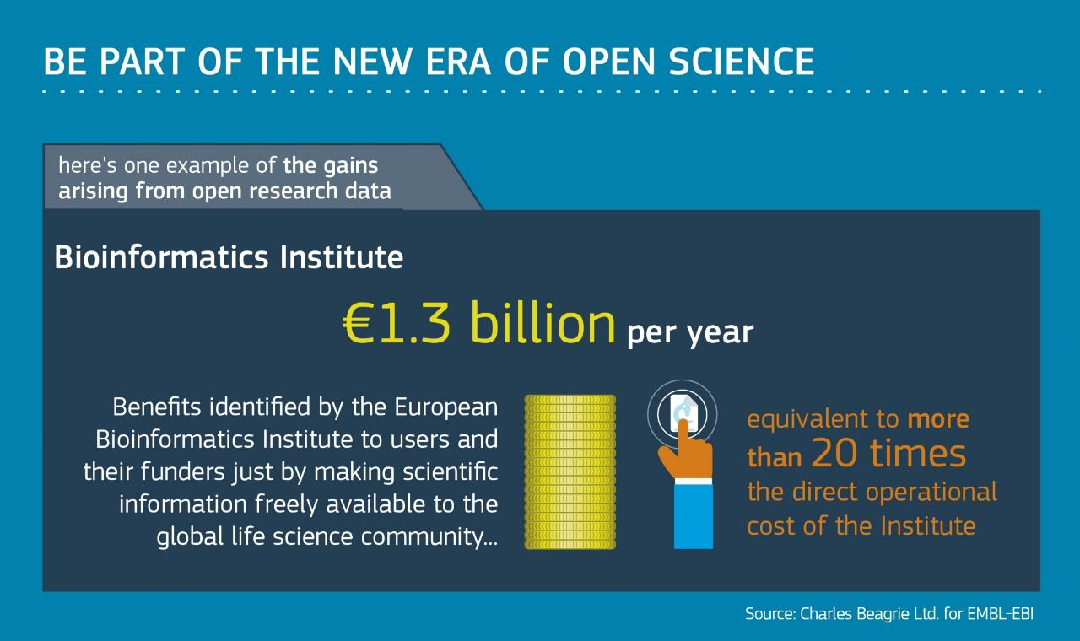

Slide 61
With thanks to Bianca Kramer & Jeroen Bosman, Utrecht University Library
for re-using their slides presented at Open Access, Open Data, Open Science EIFL Train-the-trainer programme
@MsPhelps
@jeroenbosman
(except logos)

Slide 62
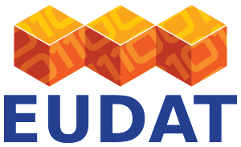
With thanks to
Marjan Grootveld: marjan.grootveld@dans.knaw.nl
Sarah Jones: sarah.jones@glasgow.ac.uk
Acknowledgements:
Thanks to DANS and DCC for reuse of slide
Notes:
Thanks

Slide 63
Thank you! Questions? iryna.kuchma@eifl.net @irynakuchma https://www.fosteropenscience.eu @fosterscience facebook.com/fosteropenscience

