Slide 1
The policy context:
Open Access/ Open Science in the EC
EC internal training: Open Access Policies and Requirements to Publications and Research data in H2020
07 February 2018
Victoria Tsoukala, RTD.A6

Slide 2
The Commission objective
optimise the impact of publicly-funded scientific research
At European level (FP7 & Horizon 2020)
At Member State level
One way to get there: open access
Expected benefits:
Better and more efficient science
Economic growth
Broader, faster, more transparent and equal access for the benefit of researchers, industry and citizens
… in the European Research Area and beyond
Open circulation of knowledge one of the five pillars of the ERA

Slide 3
A multifaceted policy approach
2012 Recommendation on Access to and Preservation of Scientific Information to MS – National Points of Reference (NPR)
2016 report, 2017 update in progress (to be published spring 2018)
Upcoming review of the 2012 Recommendation in Spring 2018
Horizon 2020
Requirements for Open access to publications and data
Funding for the uptake of such policies in MS
Funding for the development interoperable infrastructures that support open access and open science at the European level (primarily through the RI WP)
Building on investments in infrastructures to develop the European Open Science Cloud (EOSC), a trusted virtual environment to enable data driven science across boundaries and disciplines (work in progress)
Stakeholders and expertise
Open Science Policy Platform, expert groups
May 2016 Council Conclusions
Support for OA publications, data re-use & data management

Slide 4
The international landscape
Robust open access policies around the world – not invented in Europe
Strong US OA mandate for federally funded research (agencies with budget of over 100 million €), most notably NIH
Strong green open access mandate in Latin America (SCIELO)
Strong open access policies also in Canada, Australia and Japan
Developing policies in other countries, e.g. China, Russia…
Key non-state funders also have robust mandates (Wellcome Trust, Gates Foundation)

Slide 5
2017 NPR report (in progress)

Slide 6
Then and now: considerable progress
From 2017
FP7
OA Green or Gold+Green Pilot
H2020
OA Green or Gold+Green obligation
& ORD Pilot
H2020
OA Green or Gold+Green obligation
& ORD by default
2014
2008

Slide 7
…and the future….
FP9
FP7
OA Green or Gold+Green Pilot
H2020
OA Green or Gold+Green obligation
& ORD Pilot
H2020
OA Green or Gold+Green obligation
& ORD by default
2017 on
FP9
Will go beyond OA embrace and embed Open Science!!
2014
2008

Slide 8
Open access in Horizon 2020
Regulation establishing Horizon 2020
"To increase the circulation and exploitation of knowledge, open access to scientific publications should be ensured. Furthermore, open access to research data resulting from publicly funded research under Horizon 2020 should be promoted, taking into account constraints pertaining to privacy, national security and intellectual property rights"
Open access to scientific publications resulting from publicly funded research under Horizon 2020 shall be ensured [...].
Open access to research data resulting from publicly funded research under Horizon 2020 shall be promoted. [...].

Slide 9
Open Access to publications: requirements (Art. 29.2 of GA)
What: Deposit peer-reviewed paper (author version or publisher version) in repository, provide open access to it through repository
When: deposit at publication and make openly accessible at publication, or the latest make openly accessible 6M or 12M (for SSH)
UNDERSTANDING THE GA…………….
If a researcher publishes in open access venue: paper still needs to be in repository, but for access a link to publisher's oa copy can be provided
Researcher needs to make sure they can fulfil the obligation to the contract. Advance planning strongly advised on where to publish and whether publisher policy compatible with H2020 obligations!
APCs are eligible costs

Slide 10
ORD pilot requirements
Extension of limited Open Research Data (ORD) whilst retaining its key characteristics:
Targeted primarily towards data underlying publications (other data as specified in DMP)
a Data Management Plan (DMP) is obligatory for projects
Costs for open access to research data fully eligible
General approach: as open as possible, as closed as necessary
Robust opt outs options for IPR, confidentiality/privacy and security reason as well as if OA runs against the main objective of the project
Whether projects opt-out or not does not affect the evaluation

Slide 11
Projects must have a DMP
A Data Management Plan (DMP) provides information on:
The data the research will generate
How to ensure its curation, preservation and sustainability
What parts of that data will be open (and how)

Slide 12
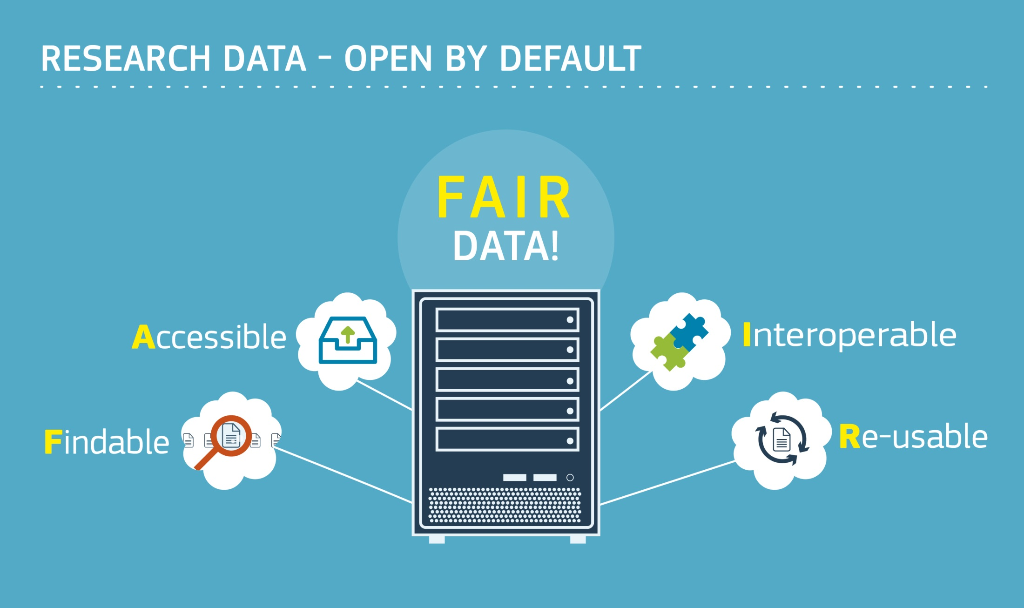
https://www.force11.org/group/fairgroup/fairprinciples

Slide 13
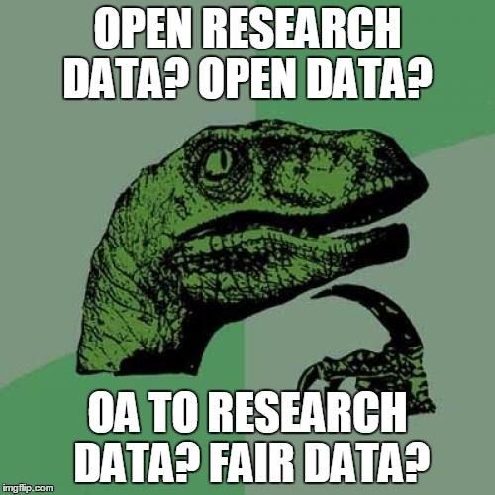
Clarifying terminology…
In the past our policy mainly addressed the 'accessibility' part of FAIR.
Started off with 'open access to research data'
Moved towards open (research) data with the ORD pilot (which also covered further aspects)
We are now seeing openness as one component of FAIR data and aim to address all of the FAIR aspects in Horizon 2020

Slide 14
FAIR Data Management DMP (1/3)
Template DMP (Annex to Guidelines on FAIR Data Management)
Provided as a service, its use is currently optional
Standard DMP template is light and flexible
Set of questions + summary table
One DMP per project not per dataset
but mention if there are specific issues for a particular dataset)
DMP as a living document
Updated as part of periodic evaluation and/or at least at the end of the project for final reporting

Slide 15
FAIR Data Management DMP (2/3)
1. Data summary
General questions about data collection/generation and the project
2.1 Making data Findable (incl. provisions for metadata)
Persistent unique identifiers, conventions followed, metadata standards, keywords...
2.2 Making data openly Accessible
Sharing (or not), restrictions on use, software, repository...
2.3 Making data Interoperable
Data exchange, ontologies (types and properties of data)...
2.4 Increasing data Re-use
Licensing issues, embargo, third parties...

Slide 16
FAIR Data Management DMP (3/3)
3. Allocation of resources
Costs (for making FAIR), personal etc. (including long term preservation)
4. Data security
Sensitive data, certification of repositories...
5. Ethical aspects
Ethical or legal issues (also in context of ethics reviews)
6. Other
Other non-H2020 procedures for data management?
The DMP template contains pointers as to what to address under each section

Slide 17
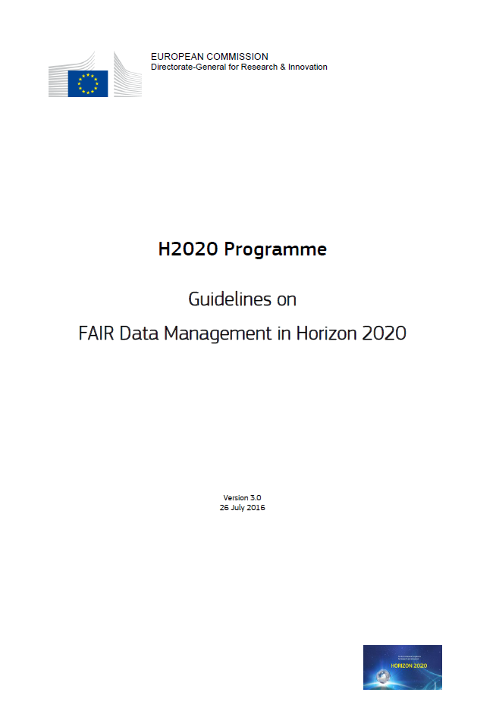
Guidelines on FAIR Data Management
Available here on the Participant Portal!
Read it!!!
Only 12 Pages!!!

Slide 18
Challenges to be solved & Tools
Open access to publications
Increasing uptake to 100% - reinforced monitoring and incentives
Open access to research data
Mainstreaming FAIR data across Horizon 2020 & FP9 – requires a change in scientific culture
Tools to further develop policy
Open Science Policy Platform
Commission Expert Groups on FAIR data & on Future of scholarly communication
continuing dialogue & cooperation with Member States (RWP, ERAC, NPR, MLE)

Slide 19
Ressources - policy
Open innovation, open science, open to the world. A vision for Europe
http://bookshop.europa.eu/en/open-innovation-open-science-open-to-the-world-pbKI0416263/
NPR report
https://ec.europa.eu/research/openscience/pdf/openaccess/npr_report.pdf#view=fit&pagemode=none
H2020 guidance
http://ec.europa.eu/research/participants/docs/h2020-funding-guide/cross-cutting-issues/open-access-dissemination_en.htm
May 2016 Council Conclusions
http://data.consilium.europa.eu/doc/document/ST-9526-2016-INIT/en/pdf
Uptake of ORD pilot (dataset to be updated)
https://data.europa.eu/euodp/data/dataset/open-research-data-the-uptake-of-the-pilot-in-the-first-calls-of-horizon-2020

Slide 20
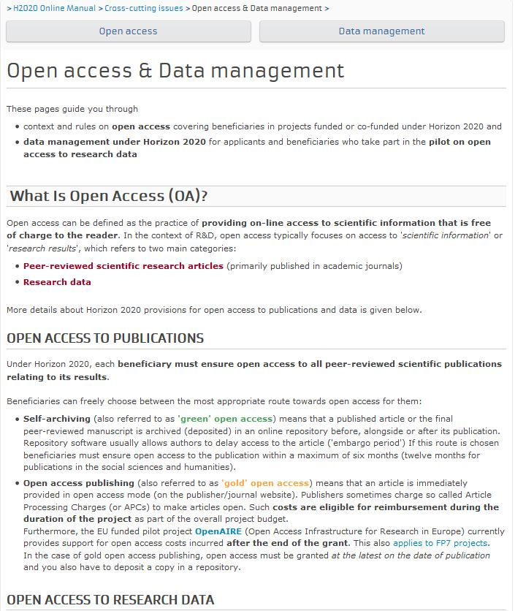
Resources (practical for EC policy)
The Participant Portal has an entire section with info and the guidelines on Open Access and Data Management in H2020, as well as FAQs
OpenAIRE is always helpful to H2020 grantees and POs. Do refer them to their helpdesk
https://www.openaire.eu/support/helpdesk
Write: RTD-open-access@ec.europa.eu
Read: here (DG RTD) & here (DG CONNECT)
Follow: @OpenAccessEC

Slide 21
Resources – practical
Sherpa-Romeo: publisher policies:
http://www.sherpa.ac.uk/romeo/
→ very few journals do not offer either green or gold
Directory of Open Access Journals:
http://doaj.org/
→ 10,039 Journals covered
Directory of Open Access Books:
http://www.doabooks.org/
Directory of Open Access Repositories:
http://www.opendoar.org/ and http://roar.eprints.org/
As well as thematic initiatives, (PubMedCentral, arXiv.org), open access publishers (e.g.PLoS) and of course…google scholar (not everything there is OA but quite a bit)

Slide 22
We welcome your input
Contact us
Mail: RTD-open-access@ec.europa.eu
Web: http://ec.europa.eu/research/openscience/index.cfm
Twitter: @OpenAccessEC

