Slide 1
Evolution of the Open Science Grid Authentication Model
Kevin Hill
Fermilab
OSG Security Team

Slide 2
Highlights
Introduction
OSG PKI transition to OSG CA
SHA2
CILogon CA certificates
Certificate-Free Job Submissions
Future Goals

Slide 3
Introduction
OSG Security Team
Mine Altunay – OSG Security Officer
Kevin Hill
Anand Padmanabhan
The Open Science Grid is funded by National Science Foundation and Department of Energy

Slide 4
OSG PKI Transition
OSG historically has used x509 certificates (proxies) for authentication.
The security team is responsible for the OSG root CA bundles.
IGTF bundle + a few additions.
DOEGrids CA shut down, and OSG started its own CA.

Slide 5
PKI Transition – DOEGrids CA
DOEGrids CA stopped issuing new certs March 2013. All existing DOEGrids certs will expire early 2014.
When announced (well ahead of time) OSG started planning to create its own CA.
Some concerns:
DOEGrids CA had its own web site for user cert requests, as well as command line tools for getting certificates.
DOEGrids CA had its own concept of Sites and Virtual Organizations.
Served wider audience than OSG.
Slightly different mapping of virtual organizations.
Notes:
DOEGrids stopped issuing certs due to …
DOEGrids VOs

Slide 6
OSG CA
OSG now has its own certificate portal with DigiCert CA signing certificates in the background.
Digicert created a separate OSG Grid root CA.
New web interface and command line tools.
Web interface part of existing OIM system.
Integrated with OSG GOC ticket system.
Some growing pains with getting old DOEGrids Virtual Organizations mapped to OSG Vos.
Notes:
ESNet and agreed tp transfer CA to osg.
VOs created Ras.

Slide 7
Certificate Approval Process
Certificate is requested.
Requester specifies a VO, as well as a sponsor.
The sponsor verifies the requester comes from a real person.
The RA approves the certificate based on sponsor’s ok.
Certificate is signed and downloaded by the requestor.

Slide 8
SHA2 Transition
SHA1 certificates are nearing the point where processing power to generate collisions won’t be unreachable
Current recommendation is to start issuing SHA2 certs December 1st. OSG will recommend January 15th, to avoid changes during the holidays.
All OSG provided software is working with SHA2.
Other software may still need testing.

Slide 9
CILogon Basic Certificates
Alternative source of x509 certificates for users.
Uses federated authentication to issue certificates authorized by requesters’ home institution, acting as a Identity Provider (IdP) .
CILogon Basic CA certs not IGTF approved currently. Unfortunately includes most sites.
CILogon Silver CA currently in IGTF Root CA bundle.
Notes:
* Sliver vs. basic.

Slide 10
CILogon Basic CA Advantages
Quick for users to get certificates
Replaces the RA->Sponsor manual verification step in the OSG CA workflow a federated authentication check via InCommon federation.

Slide 11
Future CILogon Basic usage
Currently looking for more sites to accept certs, so more users can use them.
Not currently issuing service certs.
Some sites have issue with certain IdPs, which effectively lets everyone with a valid email account sign up.
Can be limited via modified signing_policy file.
Care needed in case of updates to cilogon ca cert package.
Really not that different than regional CA or large university.
VO registration is an added authentication step.
Notes:
So far not accepting Protect Net.

Slide 12
Certificate-free Job Submission
Certificate management can be a headache, especially for new users who may not need individual certificates for any other use.
Manual approval process in the case of traditional CAs could result in delays of several days in issuing certificates.
Glidein WMS allows users to submit jobs with local account on a submission system, without their own certificate.

Slide 13
Certificate-Free Job Submission
Why do we use certificates?
Identify users running jobs (traceability)
Identify who is running a particular job.
Identify where a particular user has jobs running.
Control access
Block a compromised account from running new jobs.
Block unwanted access
Limit access to jobs from certain VOs, or other criteria.

Slide 14
Certificate-Free Job Submission
Can we do these functions without certificates?
Yes, if we move job submission from end user systems to VO managed portals.
Only reliable if user management policies of submission portal is trusted.
Certificates allow jobs to be submitted from any computer with appropriate tools installed.
Account management needs to be trusted.

Slide 15
Glidein WMS Overview
* Blatantly stolen from http://www.uscms.org/SoftwareComputing/Grid/WMS/glideinWMS/doc.prd/index.html

Slide 16
Certificate-Free Job Submission Project
Evaluate if traceability is possible, to determine individual running job submitted via Glidein without end user x509 cert.
Requires coordination of admins at worker node, factory and frontend systems.
All information was preserved in logs. Not a single stop for the information needed.

Slide 17
Traceability concerns
VOs can have multiple independent submission systems.
Access control limited to blocking dn of the VO submission system instead of individual dn.
Flocking produces additional complications.
Should all VOs be trusted?
If not, what changes should we make?

Slide 18
OSG Connect
OSG Connect project provides a web portal for users to sign up and submit jobs
Uses CILogon/InCommon federated authentication so there is only minimal delays in creating accounts for users of existing experiments
Uses Globus Online to transfer data via web browser
Submitted jobs are flocked to existing OSG VOs frontend

Slide 19
Future Plans
Continue with Digicert CA signed certificates for the time being.
Recommend CILogon CA signed certs for InCommon member sites.
Pursue federated login support via InCommon federation (CILogon).
Eliminate end user certificate requirements for normal usage from known submission nodes.
Move job submission from end user systems to VO managed portals.

Slide 20
Links
https://twiki.grid.iu.edu/bin/view/Security/
OSG Security Page
http://cilogon.org/osg
http://incommon.org/
http://osgconnect.net/
http://home.fnal.gov/~kevinh/
https://osg-docdb.opensciencegrid.org:440/cgi-bin/ShowDocument?docid=1149
Traceability Requirements for end user jobs without certificates
https://osg-docdb.opensciencegrid.org:440/cgi-bin/ShowDocument?docid=1175
An Assessment of User Job Traceability in GlideinWMS framework

Slide 21
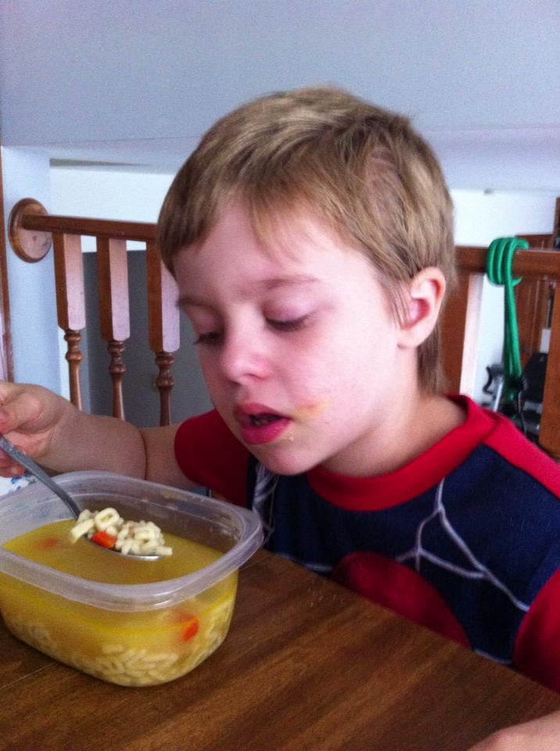
Questions?
Hopefully everyone is still awake…

