Slide 1
Open Access in Europe: progress and policy
FOSTER Project event, Croatian Ministry of Science, Education & Sports Zagreb, 10 December 2014
Alma Swan
SPARC Europe
Key Perspectives Ltd
Enabling Open Scholarship

Slide 2
Shape of this presentation
Some context
OA benefits for authors, institutions and funders
The policy picture
Policy formulation

Slide 3
Some context: progress of Open Access

Slide 4
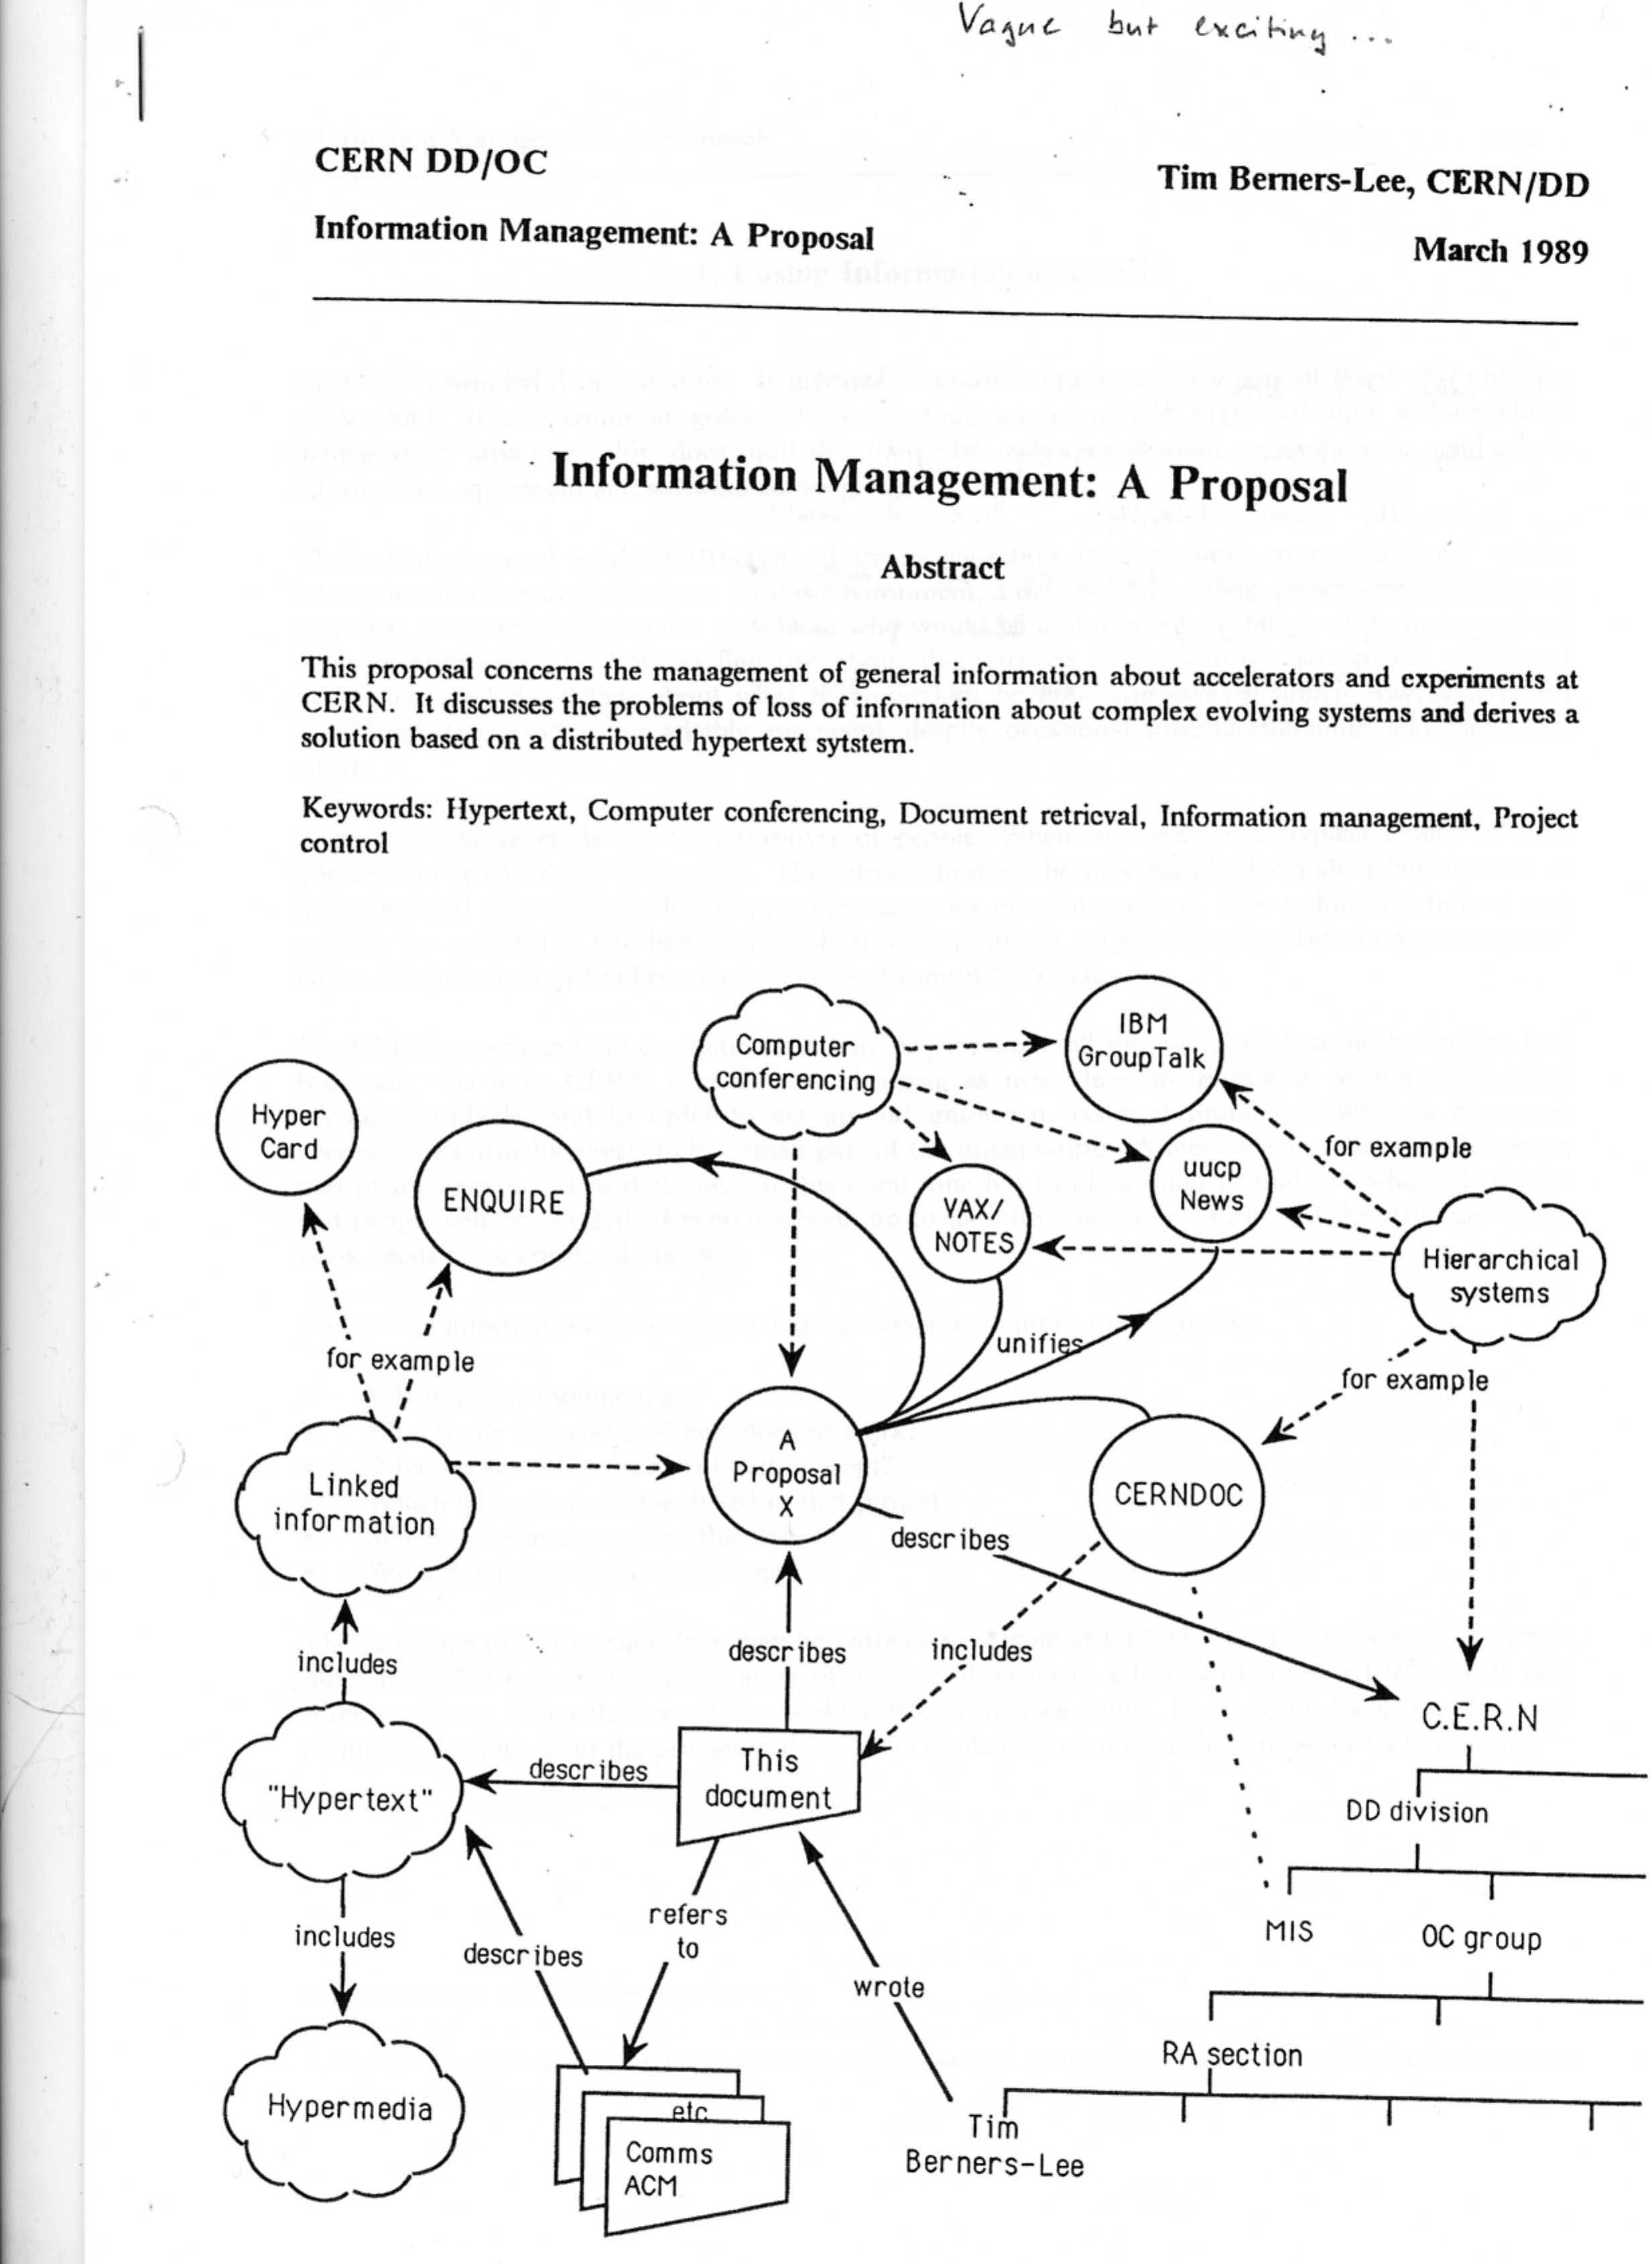

Slide 5
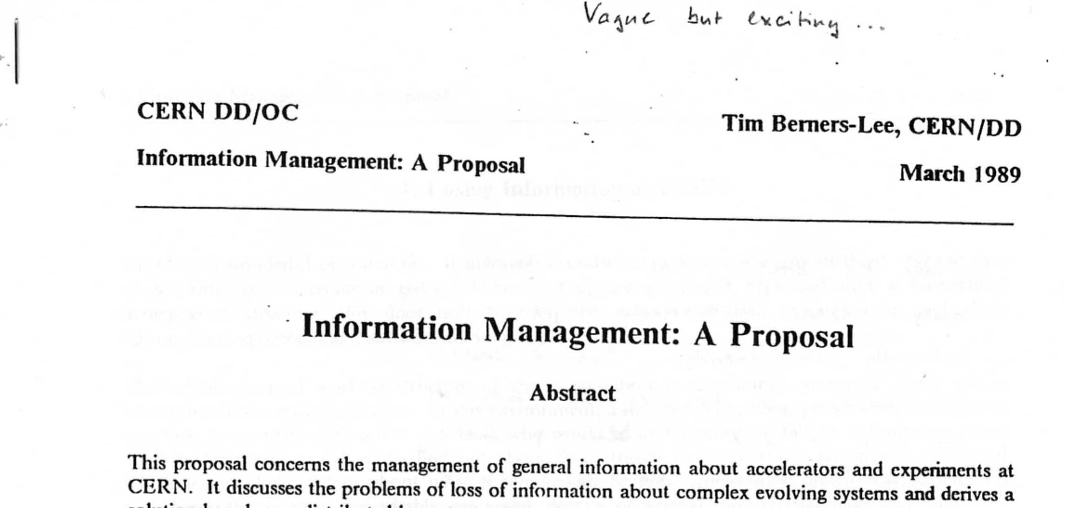

Slide 6
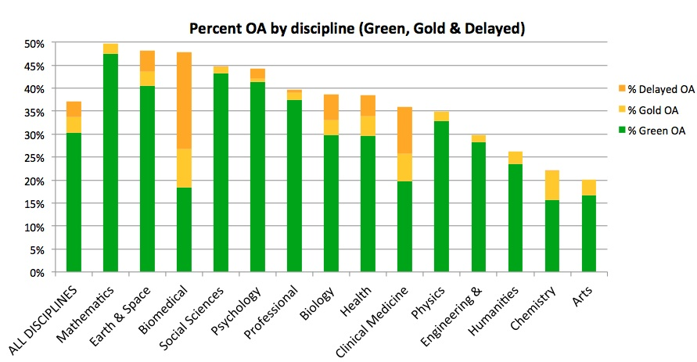

Slide 7
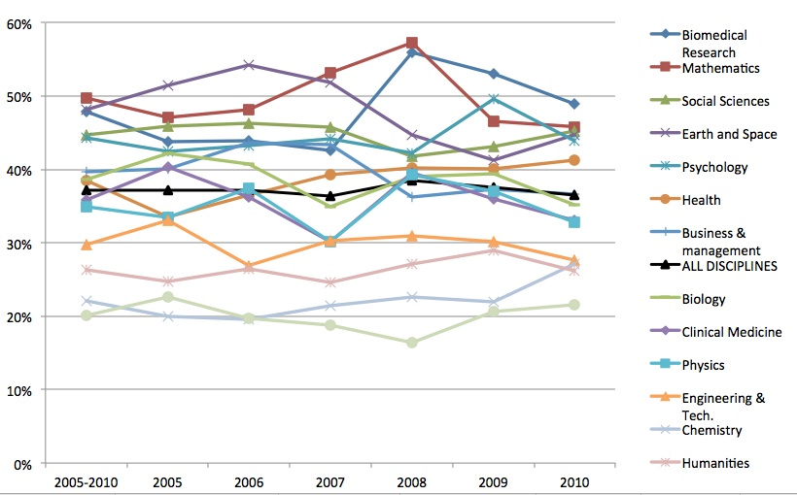

Slide 8
Why so low after > 15 years?
Lack of awareness
Lack of understanding
Overdose of misunderstandings
Fear of repercussions
Reward systems in academia entrench conservative behaviour
Glacial pace of academic adoption of the Web

Slide 9
What’s in it for authors?

Slide 10
Author advantages from Open Access
Visibility
Usage
Impact
Personal profiling and marketing

Slide 11
Visibility

Slide 12
An author’s own testimony on open access visibility
“Self-archiving in the PhilSci Archive has given instant world-wide visibility to my work. As a result, I was invited to submit papers to refereed international conferences/journals and got them accepted.”

Slide 13
Usage

Slide 14
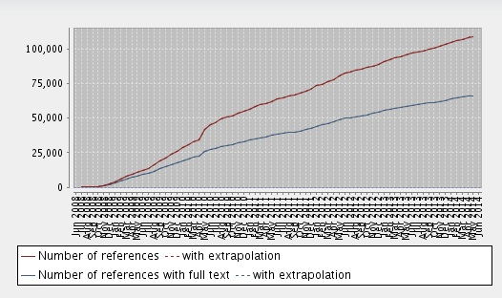
University of Liege repository: authors deposit

Slide 16
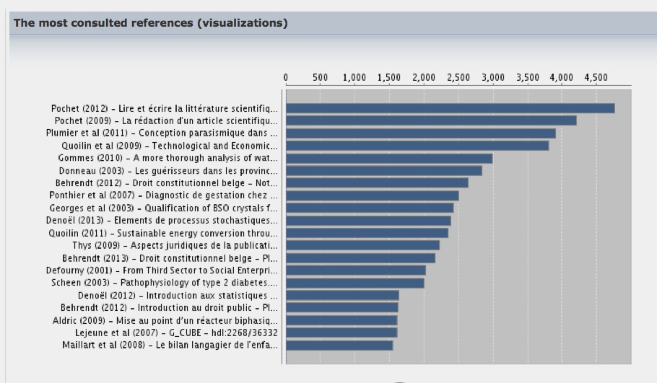
Individual article usage: annual levels

Slide 17
Individual article usage: monthly levels

Slide 18
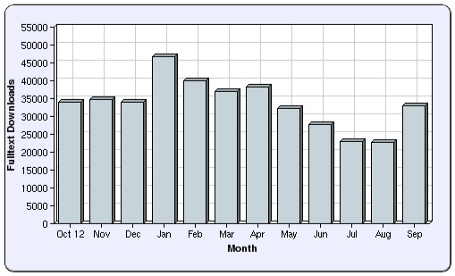
University of Salford: USIR
c9000 records

Slide 19
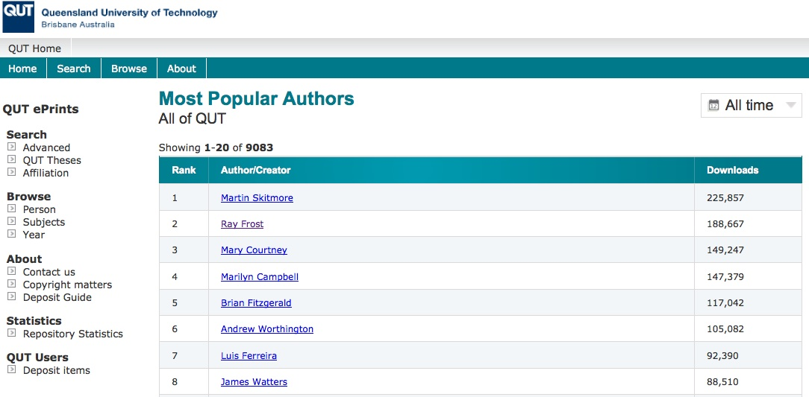
Individual authors’ usage

Slide 20
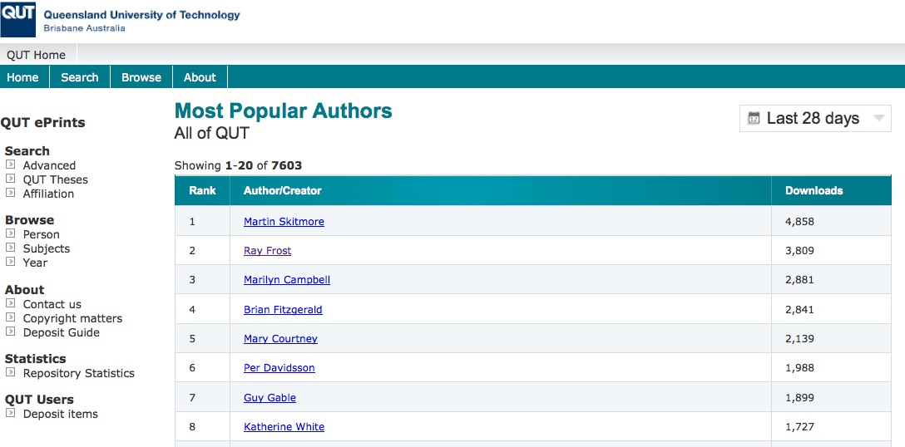
Individual authors’ usage

Slide 21
Impact

Slide 22
Citation impact
Range = 36%-200%
(Data: Stevan Harnad and co-workers)

Slide 23
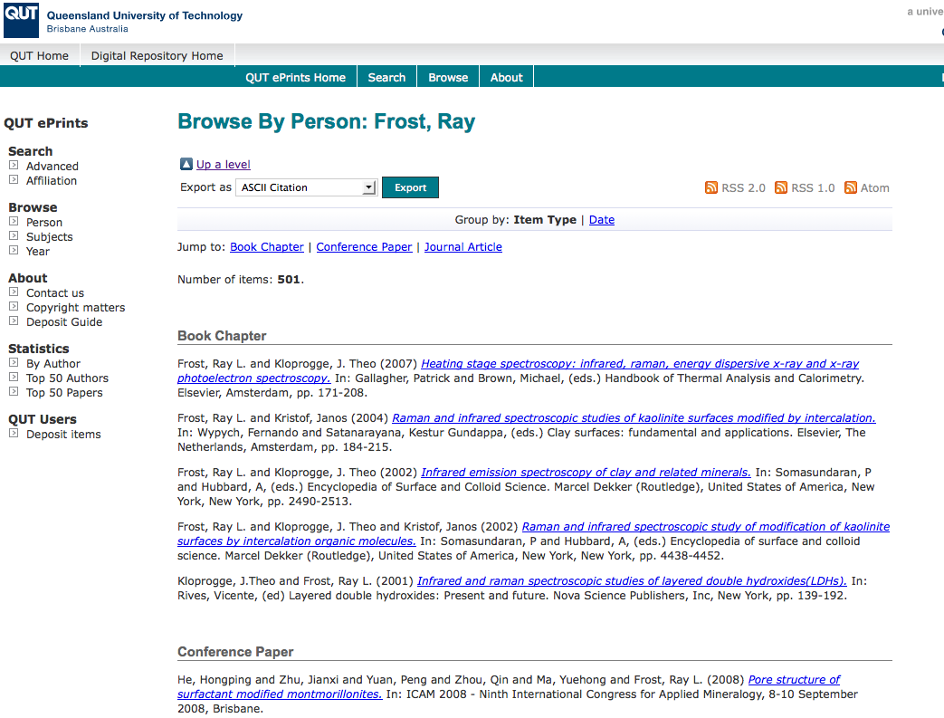
What OA means for a researcher’s citation impact

Slide 24
Top authors (by download)

Slide 25
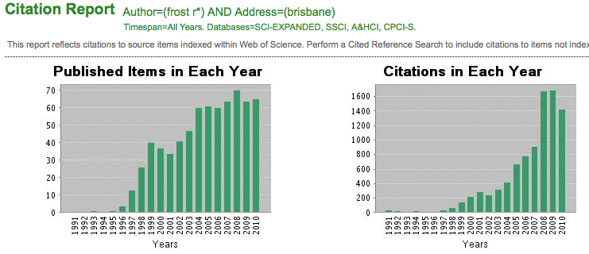
Ray Frost’s impact

Slide 26
Top authors (by download)

Slide 27
Martin Skitmore (Urban Design)

Slide 28
Engineering
Citations
Data: Gargouri & Harnad, 2010

Slide 29
Clinical medicine
Citations
Data: Gargouri & Harnad, 2010

Slide 30
Social science
Citations
Data: Gargouri & Harnad, 2010

Slide 31
Profiling and marketing

Slide 32
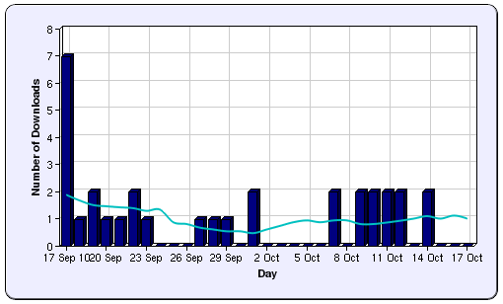

Slide 33
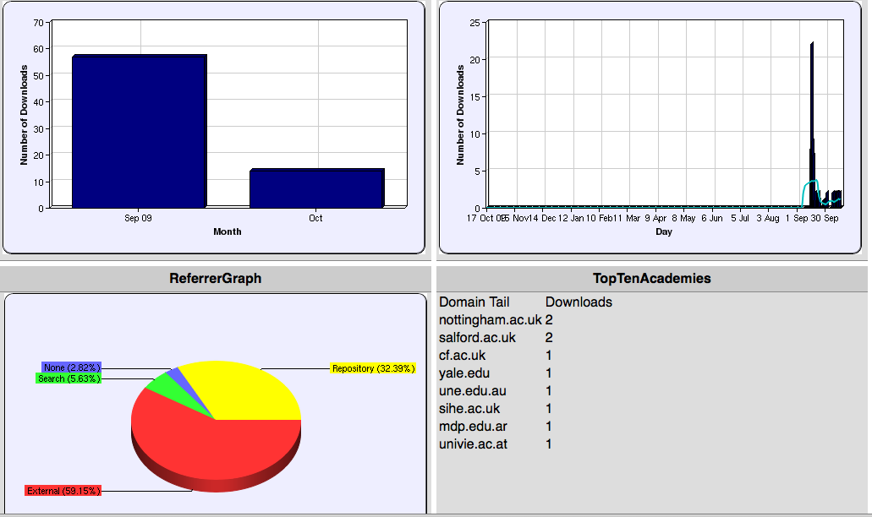

Slide 34
Melissa Terras

Slide 35
To summarise …
More views
More downloads
More tweets
More citations (see SPARC Europe site for list of studies and summary of findings)

Slide 36
For institutions?

Slide 37
“The case for Open Access within a university is not simply political or economic or professional.
It needs to rest in the notion of what a university is and what it should be .... It is central to the university’s position in the public space”
Professor Martin Hall, Vice Chancellor of the University of Salford, UK

Slide 38
Institutional and funder advantages from Open Access
Visibility, usage
Impact
Profiling and marketing
Outreach to the public: demonstrating social return
Economic benefits
Institutional management information

Slide 39
“I am asked how many articles my researchers publish each year, and I have to say ‘I have no idea!’.
It is like being the manager of a car factory and not knowing what models of car, and how many cars, my factory produces.”
Professor Bernard Rentier, Rector, University of Liege, Belgium, explaining one of the reasons why he has built an institutional Open Access repository and introduced a mandatory policy on Open Access

Slide 40
Outreach: the public
Independent researchers
Education sector
Professional community
Practitioner community
Interested ‘lay’ public
Business sector, including innovative SMEs

Slide 41
PubMed Central
2 million full-text articles
c500,000 unique users per day:
25% universities
18% government and others
40% citizens
17% companies

Slide 42
Economic implications in Denmark
Access to research articles is very/extremely important: 48%
79% have access difficulties
Difficulties in searching/accessing articles: €73m per year to researchers in Danish firms
Average delay to product or process development without access to academic research: 2.2 years
For new products: €4.8 million per company
Houghton, Swan & Brown, 2011

Slide 43
EU CIS studies

Slide 44
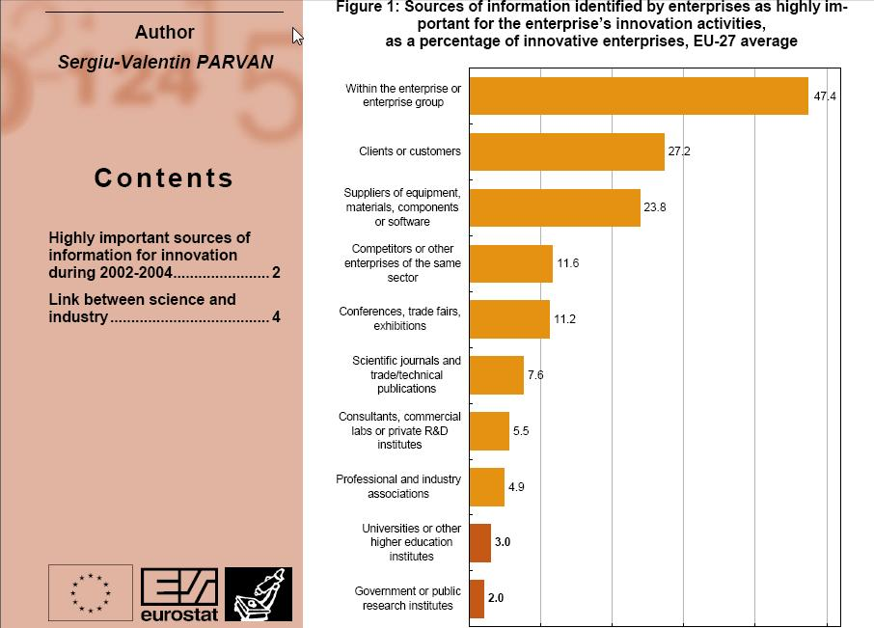

Slide 45
Total Research Income: QUT and sector
Data: Tom Cochrane, Deputy Vice-Chancellor, QUT

Slide 46
Senior Lecturer, Design, QUT
“Just last week, the General Manager of Sustainable Development from an Australian rural industry called me – based on reading one of my research papers in ePrints.
He loved what he read ..... and we are now in discussion about how we can help them measure their industry’s social impacts.”

Slide 47
For research funders?

Slide 48
Funder benefits
Better science
More efficient research process
Research impact, monitoring, management
Outreach to new users
Economic benefits

Slide 49
The Open Access policy picture

Slide 50
Policies: worldwide numbers

Slide 51
Current global picture: Open Access policies
Region | Policies
Europe | 356
North America | 146
Central & South America | 35
Africa | 11
Asia | 65
Oceania | 38
Total | 651
Data: ROARMAP (Registry of Open Access Policies and Mandates) http://roarmap.eprints.org/

Slide 52
Open Access policies worldwide

Slide 53
Policy formulation
Several essential elements
Mandatory
Deposit immediately (at acceptance for publication)
Deposit required, but OA itself may come later
Connect deposit with research assessment

Slide 54
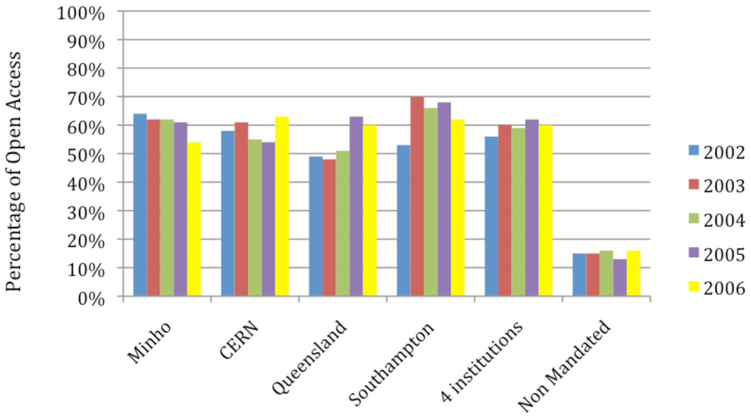
The effect of a mandatory policy

Slide 55
Current global picture: Open Access mandates
Region | Mandates
Europe | 203
North America | 70
Central & South America | 17
Africa | 6
Asia | 32
Oceania | 18
Total | 346

Slide 56
Open Access mandates worldwide

Slide 57
‘Green’ Open Access: Time of deposit
When deposit is required | Number | %
Acceptance date | 52 | 15
Publication date | 64 | 13
By the end of a defined, permitted embargo period | 33 | 9
When the publisher permits | 5 | 5
Not mentioned | 143 | 41
Other | 38 | 11

Slide 58
‘Green’ Open Access: Time of deposit

Slide 59
‘Green’ Open Access: Time of deposit

Slide 60
Link to research evaluation and assessment
Region | Number of policies linked to research assessment | % of total policies linked to research assessment
Europe | 5 | 36
North America | 4 | 29
Central / South America | 0 | 0
Africa | 0 | 0
Asia | 5 | 36
Oceania | 0 | 0
All | 14 | 100%

Slide 61
‘Gold’ Open Access
No requirements for ‘Gold’ Open Access
Some funder policies emphasise or prefer it

Slide 62
‘Gold’ Open Access: policy provisions
Gold Open Access conditions | % all | % European
‘Gold’ Open Access costs allowable from grant | 3.3 | 3.9
Funder provides additional funds for ‘Gold” OA costs | 2.7 | 4.8
Institution has a ‘Gold’ Open Access fund | 9.6 | 8.1

Slide 63
‘Gold’ Open Access: policy provisions

Slide 64
Policy effectiveness: Universite de Liege
Must deposit
At acceptance
In the institutional repository (ORBi)
May respect publisher embargoes
Deposit linked to performance assessment
Deposit rate is now 87%
The highest in the world
Second is U.Minho (Portugal): 69% (rising)

Slide 65
University of Liege repository: authors deposit

Slide 66
H2020 and Open Access
Mandatory for peer-reviewed publications
‘Green’ OA mandate (repositories)
Publish as normal in subscription-based journals
Place author’s copy in OA repository
Deposit this at acceptance for publication
‘Gold’ OA: Permits payments from grants for OA journal publication
Mute on monographs
Definite on data, announcing an open data pilot for H2020

Slide 67
OA infrastructure for EU research
Authors
OpenAIRE
Institutional repositories
HARVEST
(metadata)
Readers
Google, etc

Slide 68
Recommendation to Member States (July 2012)
Member States develop policies on OA
Consistency between H2020 policy and those of MS
Coordination of MS at EU level
Reporting at MS and EU level
Multi-stakeholder dialogue to be established

Slide 69
PASTEUR4OA project
Policy Alignment Strategies for European Union Research
Promoting policy development
Promoting good policy development:
Mandatory
Deposit in repository
At the time of acceptance for publication
Link deposit to performance evaluation
Developing a network of national expert organisations to encourage and advise policymakers

Slide 70
Policy alignment
Irons out dissonances for researchers working in interdisciplinary areas or on international teams
Supports EU harmonisation agenda for ERA (research conditions, researcher mobility, gender issues, knowledge sharing, etc)
Key issue in changing author practices and norms
Allows generic infrastructural services to be established in support of policy

Slide 71
Critical policy elements
Must deposit
At acceptance for publication
In institutional repositories
May respect publisher embargoes
Deposit linked to performance assessment

Slide 72
Thank you for listening
almaswan3@gmail.com
www.sparceurope.org
www.openscholarship.org

