Slide 1
Implementing Funders' Open Access Policies: a European Perspective
Repositories Support Project: Implementing Open Access funders’ policies
London, 23 May 2013
Alma Swan
Director of Advocacy, SPARC Europe
Convenor, Enabling Open Scholarship
Director, Key Perspectives Ltd

Slide 2
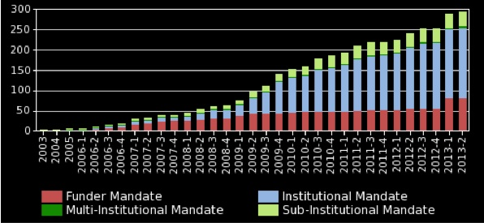
Open Access mandatory policies

Slide 3
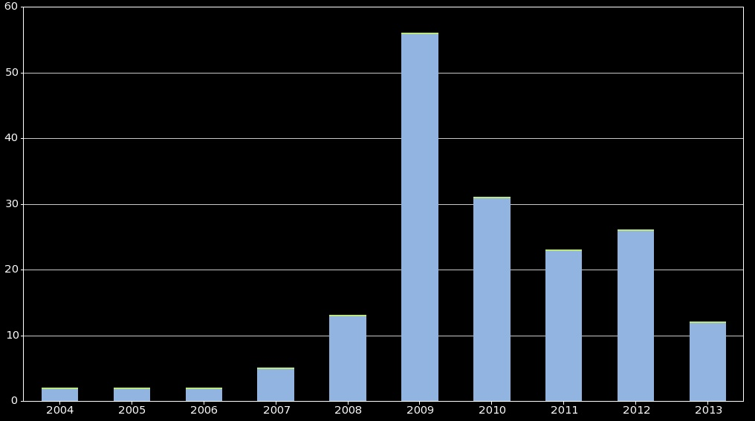
Institutional mandates

Slide 4
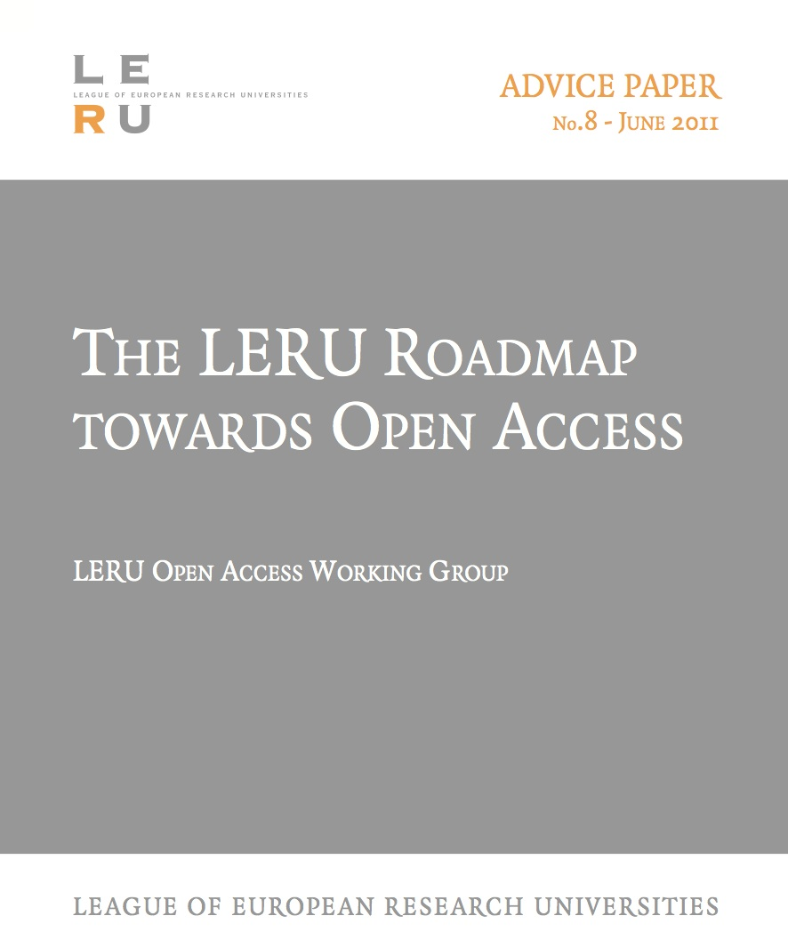

Slide 5
LERU Roadmap Towards Open Access
Laid out the background and case for OA
Described the two routes (‘Green’ and ‘Gold’)
Explained how universities can achieve OA through either (or both) of these routes

Slide 6
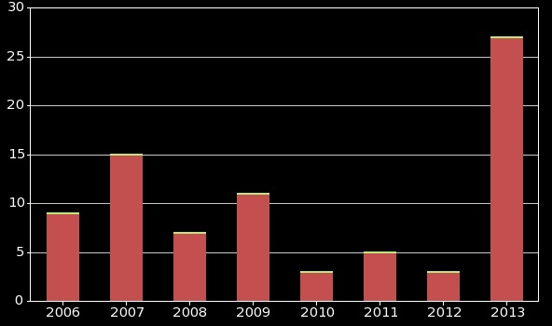
Funder mandates

Slide 7
European mandatory policies

Slide 8
New OA policies in Europe
Institutional mandates:
Belgium 1
Portugal: 3
Spain: 1
UK: 1
Ukraine 1
Funder mandates:
Denmark (joint policy from 5 national funders)
Ireland (joint policy from 17 organisations, including RPOs and funders)
EU: European Research Council: Updated guidelines (2012)
6 months embargo
including primary data
UK: RCUK: revised policy
EU: European Commission: Horizon 2020

Slide 9
H2020 and Open Access
Mandatory (non-policed mandate on 20% FP7 research)
‘Green’ OA mandate:
Authors deposit into local repositories
‘Harvested’ by OpenAIRE (Commission-funded European repository)
Shop window for European research
Permits payments from grants for ‘Gold’ OA

Slide 10
Scientific data
“Our vision is a scientific e-infrastructure that supports seamless access, use, re-use and trust of data. In a sense … the data themselves become an infrastructure – a valuable asset on which science, technology, the economy and society can advance.” (Neelie Kroes, 2011)
H2020 has a proposed DATA PILOT

Slide 11
Policy alignment
Irons out potential dissonances for researchers working in interdisciplinary areas or on international teams
Supports EU harmonisation agenda for ERA (research conditions, researcher mobility, etc)
Key issue in changing author practices and norms
Allows generic infrastructural services to be established in support of policy
Alignment in general terms across all national policies (and H2020) so far ….
….Bar one

Slide 12
Already +/- aligned in the ERA
Austria (Austrian Research Council, 2006)
Belgium (Flanders, 2007)
Belgium (Wallonia, 2013)
Denmark (the 5 research councils, 2012)
Hungary (Hungarian Research Fund, 2009)
Ireland (the 4 research funders 2007, 2008, 2009: research organisations, 2012)
Norway (Norwegian Research Council, 2009)
Spain (National Government policy 2011)
Sweden (the 2 research councils, 2009, 2010)
Switzerland (Swiss National Science Foundation, 2007)

Slide 13
Policy analysis
49 mandatory policies in ROARMAP:
Type | Number
Green OA mandate | 36
Green OA mandate with Gold option | 12
Gold preference with Green option | 1
Gold costs can be paid from research grant = 19
or claimed from funder

Slide 14
RCUK
Policy built on Finch recommendations
Favours ‘Gold’ OA
Based on:
Acquiring rights for re-use
Protecting publishers
No real attempt by Finch or RCUK to protect the UK research community from escalating publishing costs

Slide 15
Budapest Open Access Initiative
An old tradition and a new technology have converged to make possible an unprecedented public good.
Westminster Open Access Initiative
An old tradition and a new technology have converged to make possible an unprecedented injection of public cash.
Dr Les Carr, University of Southampton, 2013

Slide 16
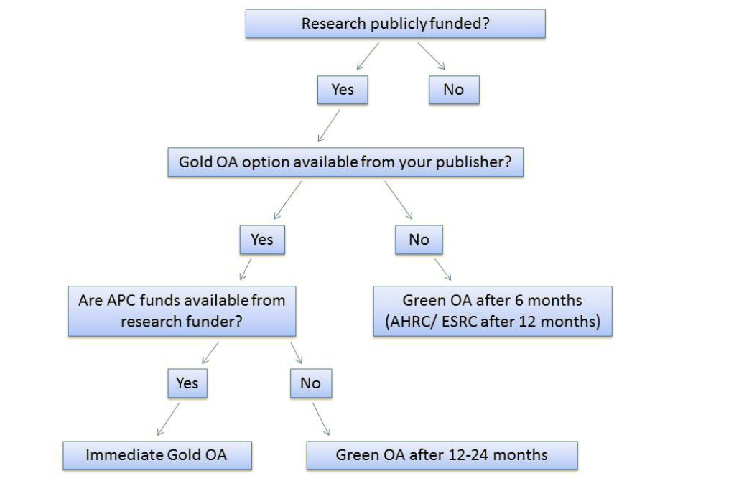
The (Publishers Association’s) decision tree

Slide 17
Springer
“Authors may self-archive the author’s accepted manuscript of their articles on their own websites. Authors may also deposit this version of the article in any repository, provided it is only made publicly available 12 months after official publication or later. …”

Slide 18
Emerald
“As a result of the changing policy-making environment, particularly in the UK where the government has enacted legislation to accelerate implementation of Open Access, Emerald is introducing a new Open Access policy.
The deposit of the post-print ... may now only be done after a 24-month embargo period from the official online date of publication. This embargo period is in line with the limits set by the RCUK for social science content.”

Slide 19
The REF (HEFCE)
Post-2014 REFs
Only articles made OA will qualify
Must have been OA (deposited) from the time the article was published
No batch uploads in REF years
Aligns with many existing policies and the likely wording of H2020 and FASTR

Slide 20
Other complications
Publishers making ‘agreements’ with funders
Publishers making ‘agreements’ with institutions
Publishers making ‘agreements’ with journal owners (Emerald/IFLA – 9 months)
The poor author!

Slide 21
What to do?
Repository managers are more important than ever now
Make things as simple as possible for authors
Deposit at acceptance
Open the full-text at the appropriate time
Be prepared to support the process more than hitherto

Slide 22
Thank you for listening
aswan@talk21.com
www.sparceurope.org
www.openscholarship.org
www.openoasis.org
www.keyperspectives.co.uk

