Slide 1
A New Semantic Similarity Based Measure for Assessing Research Contribution
Petr Knoth & Drahomira Herrmannova
Knowledge Media institute, The Open University
Notes:
In this presentation, I would like to talk about the problems of existing impact metrics. These problems led us to the development of a new approach, based on the processing of publication full-texts, for automatically assesing the research contribution.

Slide 2
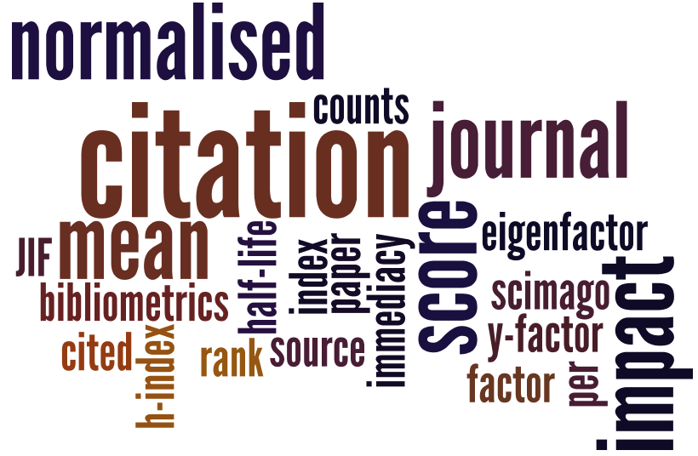
Current impact metrics
Pros: simplicity, availability for evaluation purposes
Cons: insufficient evidence of quality and research contribution
Notes:
As you might know, there is a wide range of metrics that are currently used for evaluation of research. You can see them in the foloowing tag cloud. These metrics have one thing in common. They are all based on citations. This has both advantages and disdvanatages.They are … Let me say a few more things about the cons

Slide 3
Problems of current impact metrics
Sentiment, semantics, context and motives [Nicolaisen, 2007]
Popularity and size of research communities [Brumback, 2009; Seglen, 1997]
Time delay [Priem and Hemminger, 2010]
Skewness of the distribution [Seglen, 1992]
Differences between types of research papers [Seglen, 1997]
Ability to game/manipulate citations [Arnold and Fowler, 2010; Editors, 2006]

Slide 4
Alternative metrics
Alt-/Webo-metrics etc.
Impact still dependent on the number of interactions in a scholarly communication network
Full-text (Semantometrics)
Contribution to the discipline dependent on the content of the manuscript.
Notes:
There is now also a lot of interest in new metrics, which are referred to as Alt and Webometrics. However, these metrics are (in the same way as citation based metrics) still dependent on the number of interactions in the scholarly communication network.
We are proposing a new class of evluation metrics => Semantometrics. These metrics are based on the assujmption that it is not possible to evaluate research impact without accessing the research outputs ☺ .
We will now describe one new method that falls into this class, but we emphasize that many similar methods can be developed.
////////
By Semantometrics we do not mean: the use of “a combo of folksonomies, semantic web, and Xmetrics.”

Slide 5
Approach
Premise: Full-text needed to assess publication’s research contribution.
Hypothesis: Added value of publication p can be estimated based on the semantic distance from the publications cited by p to publications citing p.
Notes:
This hypothesis is based on the process of how research builds on the existing knowledge in order to create new knowledge on which others can build. A publication, which in this way creates a \bridge" between what we already know and something new which will people develop based on this knowledge, brings a contribution to science. A publication has a high contribution if it creates a \long bridge" between more distant areas of science.

Slide 6
Contribution measure
Average distance of the set members
A
B
dist(a,b)
dist(b₁,b₂)
p
Notes:
a!=b because of loops in the citation network

Slide 7
Datasets
Requirements
Availability of full-text
Density
Multidisciplinarity

Slide 8
Datasets (present as table)
Examined datasets
CORE
Open Citation Corpus
ACM Dataset
DBLP+Citation
KDD Cup Dataset
iSearch Collection
However...
TABLE

Slide 9
Our dataset
10 seed publications from CORE with varying level of citations
missing citing and cited publications downloaded manually
only freely accessible English documents were downloaded
in total 716 documents (~50% of the complete network)
2 days to gather the data

Slide 10
Results
Publication no. | |B| (Citation score) | |A| (No. of references) | Contribution
1 | 5 (9) | 6 (8) | 0.4160
2 | 7 (11) | 52 (93) | 0.3576
3 | 12 (20) | 15 (31) | 0.4874
4 | 14 (27) | 27 (72) | 0.4026
5 | 16 (30) | 12 (21) | 0.5117
6 | 25 (41) | 8 (13) | 0.4123
7 | 39 (71) | 70 (128) | 0.4309
8 | 53 (131) | 3 (10) | 0.5197
9 | 131 (258) | 22 (32) | 0.5058
10 | 172 (360) | 17 (20) | 0.5004
 | 474 (958) | 232 (428)
Notes:
Example 1: filtering out self-citations (articles 2 and 3)
Example 2: practical paper vs popular topic (articles 8 and 9)
Example 3: survey papers (popular and highly cited with almost no contribution)

Slide 11
Results
Notes:
We are not trying to find a complete correlation (because citations are not the optimal measure), in fact a weak or no correlation is better.
It’s not good to cite just for the sake of citing, on the other hand I have to cite what I’m writing about otherwise I won’t pass peer review.

Slide 12
Current impact metrics vs Semantometrics
✔
Unaffected by, CROSS (red), TICK (green)
Sentiment, semantics, context and motives
Popularity and size of research communities
Time delay [Reduced to 1 citation]
Skewness of the distribution
Differences between types of research papers
Ability to game/manipulate citations [solved providing that self-citations not allowed]
TABLE
✔
✔
✔
✔
✔

Slide 13
Conclusions
Full-text necessary
Semantometrics are a new class of methods.
We showed one method to assess the research contribution
Notes:
The leads us to the conlusion that it is not possible to evaluate research impact without accessing the research outputs ☺

Slide 14
References
Jeppe Nicolaisen. 2007. Citation Analysis. Annual Review of Information Science and Technology, 41(1):609-641.
Douglas N Arnold and Kristine K Fowler. 2010. Nefarious numbers. Notices of the American Mathematical Society, 58(3):434-437.
Roger A Brumback. 2009. Impact factor wars: Episode V -- The Empire Strikes Back. Journal of child neurology, 24(3):260-2, March.
The PLoS Medicine Editors. 2006. The impact factor game. PLoS medicine, 3(6), June.

Slide 15
References
Jason Priem and Bradely M. Hemminger. 2010. Scientometrics 2.0: Toward new metrics of scholarly impact on the social Web. First Monday, 15(7), July.
Per Ottar Seglen. 1992. The Skewness of Science. Journal of the American Society for Information Science, 43(9):628-638, October.
Per Ottar Seglen. 1997. Why the impact factor of journals should not be used for evaluating research. BMJ: British Medical Journal, 314(February):498-502.

