Slide 1
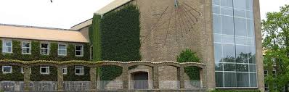
Open Access in Denmark – new politics and demands

Slide 2
Open Science
Open Science covers the work of implementing Open Access to research publications, as well as preserving and ensuring access to research data.
Open Access to peer-reviewed scientific articles
Open Access to research data

Slide 3
Political background – Open Science
In 2007 the Danish Government endorsed the EU Council’s conclusions concerning ”Scientific information in the digital age: access, dissemination and preservation”.
Open Access committee placed under the Steering Committee for Denmark´s Electronic Research Library (DEFF) – recommendations for implementation of Open Access in Denmark 2011 (report)
2012: Commission Recommendation on access to and preservation of scientific information.
December 2012: Denmark´s national innovation strategy: Denmark – a nation of solutions: Initiative 17: Strengthen commercial access to knowledge: “…..there will be an effort to increase access to publicly financed research articles “.
September 2013: Open Access to scientific articles - Internal report, Danish Agency for Science, Technology and Innovation.

Slide 4
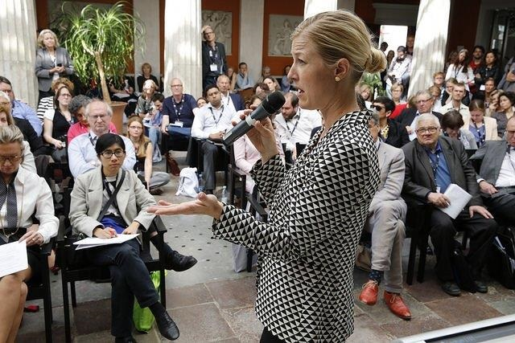
Danish National Strategy for Open Access to Scientific Articles
Announced on EuroScience Open Forum (ESOF) in Copenhagen 24th of June 2014
Minister for Higher Education and Science Sofie Carsten Nielsen presents the strategy at NordForsk-session: Scientific Impact and Open Access
Foto: NordForsk/Terje Heiestad

Slide 5

Danish National Strategy on Open Access
Vision
To create free access for all citizens, researchers and companies to all research articles from Danish research institutions financed by public authorities and/or private foundations.

Slide 6

Danish National Strategy on Open Access to Scientific Articles
Targets
To achieve by 2017 via digital archives – repositories – unimpeded, digital access for all to 80 per cent of Danish peer-reviewed scientific articles from Danish research institutions published in 2016.
To achieve from 2022 and onwards unimpeded, digital access for all to 100 per cent of all Danish peer-reviewed scientific articles from Danish research institutions published from 2021 and onwards.

Slide 7
The National Strategy on Open Acces - focus areas
Primarily the green model – the golden model is ok if it doesn´t imply extra costs for publishing
Examine the opportunity for a long-term cost-effective transition to the golden model
Collaboration between relevant actors – no legislation
Ensure that that researchers keep part of their copyright

Slide 8
The National Strategy on Open Acces - focus areas (2)
The implementation of Open Access is to be monitored on an ongoing basis
Researchers are to be informed of the practical use of the infrastructure by publishing in Open Access
Companies are to be informed of the opportunities to obtain state-of-the-art research for their innovation
one well-functioning platform for general dissemination of Danish Research findings must be created

Slide 9
Implementation based on two core principles
The implementation of Open Access is to support the possibility for Danish researchers to continue to publish in the most recognized national and international journals, and also the possibility to publish in Danish-language journals
The aggregate public expenditure for scientific publication must not increase significantly as a result of the implementation of Open Access

Slide 10
Definitions of key concepts

Slide 11
Definitions of key concepts - the National Strategy for Open Access
Focus: Scientific articles in jounals and anthologies, including conference contributions.
Scientific monographs, patents and Ph.D. and doctoral dissertations are excempted.

Slide 12
Definitions of key concepts (2)
The Green model
Green Open Access refers to publication in a quality-assured journal coupled with parallel filing of the final quality-assured version of the researcher’s article in a digital archive – a repository – to which there will be open access for all
interested persons via the Internet – potentially after a waiting period if required by the journal.

Slide 13
Definitions of key concepts (3)
The Golden model
The journal as such is published as Open Access, and all its articles are made immediately accessible online free of charge. The costs are covered either by an editing organisation or through author processing charges (APC) that are paid for each individual article.
For the time being, this model implies, however, considerable extra costs for public authorities in relation to the existing model of publication according to which payment for reading the articles is covered through subscriptions.

Slide 14
Why a national policy?

Slide 15
To increase return on investment in research for the benefit of society!

Slide 16
What are the benefits?
  Public service: Public service will be improved, for instance through improved access by doctors, teachers and so on
  Industry competitiveness: The ability to innovate and hence, the competitive position of the companies will also improve
  Quality of and transparency in research: Impact both on the integrity and the quality of research, including the appearance of new models of peer review
  Cross-disciplinary research and exchange of knowledge and ideas across professional boundaries and scientific fields at the universities will be easier
  The visibility of researchers and universities will be reinforced

Slide 17
Status - Realised potential of Open Access (articles in the bibliometric research indicator )
 | 2009 | 2010 | 2011 | 2012 | 2013
Scientific articles (journals) | 12.773 | 13.402 | 15.385 | 16.726 | 16.263
Scientific articles in Open Access (journals) | 620 | 682 | 952 | 1.171 | 1.790
Realised potential of Open Access | 4,9 % | 5,1% | 6,2% | 7% | 11%

Slide 18
How to promote Open Acces?

Slide 19
Danish National Strategy on Open Access - How to do it?
National Steering Committe on Open Access
Appointed by the Minister for Higher Education and Science in 2014

Slide 20
National Steering Committee on Open Access
Target
To coordinate the implementation and development of the National Strategy for Open Access

Slide 21
Mandate - The National Steering Committee for Open Access
The public expenditure for scientific publication must not increase significantly
Danish researchers´ freedom of publication must not be restrained
The national strategy is the basis for the Steering Committee´s work
The Steering Comittee may suggest to the Minister changes of the strategy

Slide 22
Target group - the National Steering Committee on Open Access
The 8 Danish Universities
Public research councils and public and private foundations
Governmental research institutions
Denmark´s Electronic Research Library (DEFF)
Researchers and research areas

Slide 23
Working modalities – The National Steering Comittee on Open Access
The comittee is run by the Danish Agency for Science Technology and Innovation
The steering comittee must ensure that external stakeholders can contribute to the comittee´s work
The comittee itself decides and organises what to be done according to its mandate
The committee can decide to set up task forces for special issues of a technical character
The comittee must report to the minister at least every half year

Slide 24
Members of the Steering Committe (1)
Director General Hans Müller Pedersen (Chairman), The Danish Agency for Science, Technology and Innovation
Professor Jan Philip Solovej, The Danish Council for Independent Research
Professor Birgitte Possing, Danish National Research Foundation
Forskningschef Anne-Marie Engel, Lundbeck Foundation
Scientific Officer John Peter Wittschieben, Novo Nordisk Foundation
Direktør Erland Kolding Nielsen, The Royal Library on behalf of the governmental research institutions (SEDIRK)
Chairman Børge Obel, Denmark´s Electronical Research Library (DEFF)
Dean John Renner Hansen, University of Copenhagen

Slide 25
Members of the Steering Committe (2)
Library Director Per Lindblad Johansen, Aarhus Universitet
Library Director Mogens Sandfær, Technical University of Denmark
Library Director Bertil F. Dorch, University of Southern Denmark
Senior Librarian Niels-Henrik Gylstorff, Aalborg Universitet
Senior consultant Lars Nondal, Copenhagen Business School
Senior Librarian Claus Vesterager Pedersen, Roskilde University
Associate Professor Espen Aarseth, IT University of Copenhagen
Senior Adviser, P.h.D, Charlotte Greve, University Colleges Denmark
Head of Division Kresten Bay, Ministry of Culture Denmark (observer)

Slide 26
Timetable 2014-2015 - The National Steering Committee on Open Access
1st meeting 23 April: Organising of the task
2nd meeting 17 June: Discussion of which initiatives to implement
3rd meeting 24 September: Decision on initiatives, set up of task forces and discussion of incentives
November - Progress report to the Minister
4th meeting 28 January: Reports from the task forces and discussion on incentives and preparing the next steps etc.

Slide 27
Selected initiatives in 2014-2015
Implementing of ORCID (researcher-ID) - DEFF
Redesign og konsolidation of the Danish Research Database – DEFF
Development of an Open Access Barometer – task force has been set up
Technical solution for Danish Journals with Open Access - task force has been set up

Slide 28
Funding
No funding – only limited seed money for smaller projects!

Slide 29
Open Access - parameters for succes (1)
Universities and Governmental Research Institutions
Local Open Access policy supported by management
Local infrastructures must be in place
Campaigns, incentives and service directed at researchers
Information to companies of the opportunities to obtain state-of-the-art research for their innovation
Realise the potential for legal Open Access which is unexploited!

Slide 30
Open Access - parameters for succes (2)
Public research councils and public foundations
Enforce the Open Access policy adopted in 2012!
Private research foundations
Support the national strategy by adopting local policies on Open Access

Slide 31
Open Access - parameters for succes (3)
Denmark´s Electronic Research Library (DEFF)
Negotiations with publishers in favour of targets of the National strategy
Researchers
Use the right to green Open Access, if the journal allows Open Access
Ensure that researchers keep part of their copyright

Slide 32
Open Access - parameters for succes (4)
Government
Political support for and focus on Open Open Access
Push the process forward by coordinating measures, e.g. running and chairing the National Steering Comittee on Open Access
International cooperation and alignment of policies

Slide 33
Thank you!
More information on Open Access can be found on the Danish Ministry of Higher Education and Science´s webpage:
www.ufm.dk

