Slide 1
How can Universities handle the new challenges of Research communication ?
Bernard Rentier
Honorary Rector, ULg
Chairman, Enabling Open Scholarship (EOS)
(www.openscholarship.org)
Aarhus
October 27, 2014

Slide 2
What is Open Access ?
It is NOT disclosing secret information (what is published is ipso facto public)
It is getting rid of a toll. Research results should be equally accessible to all

Slide 3
Two ways to establish open access
Green OA : publish as usual, deposit in a repository immediately after publication, open the access as soon as possible
Gold OA : publish directly in open access

Slide 4
The dangers of Gold OA
The "author pays" mode :
There is an obvious conflict of interest : "if I pay, you have to publish my work"
Publishers have started to reverse the process : expect high prices
New "publishers" building commercial operations without proper quality control

Slide 5
What are the motivations to create and open a repository ?
Register and make an inventory of the all publications by members of our Institution
Allow our researchers to reach a wider audience, and quicker
Provide our researchers with a set of high added value tools for their publications (metrics, tracking, etc)
Improve the internal evaluation procedures
Eventually reduce the cost of access to scholar literature
Be in line with the requiredments of the European Commission

Slide 6
What are the challenges when creating and opening a repository ?
Win confidence - Researchers must adhere and comply willingly
Use sticks but mostly carrots - Researchers must appropriate the tool for themselves

Slide 7
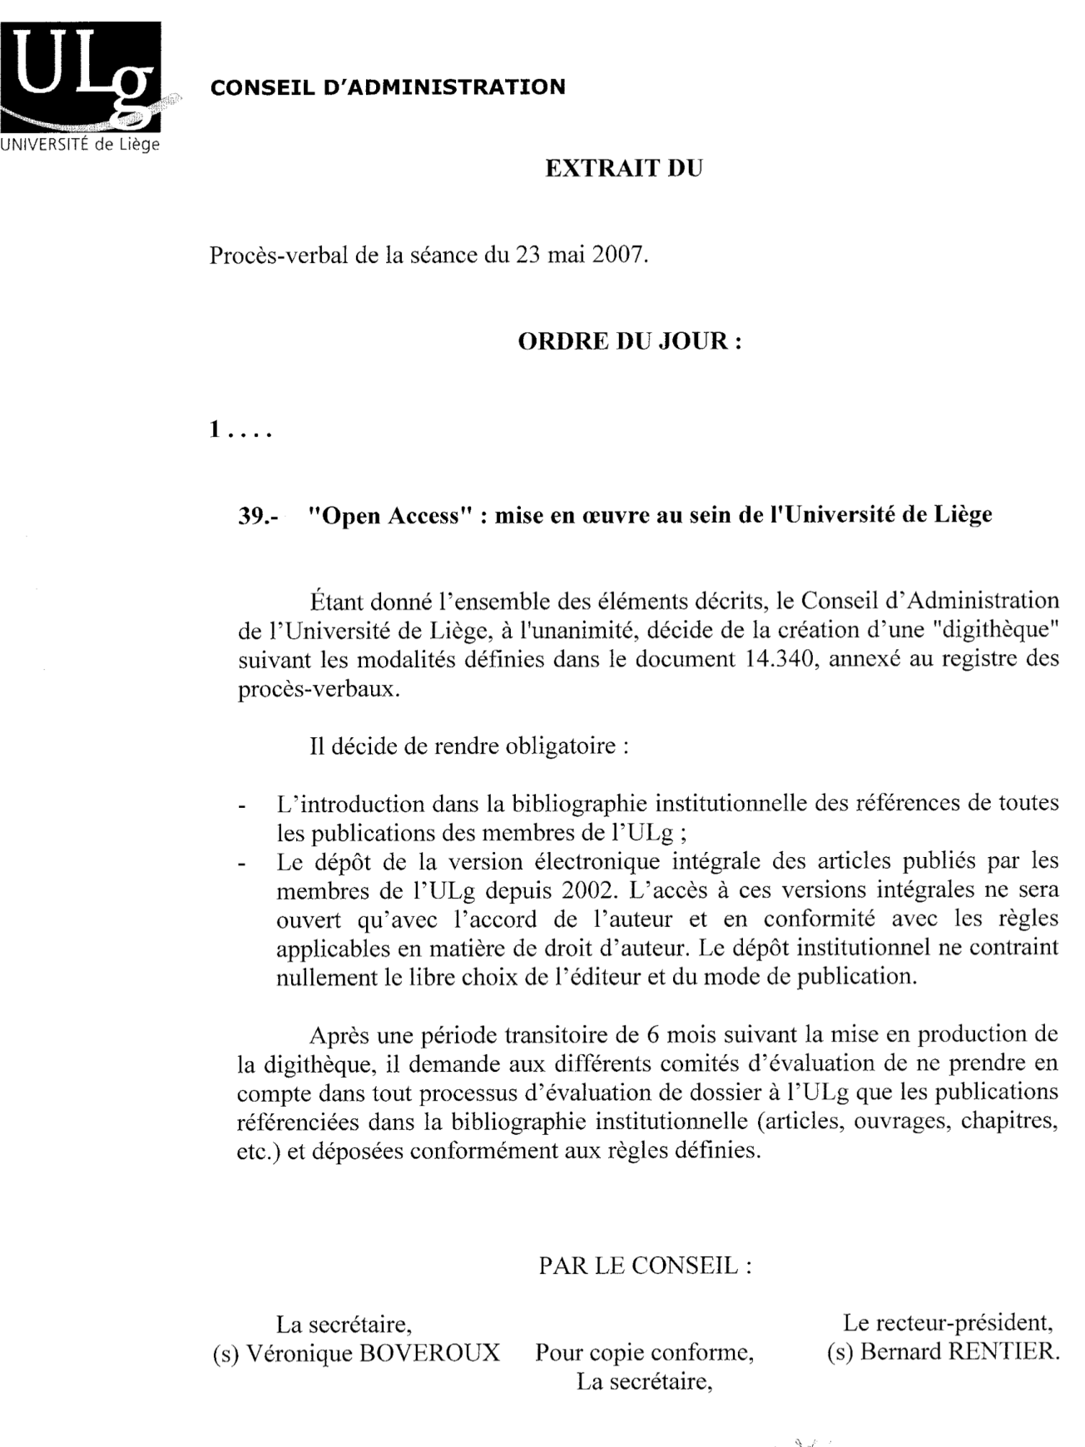
Official Statement
ORBi
Mandate
All publications
Full text since 2002
Only publications taken into account for internal evaluations (grants, promotions, etc.)
Freedom of choice
Abiding with embargo rules if required

Slide 8
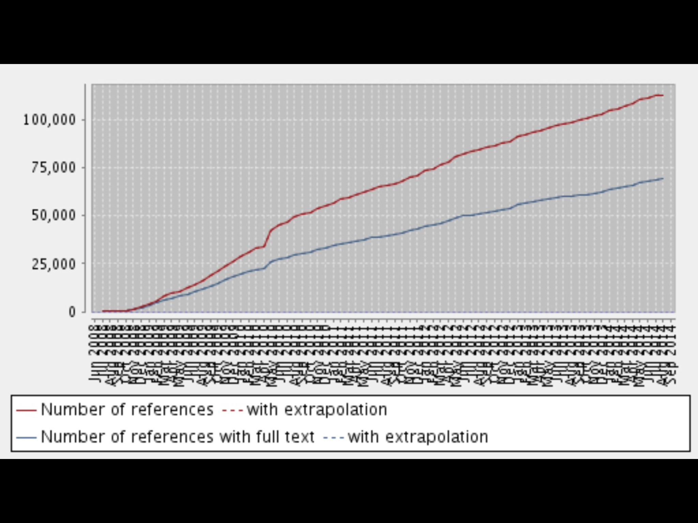
ORBi (20.10.14)
114.215 deposits
69,120 with full text

Slide 9
ORBi
Caution :
proper labeling !

Slide 10
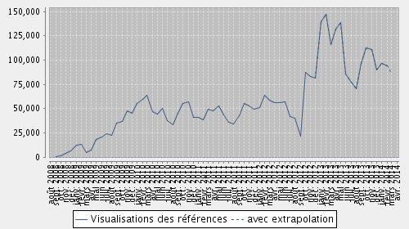
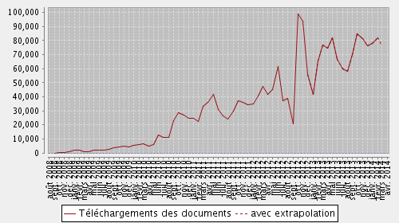
ORBi
Visits:
> 6.000 / day
Monthly rates
Downloads:
> 4.000 / day

Slide 11
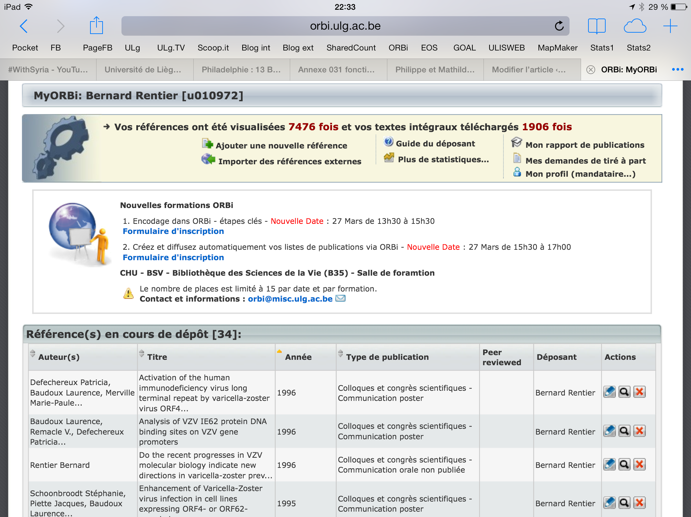
MyORbi

Slide 12
ORBi
Open Repository & Bibliography
Institutional Repository : Green Open Access

Slide 13
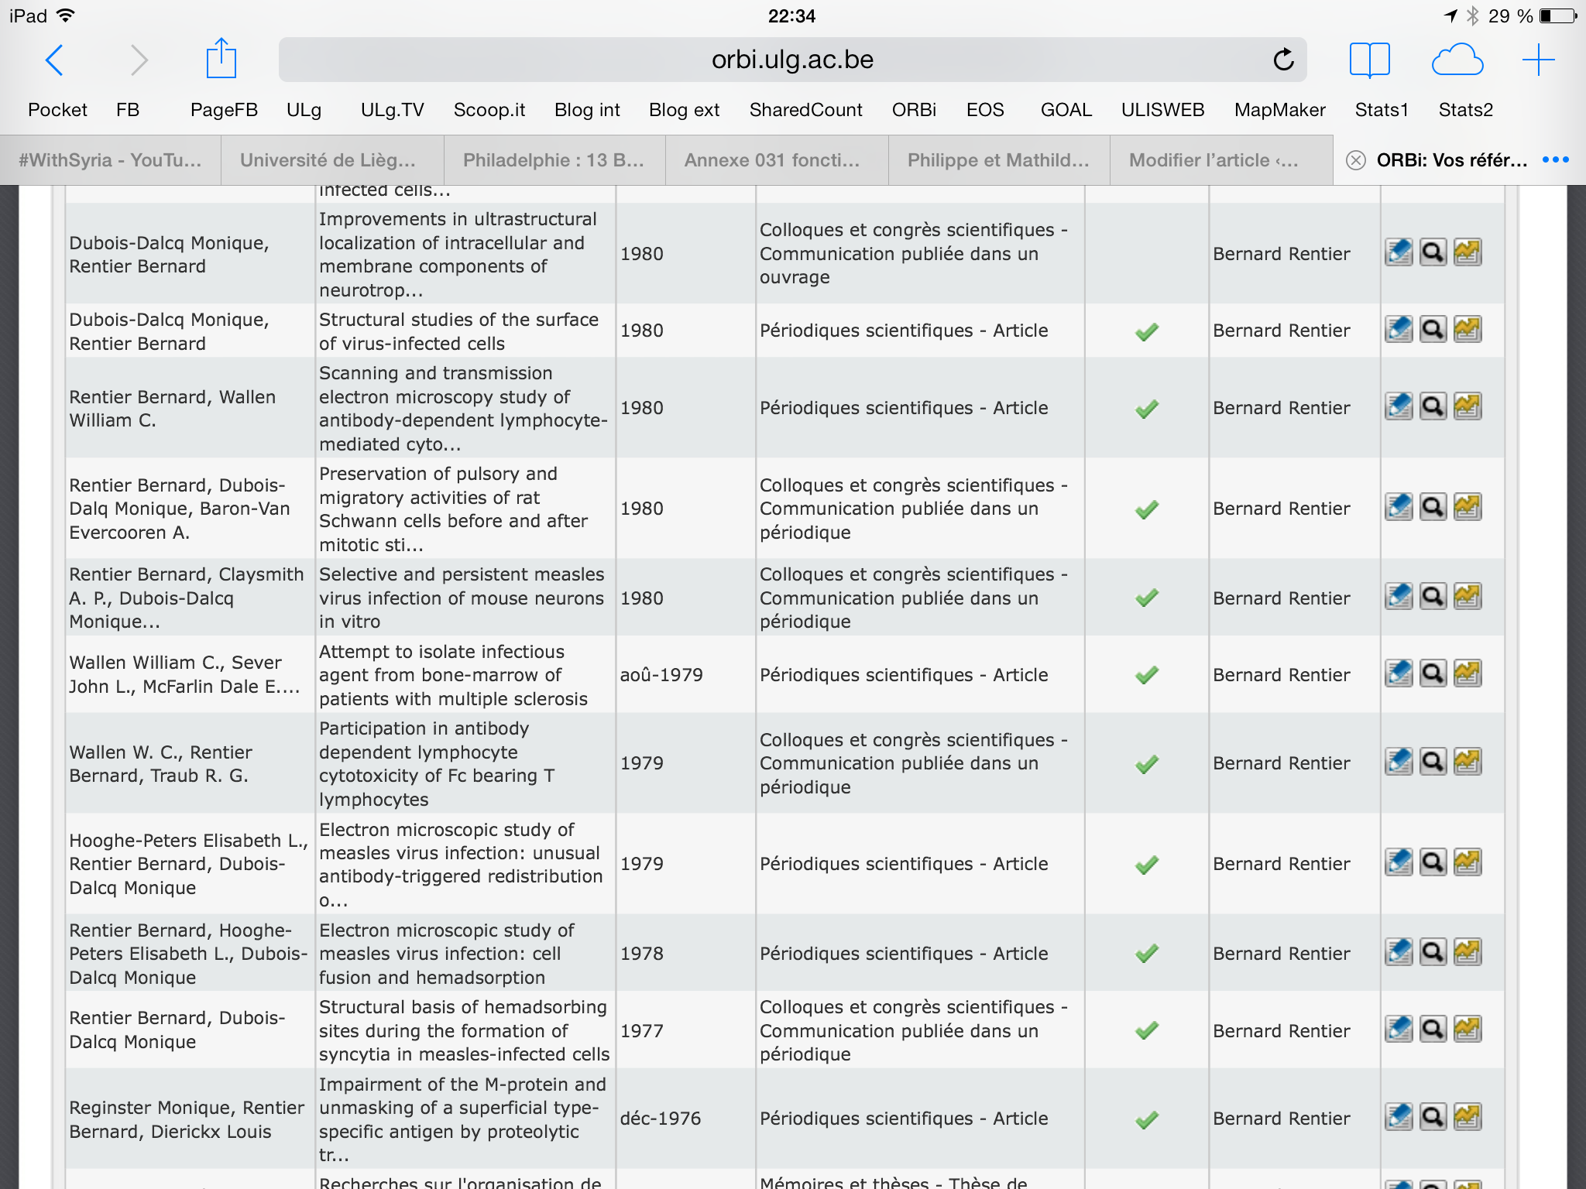

Slide 14
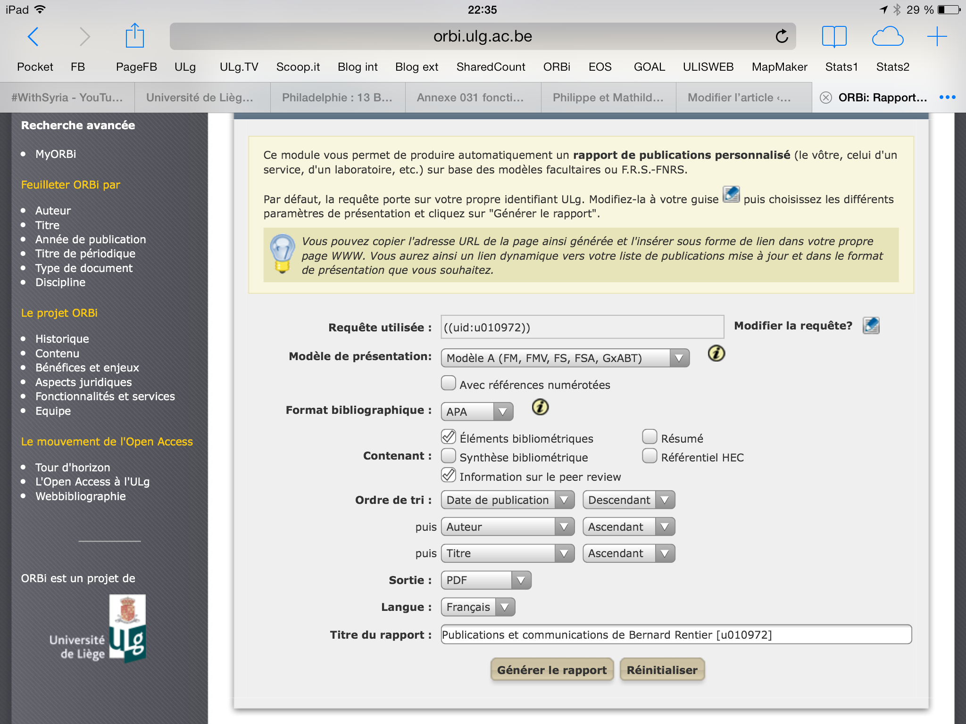

Slide 17
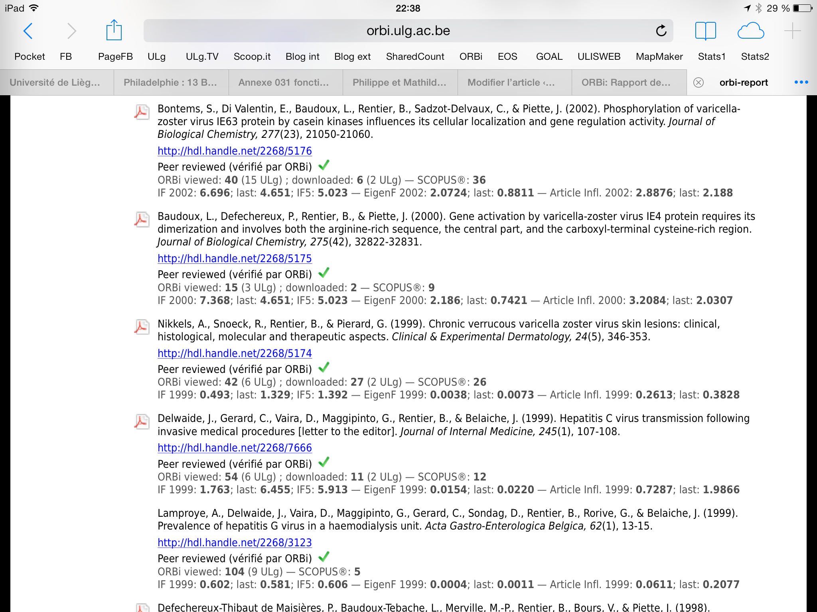

Slide 19
ORBi's compliance:
% deposits
2012 ULg publications in WoS : 82,65 % and in Scopus : 82,04 %
86% in 2013
Objective for 2014 : 90%

Slide 20
Compliance:
full text
Articles
in periodicals
since 2002
Other documents
(non mandatory)
Prior to
2002

Slide 21
Benefits : readership
Impact of open or restricted access on downloading on average per article
X 18,1

Slide 22
Benefits : citations
Impact of the presence or not in ORBi on citations (average per article)
in Scopus (n=351)
or in WoS (n=7673)
in 2011-2012

Slide 23
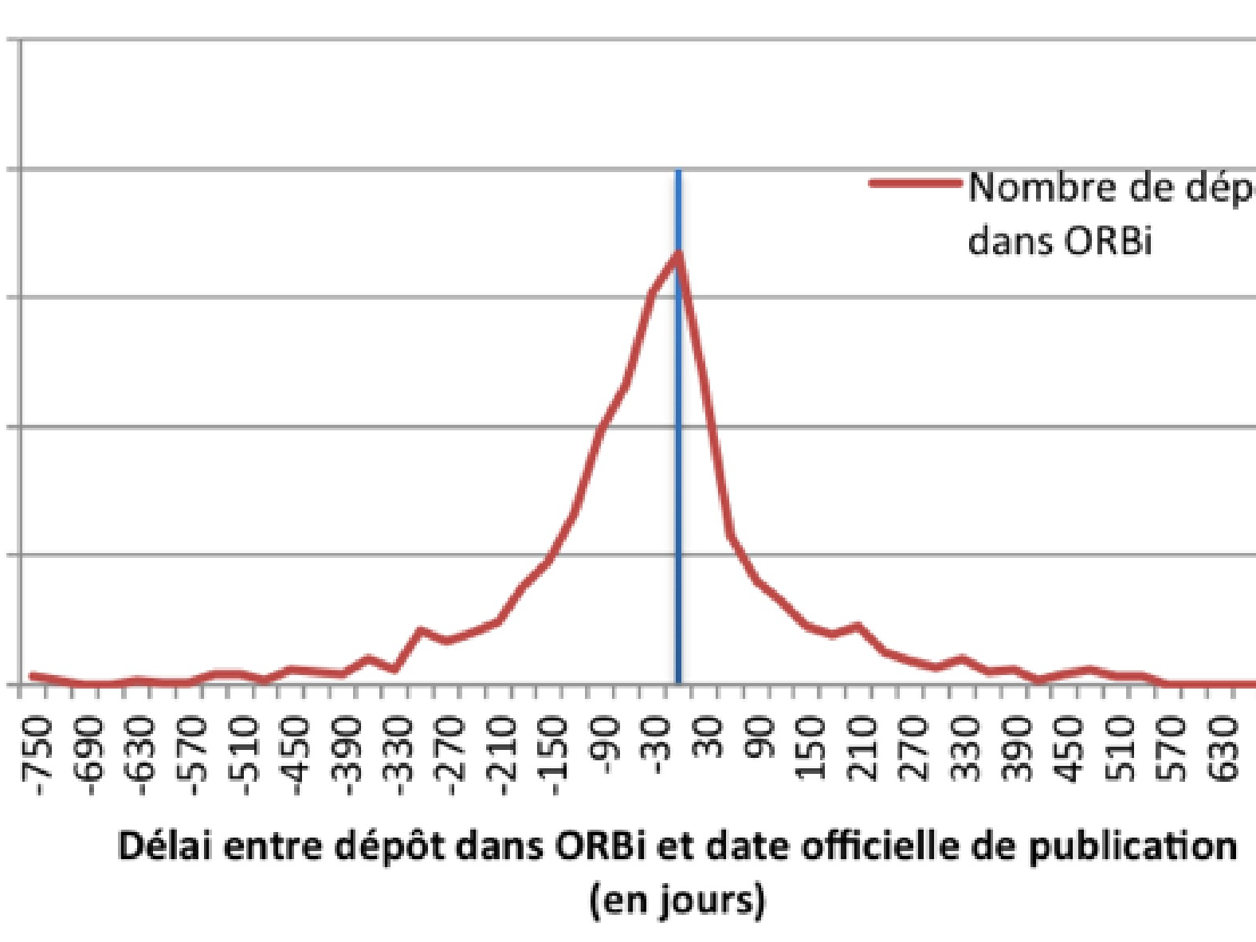
ULg authors are depositing early on

Slide 24
Benefits
increase in readership
increase in citations
personal inventory
statistical data
dynamic reporting
integrated widget
FNRS interoperability
institutional reports
institutional visibility

Slide 25
Benefits
Great discovery tools (Primo, EBSCO, EDS...) have started integrating ORBi data
Derivative of ORBi for master theses : MATHEO (MAster THEses Online)
PoPuPS : institutional publication tool

Slide 26
ORBi and its mandate are being reproduced
All belgian universities
FNRS
University of the Minho, Portugal
ORBi-lu and ULg-type mandate at the University of Luxembourg
ORBi-lor at the University of Lorraine, France
Collaboration with the University of Angers, France
Etc.

Slide 27
Open Access Gold
Free : OK
"Author pays" : danger of escalating costs again
Freemium : optional payment for added-value services

Slide 28
Perverting the gold OA model
OA journals : 172 million $ in 2012
= 2,8% scholarly publication revenues (6 billion $/yr)
34% increase since 2011
should reach 336 million $ in 2015
number of OA articles should increase by 194,000 (on a total of 1.7 million publications) to 352,000

Slide 29
Scholarly publication tomorrow ?
Perspectives
Liquid publication
Open data
Better exploitation of informatic tools
Interactivity
Transparency index
Reproducibility initiative

Slide 30
Mail: brentier@ulg.ac.be
Website: www.openscholarship.org
Blog: bernardrentier.wordpress.com

Slide 31
